Slide 1
Fully Resolved Simulation of Two-Phase Crystalline Suspensions in Magmatic Flows
Yann Thorimbert, Jonas Latt, Andrea Parmigiani and Bastien Chopard
University of Geneva
July 11 - DSFD 2017 Erlangen

Slide 2
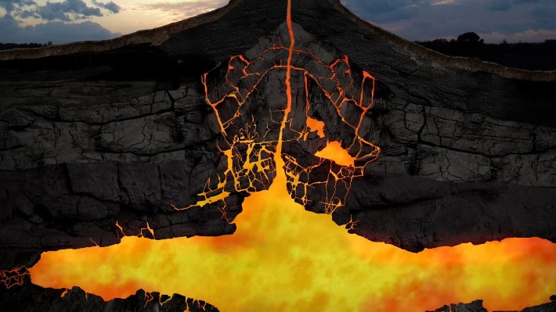
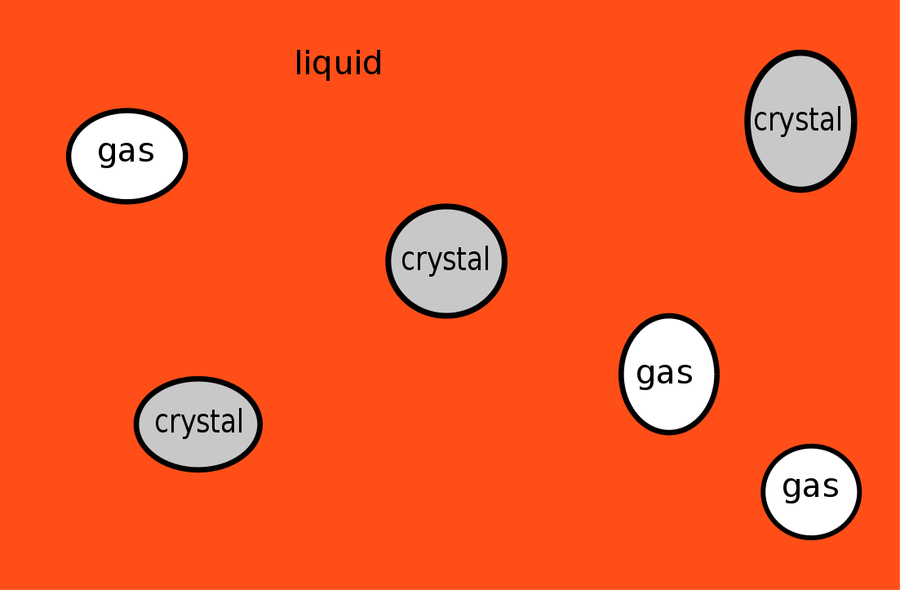
Introduction
Aim: lattice Boltzmann simulation of three-phase magma
Experimentally investigate magma rheology is difficult
First step (this work):
Two phases (liquid and solid)
No collision model between particles
Validation of the rheology in this regime
Notes:
Magma at shallow levels is a multicomponent mixture made of crystals, melt and bubbles
Local flow field for velocity and shear stress difficult to access experimentally.
Long term: 3-phase
Bullet+
Viscosity change as volume fraction of both bubbles and crsystal change ➔ fully resolved, instead of putting the rheological law into some model, I expect it to be the result of including the other phases into the fluid.
This work constitutes the first step

Slide 3
Difficulties
Crystals and bubbles : accurate boundary condition for solid phase and gas phase (2-ways couplings)
Collision model: at volume fraction higher than $ϕ≈0.2$, collisions between particles play an important role [2]
Flow properties:
Very low Re : $∼{10}^{1} −{10}^{−6}$
Wide range of volume fraction and particles aspect ratio
Performance:
Intrinsic cost of the ingredients (boundary conditions, collision model, …)
Needed size of the simulation (number of particles/bubbles, collision detection, time to reach steady state, …)
Notes:
Several diff arise from this aim.
First,..
They influe the fluid, and fluid influe them
Basalt - > rhyolite
Nu = cs2 * (t-1/2) * dx2/dt => dt scales like dx2/nu
$ν≈{10}^{−5}−{10}^{2}$ m²/s, $u$ $≈$ 1 m/s, particle size $≈$ ${10}^{−4}$ m
Finally if we put all these ingr. Together, w’ll have a performance problem, which is why we first want to see what we can do with a minimal number of ingredients before going ahead

Slide 4
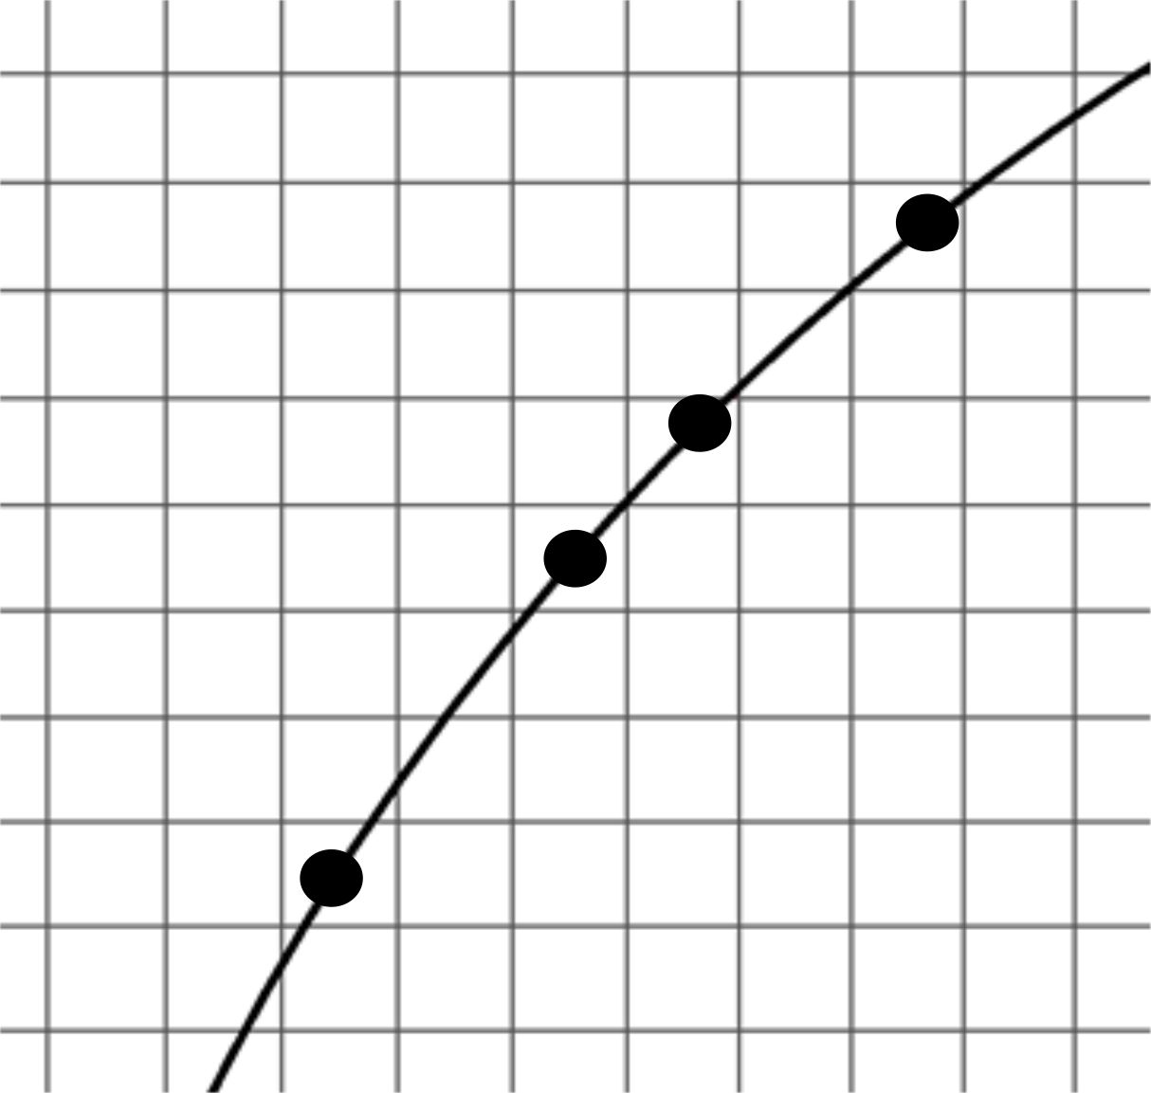
Immersed boundary method with direct forcing approach
Eulerian fluid mesh, Lagrangian solid mesh
Solid mesh not aligned with fluid mesh. Fluid mesh remains unchanged.
Compute a singular forcing term on the immersed boundary points and apply it as a body force to the fluid in order to ensure no-slip condition.
Interpolation as proposed by [5] is used to transfer information from the Eulerian to the Lagrangian grids, and vice versa.
Present work based on the implementation of Ota et al. [3] (multi direct forcing method [4])
Notes:
Si fi, u et p sont connus, alors fi(t+1) et u(t+1) peuvent l’etre via collide-and-stream (calcule fi, puis correction bodyforce). Alors u_boundary obtenu par interpolation (somme des u*W sur les sites voisins). Iterations : force_L -> force_E -> u_E -> force_L.
Eulerian and Lagrangian variables, linked by the Dirac delta function, which has to be discretized (peskin) (a la base parce que u_L = integrale{u_E*dirac(x_E-x_L)} )
Avertir connection

Slide 5
Immersed boundary method (2)
palabos.org
Notes:
Use palabos. 2 animations using ibm

Slide 6
Rheology of suspensions
Volume fraction $φ$ and maximum packing fraction $φ_{M}$
The effect of any particle with rotational symmetry is equivalent to that of a spheroid of given aspect ratio $r_{p}$ [6]
Notes:
That was for coupling.
Now dlk talk about rhelogy of susp in order to validate the simulations.

Slide 7
Rheology of suspensions (3)
Empirical law, Maron-Pierce expressed with Mueller extrapolations [2] valid for $r_{p}≥1$:
${τ=τ_{0}+{\left(\frac{1−φ}{φ_{M}}\right)}^{−2}⋅{\dot{γ}}^{n}}^{ }$,
with $n=1−0.2r_{p}⋅{\left(\frac{φ}{φ_{M}}\right)}^{4}$, and $φ_{M}=2/\left(0.321⋅r_{p}+3.02\right)$
Notes:
Phenom. Law have been proposed for a long time in order to relate shear stress tau to strian rate, as a function of the volume fraction. Here is one popular law, which also express phim as a function of aspect ratio

Slide 8
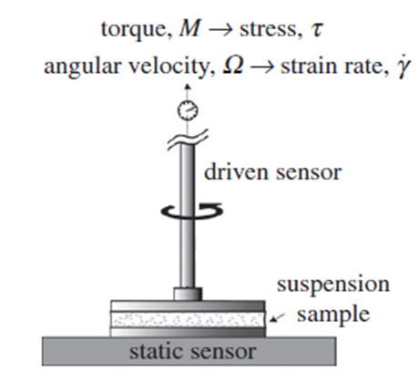
Rheology of suspensions (2)
Experimental rheometer :
imposed $τ$, observed$\dot{ γ}$
Numerical rheometer :
computed $τ$, i$mposed\dot{ γ}$
Image from [2]
Notes:
An experimentalist could do like that

Slide 9
Simulation setup
Particle Re $≈{10}^{−1}−{10}^{−3}$
$\frac{Δx}{Δt}$ $≈{10}^{−2}−{10}^{−3}$
Lattice sites $≈{10}^{5}−{10}^{6}$
$r_{p}=1$
N particles $≈0−1000$
BGK, D3Q27 topology
Shear (Couette) flow: imposed velocity at bottom and lid
No collision model ! How far can we go ?
Notes:
Reasonable resolution, this is to say acceptable simulation time on 100 cores
Pe $≈{10}^{10}−{10}^{12}$ (brownian si plus petit que 1000, sinon hydrodynamique)
St $≈1−{10}^{2}$ (couplage fluide-solide, paticules bien intégrées si st << 1)
Kn ~ 10^-6

Slide 10
Results
Example simulation with 1000 particles
Notes:
Expliquer condition de bord

Slide 11
Results (2)
Velocity profile along central column
Shear stress from the fluid on the lid has to be computed as a spatial and temporal average

Slide 12
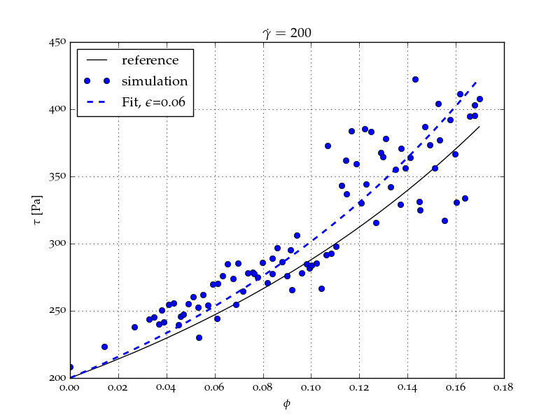
Results(3)
${τ=τ_{0}+{\left(\frac{1−φ}{φ_{M}}\right)}^{−2}⋅{\dot{γ}}^{n}}^{ }$,
with $n=1−0.2r_{p}⋅{\left(\frac{φ}{φ_{M}}\right)}^{4}$, and $φ_{M}=2/\left(0.321⋅r_{p}+3.02\right)$
$$τ=f\left(φ\right)$$
$$τ=f\left(\dot{γ}\right)$$
Notes:
As I told you, we can plot stress as a function of volume fraction (here for constant…) or as a function of strain rate (here for small value of phi).
1 point = 1 simu

Slide 13
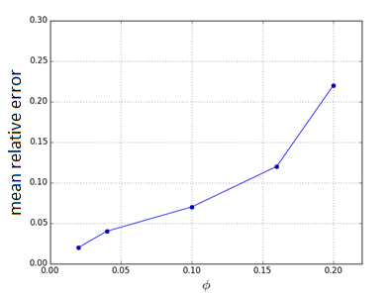
Results(4) $τ=f\left(\dot{γ}\right)$
Notes:
Mean relative error sur chaque graph
Newtonian
Dont go further with phi, because dispersion too large for the data to be relevant, reached maximum we can do without collision model with this resolution

Slide 14
Refinement of the numerical model
Acceptable accuracy without explicit collision handling up to $φ≈0.2$, for at least $\frac{a}{Δx}≈5$ (where $a$ denotes particle diameter).
For higher volume fraction we need a collision/lubrication model.
Notes:
0.2 consistant with litterature
Convergence study to be done.

Slide 15
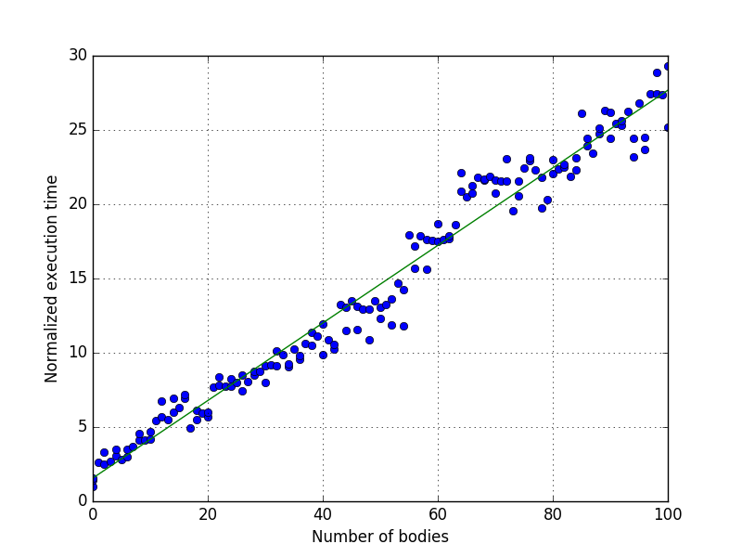
Performances
Indicative time for 12 cores:
15 minutes for simulating 40 particles of 66 vertices each and a domain of 1 mm³

Slide 16
Conclusions
The model is able to simulate fluids with suspensions up to $φ≈0.2$
This value is consistant with litterature (e.g [2]), expecting relevant particles interaction from this value of volume fraction.
20% : can be encountered in real magma (almost 1/3 of the maximum volume fraction for spheres)
In this almost Newtonian regime, accurate rheology without using collision model for $\frac{a}{Δx}≈5$.
In the future:
Use lubrication model for high volume fraction simulations
Lower Reynolds number
Validation for different particle aspect ratio
Third phase : bubbles

Slide 17
Thank you for your attention
References
[1] Janoschek, F. (2013). Mesoscopic simulation of blood and general suspensions in flow.
[2] Mueller, S. et al (2010). The rheology of suspensions of solid particles.
[3] Ota, K. et al (2012). Lift generation by a two-dimensional symmetric flapping wing: immersed boundary-lattice Boltzmann simulations.
[4] Wang, Z et al (2008). Combined multi-direct forcing and immersed boundary method for simulating flows with moving particles.
[5] Peskin, C.S (2002). The immersed boundary method.
[6] Brenner, H (1974) Rheology of a dilute suspension of axisymmetric Brownian particles
Notes:
Newtonian !

Slide 18
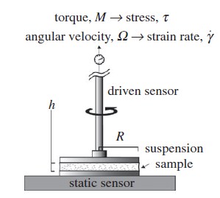
Rheology of suspensions (2)
Experimental rheometer : imposed $τ$, observed$\dot{ γ}$
Numerical rheometer : computed $τ$, i$mposed\dot{ γ}$
Apparent viscosity for $i$ particles: $η_{i}=τ/\dot{γ}$
Relative apparent viscosity for $i$ particles: $η_{r,i}=η_{i}/η_{0}$
Image from [2]

