Slide 1
Using Files
Gilles Falquet
Algorithmics and Data Management

Slide 2
Content
Files and File Formats
Reading and Writing Text Files in Python
Processing CSV Files
Processing JSON Files
Processing XML Files

Slide 3
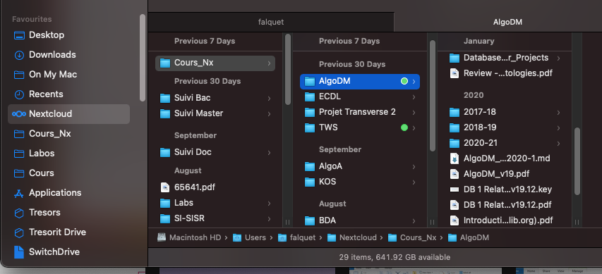
File
Content (Data)
Array of 8-bit bytes
Properties
Persist on some media
Managed by a file system
file identification: file path → content
create, modify, delete files + versioning, replication, etc.
Meta-Content (Meta-Data)
Comments, Tags
Image resolution, Camera model, ...

Slide 4
File content
Text File
a sequence of bytes that represent characters in some character encoding
ASCII, ISO 8859-1, UTF-8, UTF-16, etc.
can be displayed and modified with a text editor (NotePad, TextEdit, vi, nano, Atom, …)
Binary File ≡ not a text file
image file -- represent pixel colors (JPEG, TIFF, PNG, … )
sound file – represent sound waves
formatted document -- represent a text + images + layout + formatting (PDF, DOCX, ODF, … )
…
require specific applications for viewing and editing

Slide 5
Text file encodings
UTF-8 Encoding
01010000 01110010 01101111 01110100 11000011 10101001 01100111 11000011 10101001 00001010
P r o t é g é <LF>
ISO 8859-1 Encoding
01010000 01110010 01101111 01110100 11101001 01100111 11101001 00001010
P r o t é g é <LF>

Slide 6
Text file formats
A way to represent things in a text file
Plain text made of lines
special characters mark the end of a line (<CR>, <LF>, <CR><LF>, other)
Data Formats representations for structured data
CSV, JSON, XML, GML, graphml, RDF/turtle, …
Markup Formats representations for structured (multimedia) documents
LaTeX, XML, Markdown, …

Slide 7
Reading and Writing Text Files: Principle
Open
provide filepath, encoding, access mode, etc.
receive a File object
Read/Write
operations to read/write characters or lines
Close
release the objects used to access the file

Slide 8
Reading Text Files in Python
Opening
f = open(filepath, 'r')
f = open(filepath, 'r', encoding='utf8') # specify the encoding
Reading
the whole file in one big string: f.read()
or the whole file in a list of string (one per line): f.readlines()
or line by line reading for line in f : . . .
Closing
f.close()

Slide 9
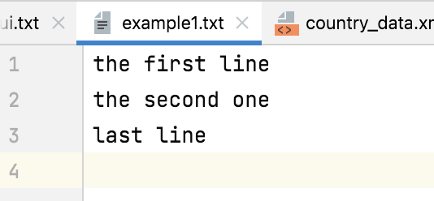
f = open('example1.txt')
content = f.read()
⇒ content ='the first line\nthe second one\nlast line\n'
f = open('example1.txt')
content = f.readlines()
⇒ content = ['the first line\n', 'the second one\n', 'last line\n']
\n represents the end-of-line character
(00001010)

Slide 10
f = open('example1.txt')
for line in f
⇒ 1st iteration: line = 'the first line\n'
⇒ 2nd iteration: line = 'the second one\n'
⇒ 3rd iteration: line = 'last line\n'
To remove the final end-of-line character
l = line.rstrip('\n')

Slide 11
Example: file statistics
def file_stat(fname: str):
lc, wc, cc = 0, 0, 0
ifile = open(fname, 'r')
for line in ifile: lc += 1 words = line.split() # split on whitespace sequences wc += len(words) cc += len(line)
print(f"File {fname} has {lc} line(s), {wc} word(s), {cc} character(s)")

Slide 12
Example – a simple file filter
def filter(ifname: str, pattern: str, ofname: str):
""" keep the lines that contain pattern
case insensitive
"""
ofile = open(ofname, 'w')
ifile = open(ifname, 'r')
for line in ifile:
if pattern.lower() in line.lower() : ofile.write(line)
ifile.close()
ofile.close()

Slide 13
Typical file processing tools (Linux, macOS)
grep, egrep, fgrep, zgrep, zegrep, zfgrep -- file pattern searcher
sort -- sort or merge records (lines) of text and binary files
tr -- translate characters
sed -- stream editor
iconv -- character set conversion
diff -- compare files line by line
awk -- pattern-directed scanning and processing language

Slide 14
CSV files
Each record is located on a separate line. For example:
aaa,bbb,ccc <LF>
zzzzzzzz,y,xxx <LF>
The last record in the file may or may not have an ending line break. For example:
aaa,bbb,ccc <LF>
zzz,yyy,xxx
Reference: https://www.ietf.org/rfc/rfc4180.txt

Slide 15
CSV files
Fields containing line breaks, double quotes, and commas should be enclosed in double-quotes. For example:
"aaa","b<LF>
bb","ccc" <LF>
"zzz,y",www,h
If double-quotes are used to enclose fields, then a double-quote appearing inside a field must be escaped by preceding it with another double quote. For example:
"aaa","b""bb","ccc"
aaa | b bb | ccc
zzz,y | www | h
aaa | b"bb | ccc

Slide 16
Extracting the fields of a CSV line is non-trivial
line.split(',') cannot be used because commas may appear within a (quoted) field
the content of a quoted field cannot be extracted by examining the characters until a " is found because "" is a quote within a quoted field.
⇒ use the csv module of the python library

Slide 17
Reading a CSV file
import csv
csvfile = open(fname)
reader = csv.reader(csvfile)
for row in reader:
# row is a list of strings, one for each column
...

Slide 18
Reading into dictionaries
csvfile = open(fname)
reader = csv.DictReader(csvfile,['name','birth','mother','father'])
for row in reader:
# row['name'] = first column, row['birth'] = second, ...
Use the first row as column names:
reader = csv.DictReader(csvfile)

Slide 19
Typical workflow
export
read
File.xlsx
File.csv
print
program.py
import
write
ResultFile.xlsx
ResultFile.csv

Slide 20
Why read CSV files and process them in python instead of doing everything in Excel?
Although Excel is Turing complete, many things are difficult to express with formulae
Or they require several "manual" steps
Add 4 columns with the grandparents of each person (when they are known)
Remove the lines describing people who have a parent born before 1848.
Transpose (part of) a worksheet
Name | Born | Mother | Father
Irina | 1812 | Karen | Joseph
John | 1822 | Lisa | Thomas
Max | 1817 | Lisa | Thomas
Marie | 1835 | Irina | Carl
Raymond | 1848 | Jacqueline | John
Albert | 1857 | Marie | John
Denise | 1862 | Marie | Max
Donald | 1890 | Denise | Albert
Paul | 1896 | Denise | Raymond

Slide 21
JSON files (Javascript Object Notation)
The JSON format is in fact a subset of the python syntax for lists and dictionaries
the keys must be strings
the strings must be quoted with double quotes only
Reference: https://www.json.org/json-en.html

Slide 22
A JSON File
[ { "name": "Liechtenstein", "year": 2008, "gdppc": 141100, "neighbor": [ {"name": "Austria", "direction": "E" }, {"name": "Switzerland","direction": "W"} ] }, { "name": "Panama", "year": 2011, "gdppc": 13600, "neighbor": [ {"name": "Costa Rica", "direction": "W"}, {"name": "Colombia", "direction": "E"} ] } ]

Slide 23
Loading a JSON file
f = open('data/countries.json')
content = f.read()
data = json.loads(content)
⇒ data = [{"name": "Liechtenstein", "year": 2008,"gdppc": 141100,"neighbor": [{"name": "Austria", "direction": "E" },{"name": "Switzerland", "direction": "W"}]},{"name": "Panama", "year": 2011,"gdppc": 13600,"neighbor": [{"name": "Costa Rica", "direction": "W"},{"name": "Colombia", "direction": "E"}]}]

Slide 24
Print the neighbours of the countries that have a GDPPC > 10000
f = open('data/countries.json')
content = f.read()
countries = json.loads(content)
for country in countries:
if country["gdppc"] > 50000 :
print(country["name"])
for neigh in country["neighbour"] :
print(" "+neigh["name"])

Slide 25
XML files
An ordered hierarchical structure
made of elements
tag (element name)
content: texts and embedded elements
attributes (name = value pairs)
syntax:
<tag attr₁ = value₁ ,…> content </tag>
<world-colors>
<flag country="Estonia">
<color>blue</color>
<color>black</color>
<color>white</color>
</flag>
<flag country="North Macedonia">
<color>red</color>
<color>yellow</color>
</flag>
</world-colors>

Slide 26
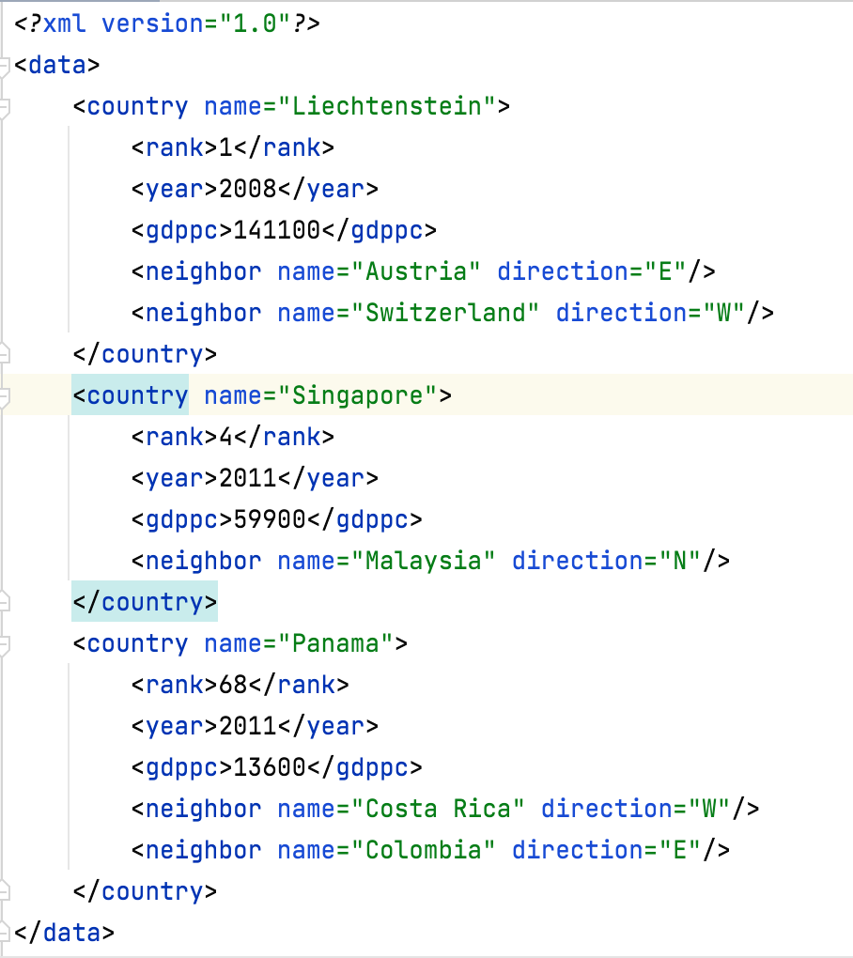
Same content in JSON
[ { "name": "Liechtenstein", "rank": 1, "year": 2008, "gdppc": 141100, "neighbor": [ {"name": "Austria", "direction": "E" }, {"name": "Switzerland","direction": "W"}] }, { "name": "Singapore", "rank": 4, "year": 2011, "gdppc": 59980, "neighbor": [ {"name": "Malaysia", "direction": "N"}] }, { "name": "Panama", "rank": 68, "year": 2011, "gdppc": 13600, "neighbor": [ {"name": "Costa Rica", "direction": "W"}, {"name": "Colombia", "direction": "E"}] } ]

Slide 27
An XML document is a tree
<data>
children
name
<country>
<country>
<country>
Lichtenstein
children
<rank>
<year>
<gdppc>
<neighbor>
<neighbor>
text
text
text
direction
direction
name
name
1
2008
141100
Austria
E
Switzerland
W

Slide 28
The xml package
import xml.etree.ElementTree as et
t = et.parse(filename) | read filename and build an xml tree t
e = t.getroot() | get the root element of t
e.findall('tagname') | all the children of e with tag tagname
e.find('tagname') | first child of e with tag tagname
e.attrib | dictionary with the attributes (keys) and their values
e.text | first text of element e
e.tail | text after e in the parent element
for ce in e | iterate over all the children ce of e

Slide 29
Print the neighbours of the countries that have a GDPPC > 10000
obtain the root element
def neighbours_of_gdppc(filename: str):
tree = et.parse(filename)
root = tree.getroot()
for country in root.findall('country'):
gdppc = int(country.find('gdppc').text)
if gdppc > 50000:
print(country.get('name'),':')
for neigh in country.findall('neighbor'):
print(' ', neigh.get('name'))
get all the children with tag 'country'
get the text of the child with tag 'gdppc'
get the value of the attribute 'name'

Slide 30
output
Liechtenstein :
Austria
Switzerland
Singapore :
Malaysia

Slide 31
Complete Exploration of an XML tree
import xml.etree.ElementTree as et
def explore(filename: str):
tree = et.parse(filename)
root = tree.getroot()
depth_first_explore(root, 0)
def depth_first_explore(e: et.Element, depth: int):
print(f"Exploring {e.tag}, depth is {depth}")
print(e.attrib)
if e.text != None : print(f"'{e.text}'")
for child in e :
depth_first_explore(child, depth+1)
if e.tail != None : print(f"'{e.tail}'")

Slide 32
Exploring data, depth is 0
{}
'
'
Exploring country, depth is 1
{'name': 'Singapore'}
'
'
Exploring rank, depth is 2
{'updated': 'yes'}
'5'
'
'
Exploring year, depth is 2
{}
'2011'
'
'
Exploring gdppc, depth is 2
{}
'59900'
'
'
Exploring neighbor, depth is 2
{'name': 'Malaysia', 'direction': 'N'}
'
'
'
'
Exploring country, depth is 1
{'name': 'Liechtenstein'}
'
'
<data> <country name="Singapore"> <rank updated="yes">5</rank> <year>2011</year> <gdppc>59900</gdppc> <neighbor name="Malaysia" direction="N"/> </country> <country name="Liechtenstein"> <rank updated="yes">2</rank> <year>2008</year> <gdppc>141100</gdppc> <neighbor name="Austria" direction="E"/> <neighbor name="Switzerland" direction="W"/> </country> <country name="Panama"> <rank updated="yes">69</rank> <year>2011</year> <gdppc>13600</gdppc> <neighbor name="Costa Rica" direction="W"/> <neighbor name="Colombia" direction="E"/> </country> </data>

