Slide 1
Sets, Dictionaries
Gilles Falquet
Université de Genève/GSEM MSc. Business Analytics

Slide 2
Sets
A set is a non-indexed collection of objects
The elements of a set can be objects of any type
Two sets are equal if they contain the same elements
{4, 7, 1} == {1, 7, 4}

Slide 3
Mutable sets in Python
set()
Creates an empty set
{v1, v2, …, vn}
Creates a set containing v1, v2, . . . , vn
‼️ s = {} does not create an empty set (creates an empty dictionary)
set([v1, v2, . . . , vn])
Creates a set from the list [v1, v2, …, vn]

Slide 4
Mutable sets in Python
s.add(e) Adds e to s
s.remove(e) Removes e from s
e in s True is e is a member of s, otherwise False

Slide 5
s = set() ⇒ ø
s.add(33) ⇒ {33}
s.add(44) ⇒ {33, 44}
s.add(33) ⇒ {33, 44} nothing added !
s.remove(33) ⇒ {44}
s.remove(111) ⇒ ** KeyError **
111 in s ⇒ False

Slide 6
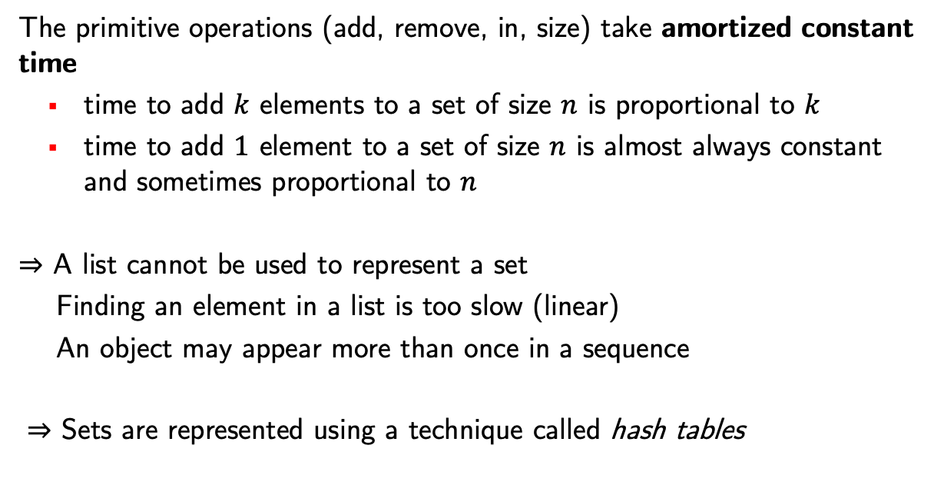
Computational cost of the operations
The primitive operations (add, remove, in, size) take amortized constant time
time to add $k$ elements to a set of size $n$ is proportional to $k$
time to add $1$ element to a set of size $n$ is almost always constant and sometimes proportional to $n$
⇒ A list cannot be used to represent a set
Finding an element in a list is too slow (linear)
An object may appear more than once in a sequence
⇒ Sets are represented using a technique called hash tables

Slide 7
Use case: Counting the Unique Words in a Text
Problem: A text is represented by strings. How many different words are there in the text?
Algorithm:
isolate each word of the text (split the text)
add each word to a set
if the word is already in the set nothing happens
the result is the size of the set
at the end the set contains all the words that appear in the text
if a word appears multiple times in the text, it will appear only once in the set (by definition)

Slide 8
In python
import re
def unique_word_count(text: str) -> int :
word_list = re.split("[ ,;.!?]+", text)
# separator = (space , ; . ! ?) one or more times
word_set = set()
for w in word_list : word_set.add(w)
return len(word_set)

Slide 9
Iterating over a Set
Sets are not indexed, there is no first element, second, etc.
The for x in set loop
iterates over all the elements of a set,
in an arbitrary order

Slide 10
"""
print the long words in words
"""
for w in words :
if len(w) > 10 :
print(w)

Slide 11
Global Operations on Sets
s = set([3, 4, 5]) # or s = {3, 4, 5}
t = set([4, 6, 8]) # or t = {4, 6, 8}
u = s . union(t) ⇒ u = {3, 4, 5, 6, 8}
v = s . intersection(t) ⇒ v = {4}
w = s . difference(t) ⇒ w = {3, 5}
These operations create new sets

Slide 12
Dictionaries
A dictionary is an indexed collection
in which the indices (keys) can be of any type
Indices (Keys):
"Mont Blanc"
"Salève"
"K2"
"अन्नपूर्णा"
Values:
4810
1379
8611
8091

Slide 13
Creating dictionaries in Python
The constructor
{ key₁ : value₁, key₂ : value₂, … }
builds a dictionary
height = {"Mont Blanc": 4810, "Salève": 1379, "K2": 8611, "अन्नपूर्णा": 8091}
flagColors = { "turkey": {"red", "white"},
"italy": {"red", "white", "green"},
"greece": {"white", "blue"} }

Slide 14
Accessing Dictionary Elements – similar to list access
height = {"Mont Blanc": 4810, "Salève": 1379, "K2": 8611}
height["Salève"] ⇒ 1379
height["Matterhorn"] << KeyError 'Matterhorn' does not exist
Safe access
height.get("Matterhorn") ⇒ None, no error
height.get("Matterhorn", 0) ⇒ 0, no error

Slide 15
Update Operations
h = {"Mont Blanc": 4810, "Salève": 1379, "K2": 8611}
h = ["Matterhorn"] = 4478 # add a new key-value pair
h = ["Mont Blanc"] = 4807 # modify an existing key-value pair
h.pop("K2", defval) # remove the key-value with this key
# return h["K2"]
# or defval if no pair with this key

Slide 16
Use case: text similarity
How to quantify the similarity between documents?
Salton (1975): represent each document as a frequency "vector"
Compare the vectors

Slide 17
Example
"(1) Everyone has the right freely to participate in the cultural life of the community, to enjoy the arts and to share in scientific advancement and its benefits. (2) Everyone has the right to the protection of the moral and material interests resulting from any scientific, literary or artistic production of which he is the author. "
--> frequency vector representation
{'arts' : 1, 'production' : 1, 'is' : 1, 'he' : 1, 'share' : 1, 'of' : 3, 'moral' : 1, 'participate' : 1, 'benefits' : 1, 'or' : 1, 'any' : 1, 'freely' : 1, '(2)' : 1, 'cultural' : 1, 'protection' : 1, 'from' : 1, 'life' : 1, 'to' : 4, 'everyone' : 2, 'resulting' : 1, 'and' : 3, 'its' : 1, 'in' : 2, 'artistic' : 1, '(1)' : 1, 'the' : 8, 'has' : 2, 'enjoy' : 1, 'author' : 1, 'scientific' : 2, 'right' : 2, 'advancement' : 1, 'which' : 1, 'interests' : 1, 'material' : 1, 'literary' : 1, 'community' : 1}

Slide 18
Building the Vector Representation of a Document
def build_vector(content: str) -> dict[str, int] :
vector = {}
word_seq = re.split("[ ,;.!?]+", content)
for raw_word in word_seq :
word = raw_word.lower()
if word in vector : vector[word] = vector[word]+1
else: vector[word] = 1
return vector

Slide 19
Cosine similarity
Texts 1 and 2 represented by vectors $v_{1}$ and $v_{2}$
$$sim(v_{1},v_{2})=\frac{v_{1}∙v_{2}}{\sqrt{{(v}_{1}∙v_{1}){(v}_{2}∙v_{2})}}$$
where
$$v_{1}∙v_{2}= v_{1}\left[w_{1}\right]×{ v}_{2}\left[w_{1}\right]+…+v_{1}\left[w_{n}\right]×{ v}_{2}\left[w_{n}\right]$$
$\left\{w_{1},…,w_{n}\right\}=$keys that appear in both $v_{1}$ and $v_{2}$

Slide 20
Scalar product of two document vectors
Multiply the values corresponding to the same keys and add the results
v1 = {'art' : 3, 'production' : 1, 'is' : 1, 'everyone' : 2}
v1 $∙$ v2 =
6
+
4
v2 = {'art' : 2, 'description' : 1, 'is' : 4}

Slide 21
Scalar Product of two Document Vectors
import math
def product (v1: dict[str, int], v2: dict[str, int]) -> float :
sp = 0.0
for word in v1 :
sp += v1[word] * v2.get(word, 0) # word not in v2 → 0
return sp

Slide 22
Document similiarity
import math
def similarity (s1: str, s2: str) -> float :
"""
compute the cosine similarity of the texts in s1 and s2
"""
d1 = build_vector(s1)
d2 = build_vector(s2)
return product(d1, d2) /
(math.sqrt(product(d1, d1)* product(d2, d2)))

