Slide 1
Programming with Functions
Algorithms and Data Management
G. Falquet

Slide 2
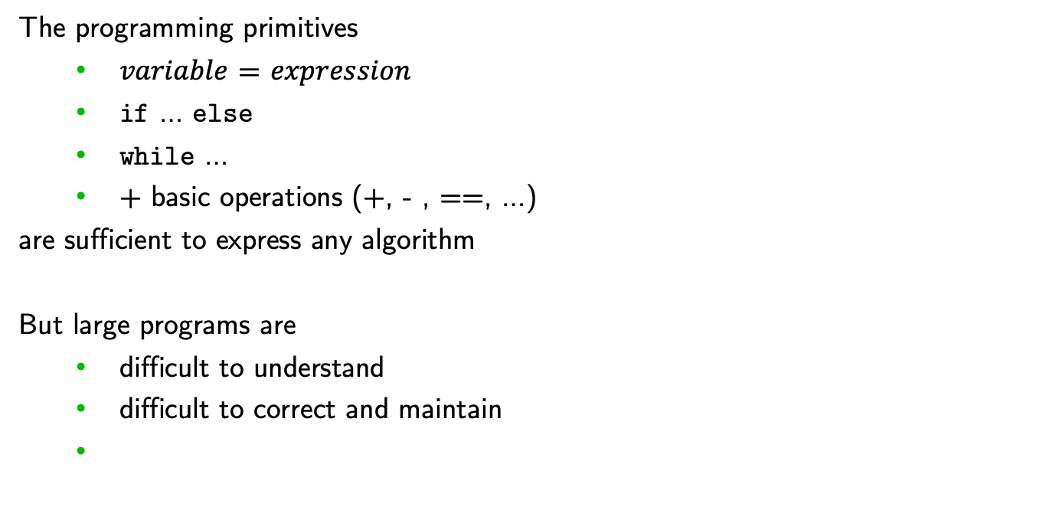
The programming primitives
$variable$ = $expression$
if … else
while …
+ basic operations (+, - , ==, …)
are sufficient to express any algorithm
But large programs are
difficult to understand
difficult to correct and maintain

Slide 3
what's the purpose of this program?
n = int(input('n: ')) p = 1 found = False while p < n//2 and not found: p += 1 d = 2 maxDiv = int(math.floor(math.sqrt(p))) while d <= maxDiv and p % d != 0 : d = d + 1 if d > maxDiv : np = n - p d = 2 maxDiv = int(math.floor(math.sqrt(np))) while d <= maxDiv and np % d != 0 : d = d + 1 if d > maxDiv : print(f'{n} = {p} + {n-p}') found = True
what does each part do?

Slide 4
To make programs more understandable: use decomposition and abstraction
decompose complex programs into manageable/understandable parts
each part has
an abstract view (what it does)
an implementation (how it is done)

Slide 5
Example: an MP3 player
Abstraction
MP3 player = device to store and play music
It is a black box
provides well defined services
the user needs to know the interface operation (buttons, screen)
the user does not need to know the internal electronic operation

Slide 6
Decomposition principle: different devices work together to achieve an end goal
To build a sound system: interconnect
an internet connection box
an MP3 player
one or more bluetooth speakers
Internet Box
MP3 player
Speaker
Sound system

Slide 7
In computing
Two types of abstractions
Functions:
procedural abstraction
Classes:
data type abstraction

Slide 8
Functional abstraction
a function encapsulate a part of the computation
a piece of code that is a black box
can be used without knowing the details

Slide 9

in Python
def $function name$ ($parameter$: $type$, ...) -> $result type$ :
"""
$description$
"""
$instructions$

Slide 10

in Python
def power (x: float, n: int) -> float :
"""
compute the n-th power of x
"""
$instructions$
profile

Slide 11
in Python, with the implementation
profile
def power (x: float, n: int) -> float :
"""
compute the n-th power of x
"""
r = 1
for i in range(n):
r = r * x
return r
body

Slide 12
Function invocation (function call)
def power (x: float, n: int) -> float :
...
initial, rate, duration = 100, 0.01, 50
population = initial * power(1 + rate, duration)
...
r = 6.5
volume = 4.0/3.0 * math.pi * power(r, 3)

Slide 13
A function can call another function
def diff_cubes(p: float, q: float) -> float :
"""
Computes p^3 – q^3
"""
diff = power(p, 3) – power(q, 3)
return diff

Slide 14
Result = the value of the return statement
def min3(x: float, y: float, z: float) -> float :
"""
returns the smallest among x, y, and z
"""
if x <= y and x <= z : return x
if y <= z : return y
else: return z
The return statement stops the execution of the function and returns a result

Slide 15
GCD as a function
def gcd(a: int, b: int) -> int :
while a != b :
if a > b : a = a - b
else: b = b - a
return a
The formal parameters are local variables within the function body

Slide 16
GCD as a function – another implementation
def gcd(a: int, b: int) -> int :
while b != 0:
t = b
b = a mod b
a = t
return a

Slide 17
Writing good documentation: the pre/post technique
specify the function with a PRE and a POST condition
meaning
if PRE is true before the execution of the body
then POST will be true after the execution of the body
if PRE is false then POST may be true or false after the execution

Slide 18
Example: the min specification made very precise
def min3(x: float, y: float, z: float) -> float :
"""
pre: x, y, z are float numbers (expressed in the profile)
post: the result is a number r such that
1. r ≤ x and r ≤ y and r ≤ z
2. r = x or r = y or r = z
"""
if x <= y and x <= z : return x
if y <= z : return y
else: return z

Slide 19
Example
if a ≤ 0 or b ≤ 0 there
is no commitment about the result
def gcd(a: int, b: int) -> int :
"""
pre: a and b are strictly positive
post: the result is the greatest common divisor of a and b
"""
while b != 0:
t = b
b = a mod b
a = t
return a

Slide 20
Functions and problem decomposition
Bottom-up approach
define simple functions
use these functions to create more complex functions
work by abstraction
To-down approach
to solve a complex problem, break it down into smaller parts
define a function for each part
if the parts are still too complex, break them down into subparts
etc.

Slide 21
Top down decomposition for a word counting problem
count the words in a string that have more than 5 characters
definition: a word is a sequence of characters between two separator characters (space, comma, colon, start-of-line, end-of-line)
Albert, and many others, think this is correct.
word
word
separators

Slide 22
Algorithm (abstract)
Albert, and many others, think this is correct.
look at the first word (if there is one)
while not at the end of the string
count the characters of the current word
if count > 5 increment a word counter
move to the beginning of the next word (if there is one)

Slide 23
Algorithm (more concrete)
Albert, and many others, think this is correct.
$$index$$
☝️
☝️
☝️
$$long_word_counter = 0$$
$index = 0$ # the character we are looking at
increment $index$ to the reach the beginning of a word (or the end of the string)
while $index$ not at the end of the string
count the characters of the current word at $index$
if count > 5 : $long_word_counter$ $+= 1$
move index to the beginning of the next word (or the end of the string)

Slide 24
in Python (still abstract)
def count_long_words(s: str) -> int : i = 0 long_word_counter = 0
i = move_to_beginning_of_word(i, s) while i < len(s) : c = count_word_characters(i, s) if (c > 5) : long_word_counter += 1 i = i + c
i = move_to_beginning_of_word(i, s) return long_word_counter

Slide 25
Example: primality test
def move_to_beginning_of_word(i: int, s: str) -> int :
"""
pre: 0 ≤ i < len(s)
post: result = position of the first word at or after i in s
or len(s) if there is none
""" idx = i while idx < len(s) and is_separator(s[idx]) : idx += 1 return idx

Slide 26
Example: primality test
def count_word_characters(i: int, s: str) -> str :
"""
result = number of characters of the word starting at i in s
""" idx = i while idx < len(s) and not is_separator(s[idx]) : idx += 1 return idx - i

Slide 27
Example: primality test
def is_separator(c: str) -> bool :
"""
pre: c is a one character string
""" return c in [' ', ',', ';', ':', "'", '!', '.', '?']

Slide 28
Decomposition and dependencies
count_long_words
depends on
depends on
move_to_beginning_of_word
count_word_characters
depends on
depends on
is_separator

Slide 29
The Standard Python Library
Thousands of pre-defined functions
Grouped in packages
https://docs.python.org/3/library/index.html

Slide 30
Non-Functional Functions = Procedures
A procedure is a function that
does not return a result value
has some effect (side effect)
prints something, modify a file, ...
changes the value of some variable
interacts with the user

Slide 31
def print_string_with_spaces(s: str) : print("< ") for i in range(len(s)) print(s[i]+" ") print(" >")
print_string_with_spaces("What is this?")
→ < W h a t i s t h i s ? >

Slide 32
Without explicit return statement a function returns None
def print_string_with_spaces(s: str) : print("< ") for i in range(len(s)) print(s[i]+" ") print(" >")
a = print_string_with_spaces("What is this?")
# the value of a is None

Slide 33
Local variables and execution environment
The execution of a function takes place in an execution environment
Set of local variables and objects
Created at function invocation
Erased at function return

Slide 34
def f1(y: int) -> int: a = y-1 print(a) b = f2(a) print(a) def f2(x: int) -> int : a = x*3 print(a) return a - 7
f1(33)

Slide 35
def f1(y: int) -> int: a = y-1 print(a) b = f2(a) print(a) def f2(x: int) -> int : a = x*3 print(a) return a - 7
f1(33)
f1
y: 33
a: …
b: …

Slide 36
def f1(y: int) -> int: a = y-1 print(a) b = f2(a) print(a) def f2(x: int) -> int : a = x*3 print(a) return a - 7
f1(33)
f1
y: 33
a: 32
b: …

Slide 37
def f1(y: int) -> int: a = y-1 print(a) b = f2(a) print(a) def f2(x: int) -> int : a = x*3 print(a) return a - 7
f1(33)
f1
y: 33
a: 32
b: …
32

Slide 38
def f1(y: int) -> int: a = y-1 print(a) b = f2(a) print(a) def f2(x: int) -> int : a = x*3 print(a) return a - 7
f1(33)
f1
y: 33
a: 32
b: …
32

Slide 39
def f1(y: int) -> int: a = y-1 print(a) b = f2(a) print(a) def f2(x: int) -> int : a = x*3 print(a) return a - 7
f1(33)
f2
x: 32
a: …
f1
y: 33
a: 32
b: …
32

Slide 40
def f1(y: int) -> int: a = y-1 print(a) b = f2(a) print(a) def f2(x: int) -> int : a = x*3 print(a) return a - 7
f1(33)
f2
x: 32
a: 96
f1
y: 33
a: 32
b: …
32

Slide 41
def f1(y: int) -> int: a = y-1 print(a) b = f2(a) print(a) def f2(x: int) -> int : a = x*3 print(a) return a - 7
f1(33)
f2
x: 32
a: 96
f1
y: 33
a: 32
b: …
32
96

Slide 42
def f1(y: int) -> int: a = y-1 print(a) b = f2(a) print(a) def f2(x: int) -> int : a = x*3 print(a) return a - 7
f1(33)
f2
x: 32
a: 96
f1
y: 33
a: 32
b: …
32
96

Slide 43
def f1(y: int) -> int: a = y-1 print(a) b = f2(a) print(a) def f2(x: int) -> int : a = x*3 print(a) return a - 7
f1(33)
f1
y: 33
a: 32
b: 89
32
96

Slide 44
def f1(y: int) -> int: a = y-1 print(a) b = f2(a) print(a) def f2(x: int) -> int : a = x*3 print(a) return a - 7
f1(33)
f1
y: 33
a: 32
b: 89
32
96
32

Slide 45
With this technique, functions can call themselves (recursion)
When a problem can be solved by applying the same algorithm on a subproblem
Example. $p^{n}$ =
$1$ if $n=0$
$p^{n/2} × p^{n/2}$ if $n$ is even
$p^{n/2} × p^{n/2} × p$ if $n$ is odd

Slide 46
in Python
def power(x: float, n: int) -> float:
if n == 0 : return 1
p = power(x, n//2)
if n % 2 == 0 : return p*p
else: return x*p*p

Slide 47
Execution for power(2, 10)
def power(x: float, n: int) -> float: if n == 0 : return 1 p = power(x, n//2)
if n % 2 == 0 : return p*p
else: return x*p*p
power(2,10)
2 10
power(2, 10)
p:

Slide 48
in power(2, 5)
def power(x: float, n: int) -> float: if n == 0 : return 1 p = power(x, n//2)
if n % 2 == 0 : return p*p
else: return x*p*p
power(2,10)
2
5
power(2, 5)
p:
power(2, 10)
p:

Slide 49
in power(2, 2)
def power(x: float, n: int) -> float: if n == 0 : return 1 p = power(x, n//2)
if n % 2 == 0 : return p*p
else: return x*p*p
power(2,10)
2
2
power(2, 2)
p:
power(2, 5)
p:
power(2, 10)
p:

Slide 50
in power(2, 1)
def power(x: float, n: int) -> float: if n == 0 : return 1 p = power(x, n//2)
if n % 2 == 0 : return p*p
else: return x*p*p
power(2,10)
2
1
power(2, 1)
p:
power(2, 2)
p:
power(2, 5)
p:
power(2, 10)
p:

Slide 51
in power(2, 0)
def power(x: float, n: int) -> float: if n == 0 : return 1 p = power(x, n//2)
if n % 2 == 0 : return p*p
else: return x*p*p
power(2,10)
2
0
power(2, 0)
p:
power(2, 1)
p:
power(2, 2)
p:
power(2, 5)
p:
power(2, 10)
p:

Slide 52
back in power(2, 1)
def power(x: float, n: int) -> float: if n == 0 : return 1 p = power(x, n//2)
if n % 2 == 0 : return p*p
else: return x*p*p
power(2,10)
2
1
power(2, 1)
p: 1
power(2, 2)
p:
power(2, 5)
p:
power(2, 10)
p:

Slide 53
back in power(2, 1)
def power(x: float, n: int) -> float: if n == 0 : return 1 p = power(x, n//2)
if n % 2 == 0 : return p*p
else: return x*p*p
power(2,10)
2
1
power(2, 1)
p: 1
2
power(2, 2)
p:
power(2, 5)
p:
power(2, 10)
p:

Slide 54
back in power(2, 2)
def power(x: float, n: int) -> float: if n == 0 : return 1 p = power(x, n//2)
if n % 2 == 0 : return p*p
else: return x*p*p
power(2,10)
2
2
power(2, 2)
p: 2
power(2, 5)
p:
power(2, 10)
p:

Slide 55
back in power(2, 2)
def power(x: float, n: int) -> float: if n == 0 : return 1 p = power(x, n//2)
if n % 2 == 0 : return p*p
else: return x*p*p
power(2,10)
2
2
4
power(2, 2)
p: 2
power(2, 5)
p:
power(2, 10)
p:

Slide 56
back in power(2, 5)
def power(x: float, n: int) -> float: if n == 0 : return 1 p = power(x, n//2)
if n % 2 == 0 : return p*p
else: return x*p*p
power(2,10)
2
5
power(2, 5)
p: 4
power(2, 10)
p:

Slide 57
back in power(2, 5)
def power(x: float, n: int) -> float: if n == 0 : return 1 p = power(x, n//2)
if n % 2 == 0 : return p*p
else: return x*p*p
power(2,10)
2
5
32
power(2, 5)
p: 4
power(2, 10)
p:

Slide 58
back in power(2, 10)
def power(x: float, n: int) -> float: if n == 0 : return 1 p = power(x, n//2)
if n % 2 == 0 : return p*p
else: return x*p*p
power(2,10)
2 10
power(2, 10)
p: 32

Slide 59
back in power(2, 10)
def power(x: float, n: int) -> float: if n == 0 : return 1 p = power(x, n//2)
if n % 2 == 0 : return p*p
else: return x*p*p
power(2,10)
2 10
1024
power(2, 10)
p: 32

Slide 60
Summary
Functions are used to
Write an algorithm once and use it in several places
Decompose problems in smaller parts
Or create more complex behaviors by composition
Functions execute in a local environment

