Slide 1
Functional programming on collections
Gilles Falquet
Université de Genève/GSEM MSc. Business Analytics

Slide 2
Many tasks on collections (lists, sets, dictionaries) can be expressed as combinations of
mapping: applying a function to every member of the collection
reducing: applying a binary operation between the members
filtering: selecting members that satisfy a condition
…

Slide 3
Map
map(function, collection) : applies a function to each element of a collection
def f(x: int) -> int : return x % 2
s = [3, 4, 5, 11, 2, 4]
t = list(map(f, s))
⇒ [1, 0, 1, 1, 0, 0]
!! produces a <map object>, not a collection, must be converted to a list, set, dict

Slide 4
Map on sets
def f(x) :
return len(x)
word_sizes = set(map(f , {"you", "will", "find", "the", "details"}))
⇒ word_sizes = {3, 4, 7}

Slide 5
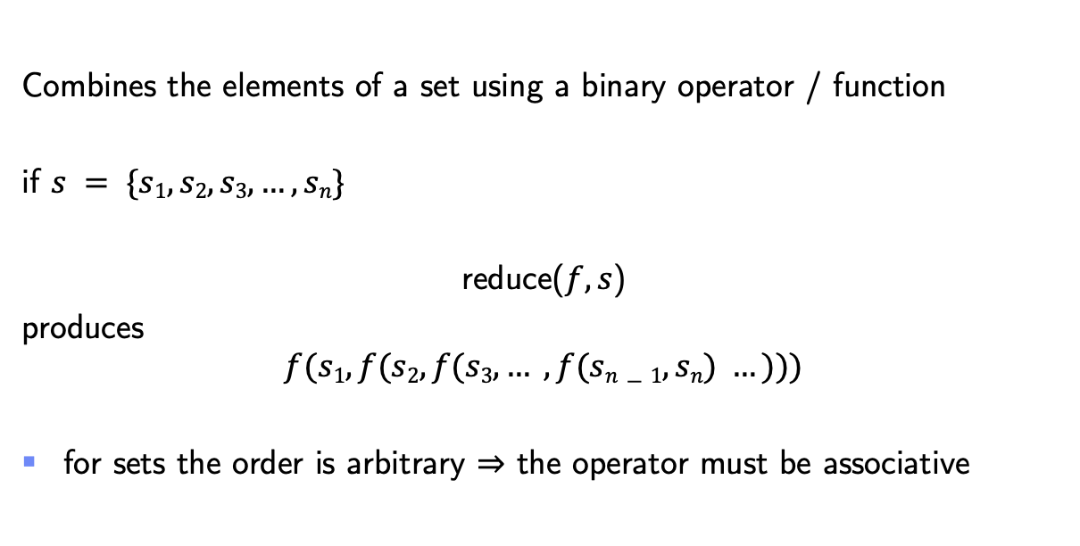
Functional Operations : Reduce
Combines the elements of a set using a binary operator / function
if $s = \{s1, s2, s3, …, sn\}$
reduce($f, s$)
produces
$$f(s1, f(s2, f(s3, … ,f(sn−1, sn) …)))$$
for sets the order is arbitrary ⇒ the operator must be associative

Slide 6
Functional Operations on Sets: Reduce
from functools import reduce
def f(x, y) : return x + y
reduce(f, {1, 4, 9, 16, 25})
⇒ 55
alternatively, with a lambda expression (anonymous function) :
reduce(lambda x,y : x+y, {1, 4, 9, 16, 25})

Slide 7
Map + Reduce
from functools import reduce
def square(x) : return x * x
def sum(x, y) : return x + y
def sum_of_squares(v: list[float]) -> float :
return reduce(sum, map(square, v))
s = sum_of_squares([1,2,3,4])
⇒ 30

Slide 8
Filter
Select the elements of a collection that satisfy a condition (boolean function)
v = {"colorless", "green", "ideas", "sleep", "furiously"}
def ends_with_s(x: str) -> bool :
return x[-1] == "s"
s = set(filter(ends_with_s, v))
⇒ {"colorless", "ideas"}

Slide 9
Example: the sieve of Eratosthenes
primes:
2
3
5
7
. . .
2
3
4
5
6
7
8
9
10
11
12
13
14
15
16
17
…
3
5
7
9
11
13
15
17
…
5
7
11
13
17
…
7
11
13
17
…
. . .
To find the prime numbers between 2 and k
make a list 2, 3, 4 …, k
while the list is not empty
put the first element of the list in the list of primes
remove all the multiples of the first element (including itself) from the list

Slide 10
def sieve(max:int) :
""" find all the primer between 2 and max
with Eratosthenes method
"""
n = [x for x in range(2, max+1)] # (2, 3, 4, ..., max)
primes = []
while len(n) > 0 :
p = n[0]
def not_multiple_of_p(x: int) -> bool : return x % p != 0
n = list(filter(not_multiple_of_p, n))
primes.append(p)
print(primes)

Slide 11
zipping two or more collections
zip(a, b): Iterate over a and b in parallel, producing pairs (2-tuples) with an item from each one.
x = [1,2,3]
y = [7,77,777]
z = list(zip(x,y))
⇒ z = [(1, 7), (2, 77), (3, 777)]

Slide 12
Weighted sum with zip
weights = [0.1, 0.2, 0.4, 1.0, 0.5, 0.2, 0.1]
values = [10, 10, 8, 8, 7, 11, 34]
wsum = sum(map(lambda pair : pair[0] * pair[1],
zip(weights, values)))

Slide 13
Why use functional constructs?
Avoid programming explicit iterations (while …, for …)
no index manipulation
less instructions ⇒ less potential programming errors
Functional constructs can be executed more efficiently
in parallel if multiple processors are available

