Slide 1
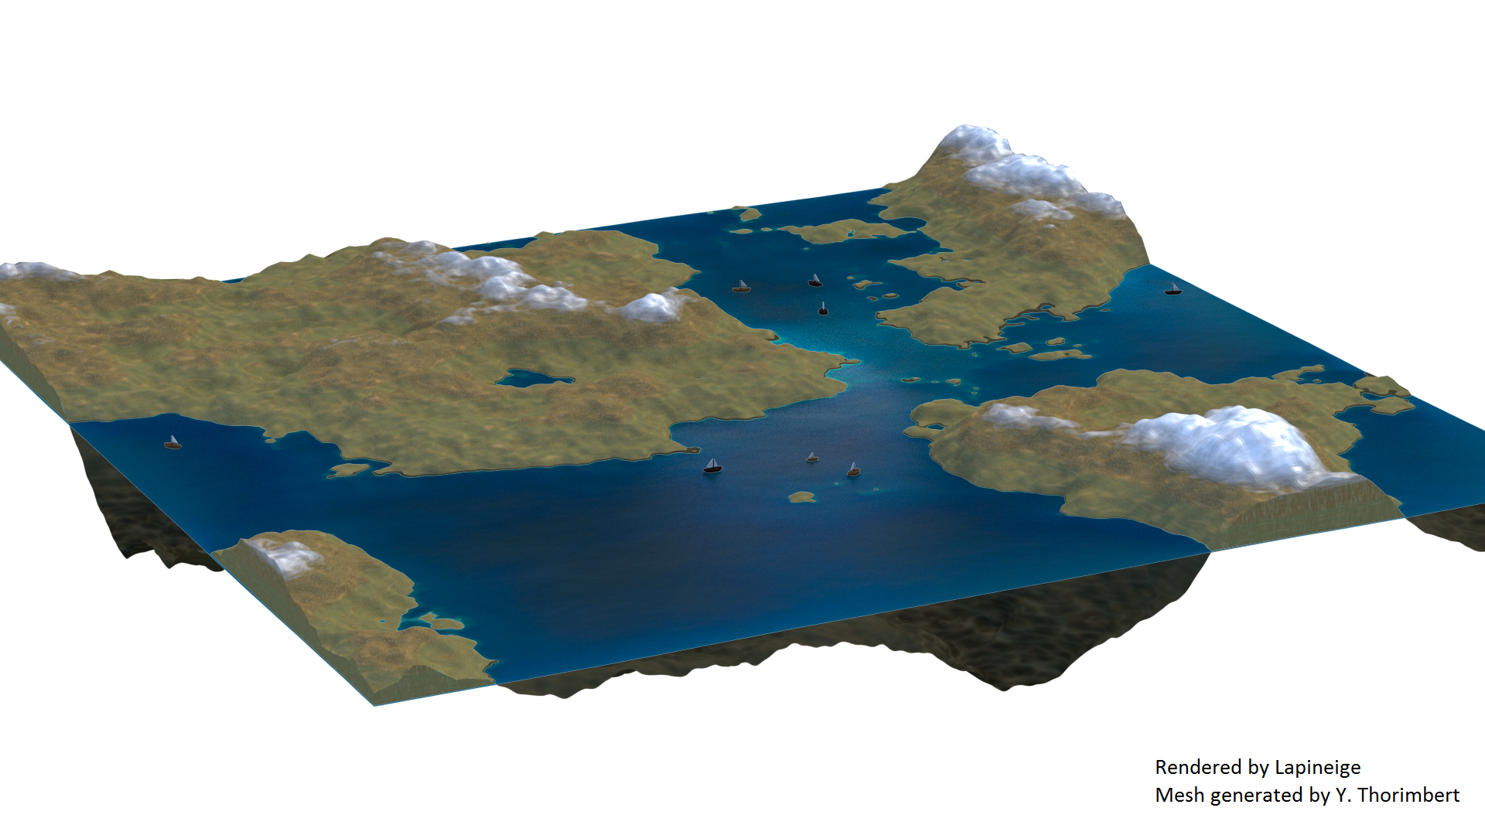
Procedural terrain and texture generation

Slide 2
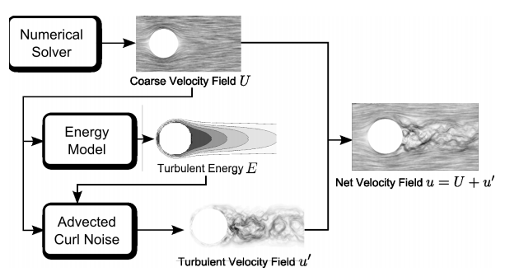
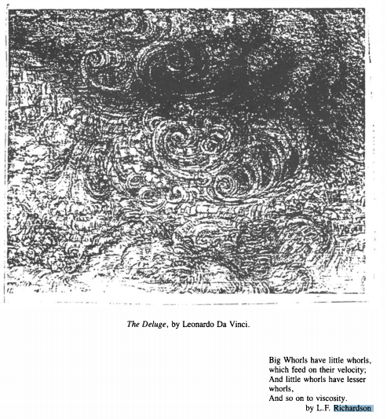
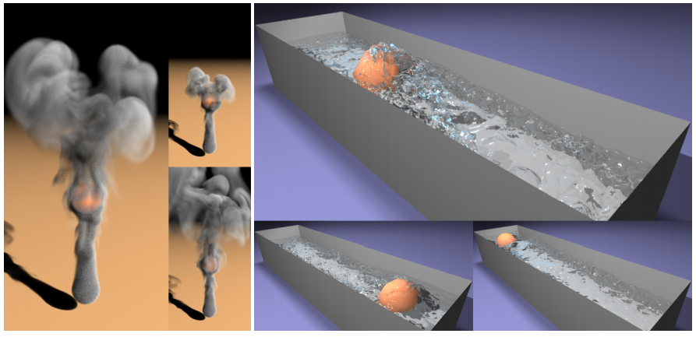
When fluids need noise
images: [Narain 2008]
image: [Kappraff 1986]

Slide 3
Content
Procedural generation
  Procedural content
  Coherent noise
Survey of popular methods
  Midpoint displacement
  Perlin noise
  Simplex noise
Study of gradient noise methods

Slide 4
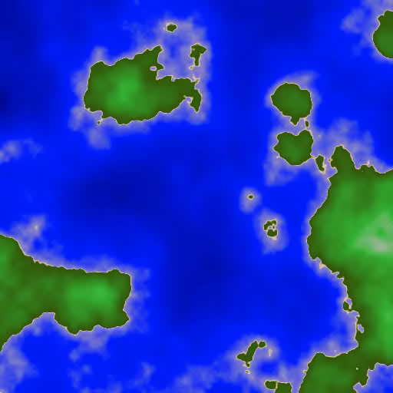
Procedural generation
Random but structured:
  Use algorithms to generate content
  Save human work
  Save computer memory
Generation of names, labyrinths, donjons, bricks, music, textures, vegetation, landscapes, cities, …
Industrial applications: Vehicle dynamics[Dawkins 2012], military training[Smelik 2009], …

Slide 5
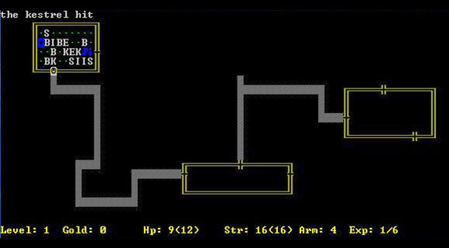
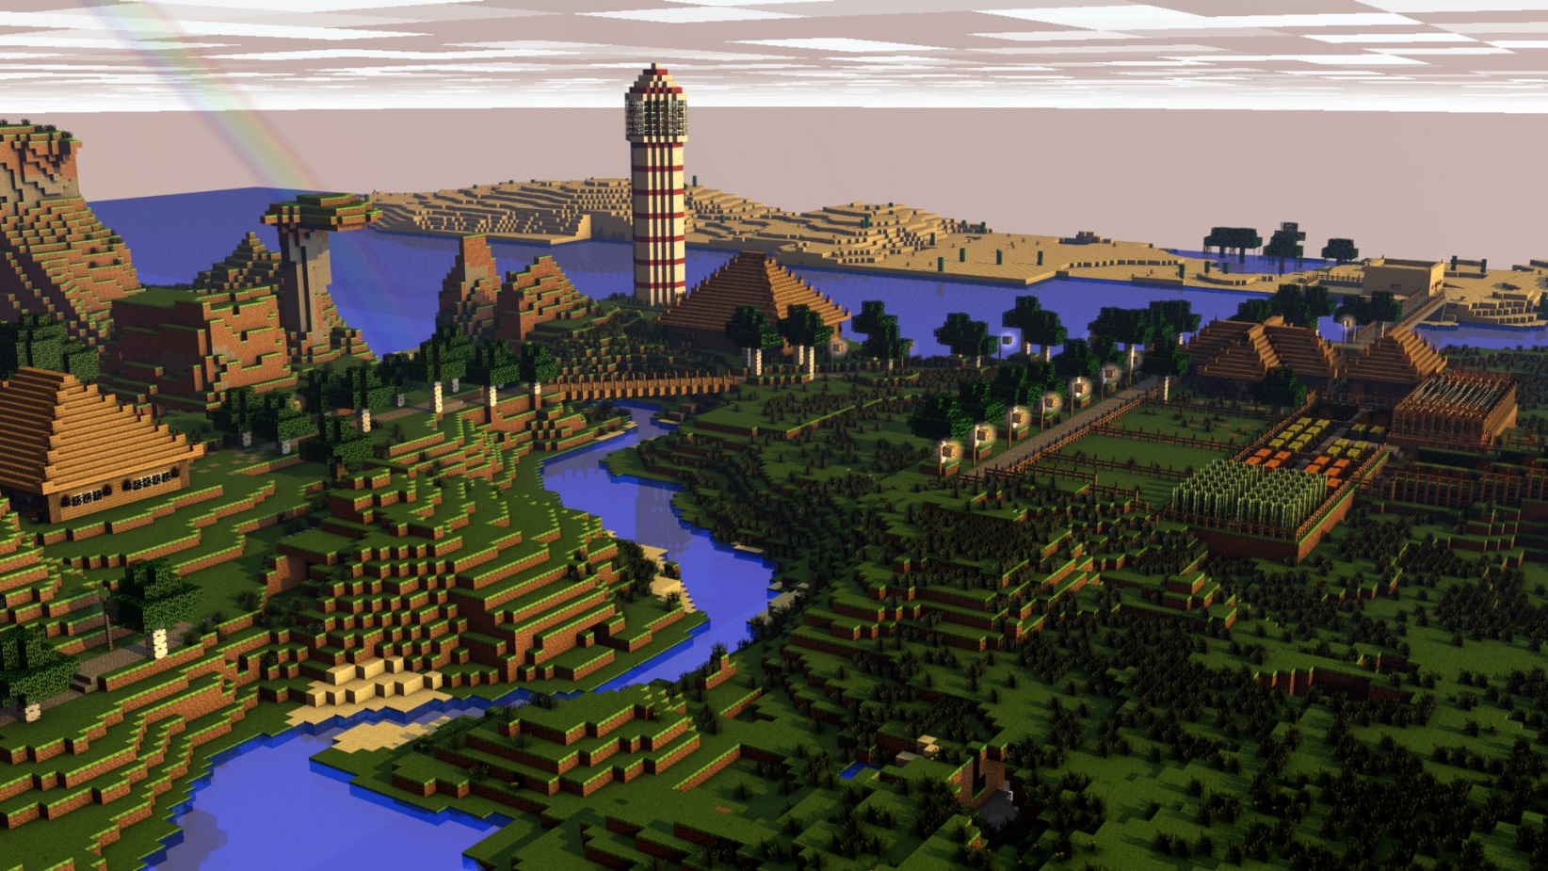
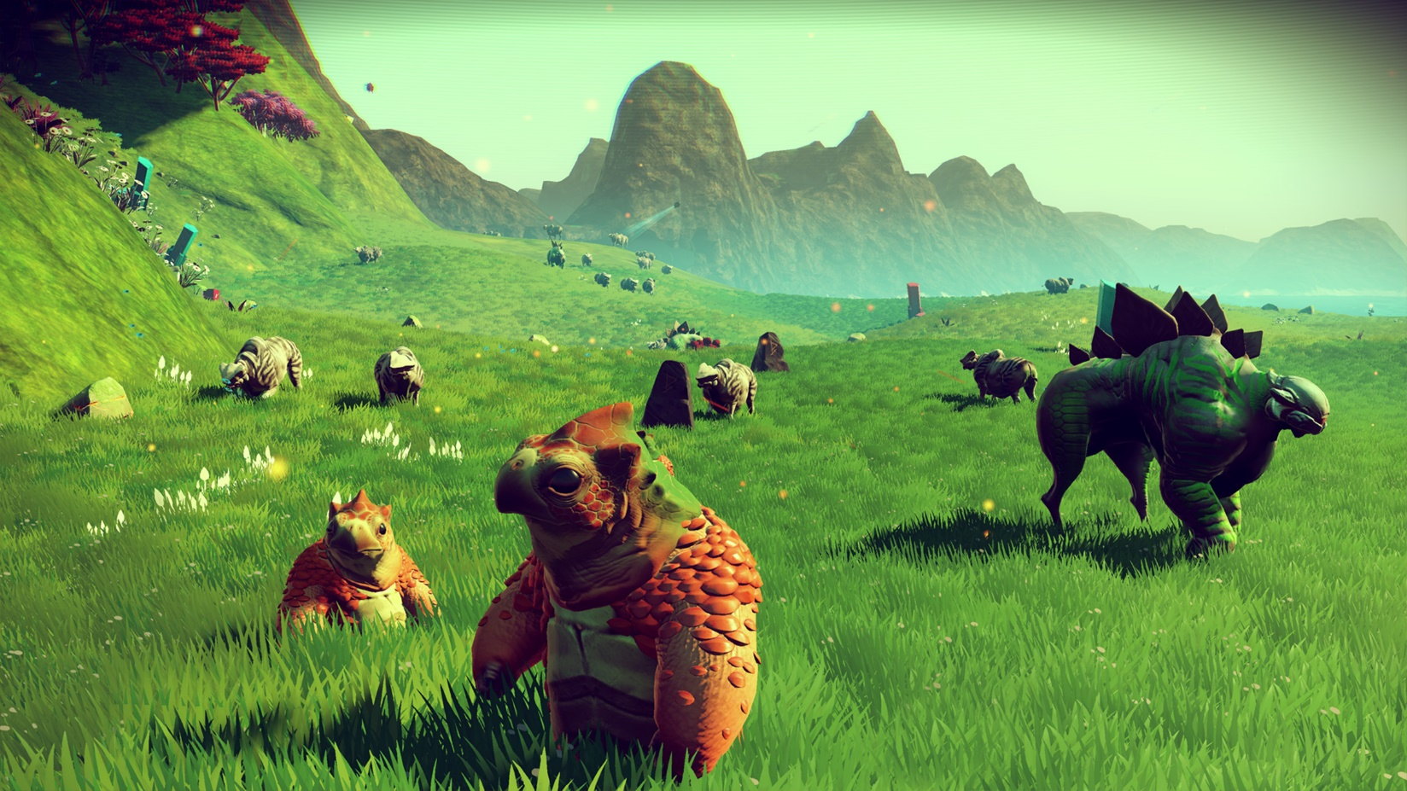
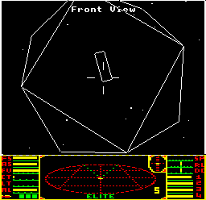
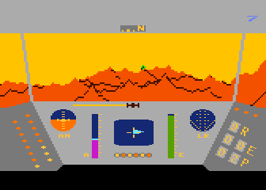
Procedural generation (2)

Slide 6


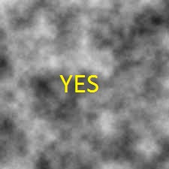
Coherent noise
Replicable
A small displacement results in a small variation of height
A large displacement results in a random variation of height

Slide 7
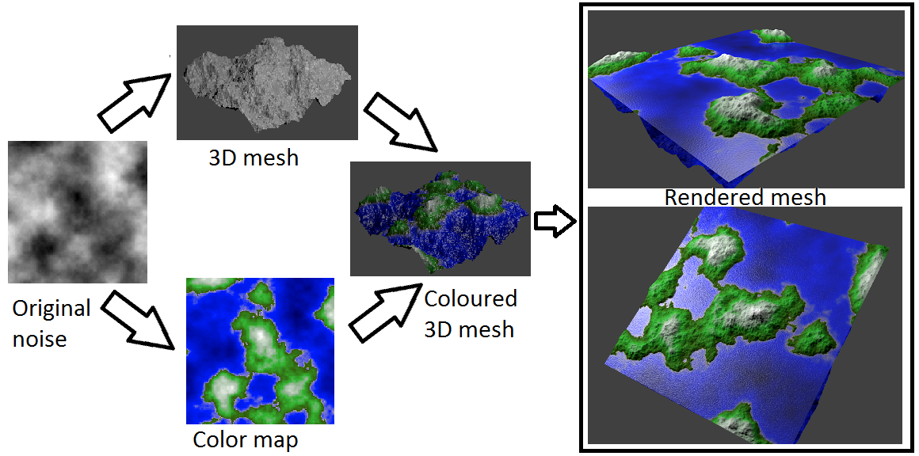
From noise to terrain
Map value to height
  Colorscale (2D model) or meshed terrain (3D model)
  Need 3D height map for generating caves

Slide 8
Popular methods
Midpoint displacement (1986)
Perlin noise (1985)
Simplex noise (2001)

Slide 9
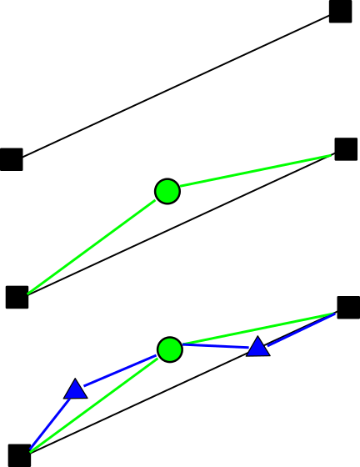
Midpoint displacement method [Miller 1986]
Every new point is the average of its neighborhood…
…plus a random offset

Slide 10
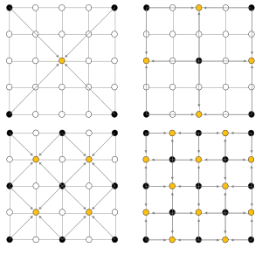
Diamond-Square algorithm
image: Christopher Ewin

Slide 11
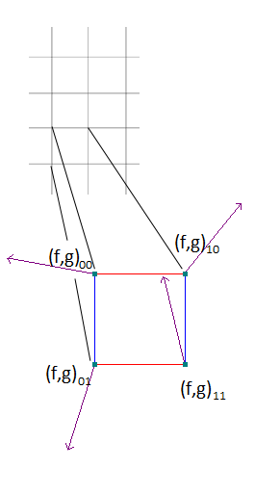
Perlin noise [Perlin 1985]
Regular grid
Gradient noise
Multiple octaves
  Superimposition of multiples
  independant noises of increasing level of detail and decreasing amplitude

Slide 12
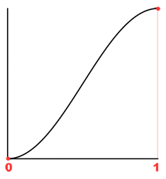
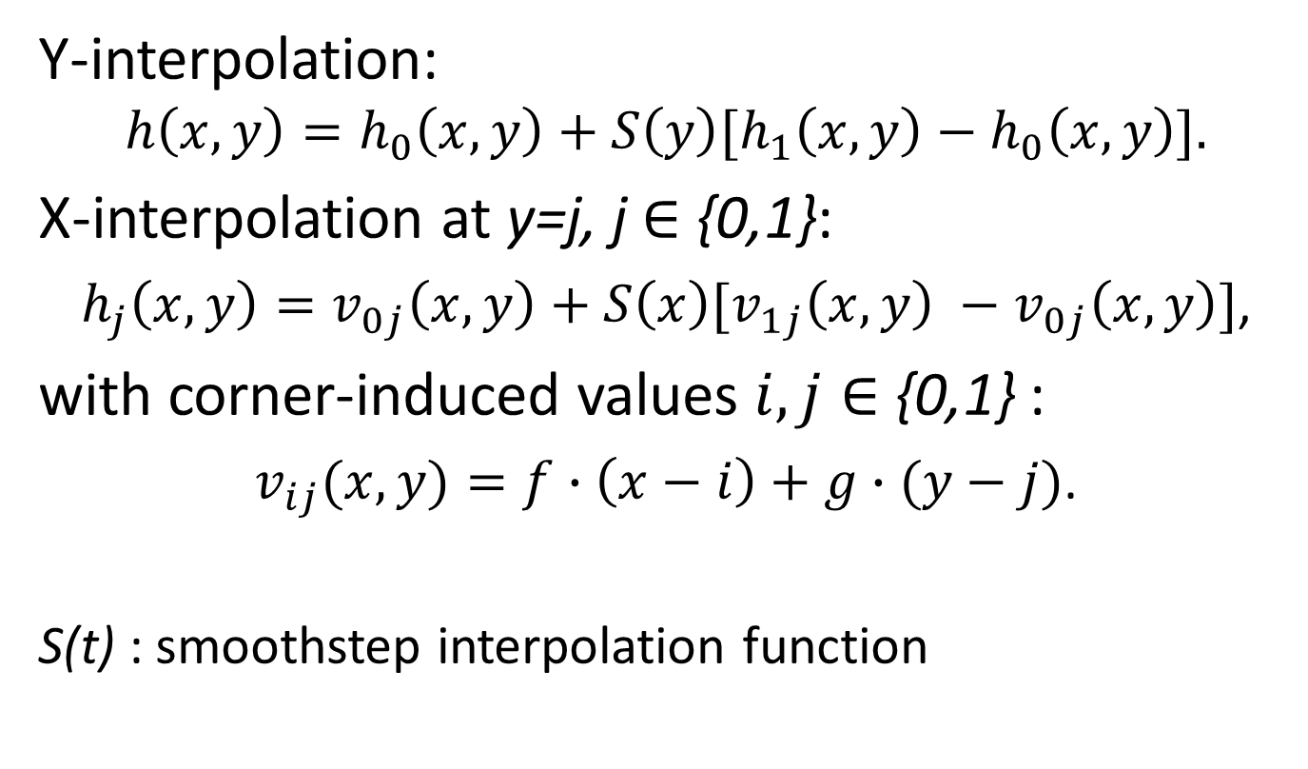
Perlin noise (2)
Y-interpolation:
$$h\left(x,y\right)=h_{0}\left(x,y\right)+S\left(y\right)[h_{1}\left(x,y\right)−h_{0}\left(x,y\right)].$$
X-interpolation at y=j, j $∈$ {0,1}:
$h_{j}\left(x,y\right)=v_{0j}\left(x,y\right)+S\left(x\right)[v_{1j}\left(x,y\right) −v_{0j}\left(x,y\right)]$,
with corner-induced values $i,j∈$ {0,1} :
$v_{ij}(x,y)=f∙\left(x−i\right)+g∙(y−j)$.
S(t) : smoothstep interpolation function

Slide 13
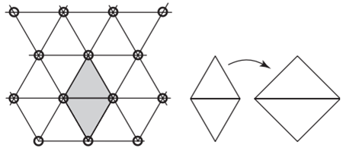
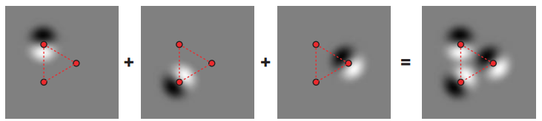

Simplex noise [Perlin 2001]
Apply Perlin noise to a simplex grid
Hypercube in $D$ dimensions has $2^{D}$ corners
Simplex in $D$ dimensions has $D+1$ corners
images: Stefan Gustavson

Slide 14
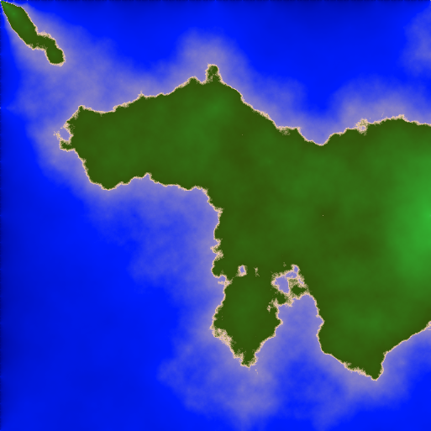
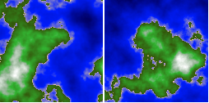
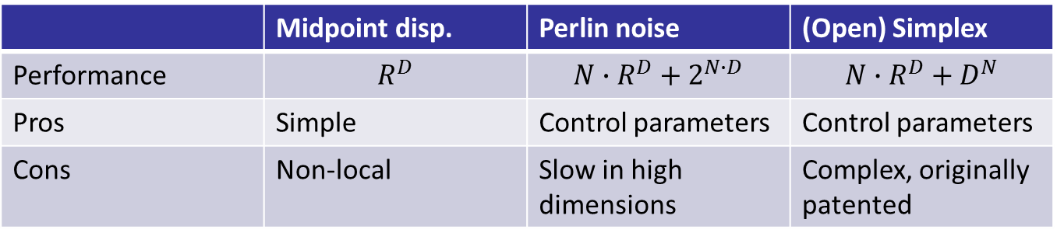

Comparison
$N$: number of octaves $R$: resolution
 | Midpoint disp. | Perlin noise | (Open) Simplex
Performance | $$R^{D}$$ | $$N∙R^{D}+2^{N∙D}$$ | $$N∙R^{D}+D^{N}$$
Pros | Simple | Control parameters | Control parameters
Cons | Non-local | Slow in high dimensions | Complex, originally patented

Slide 15
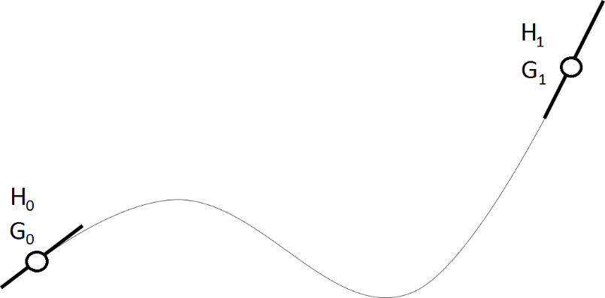
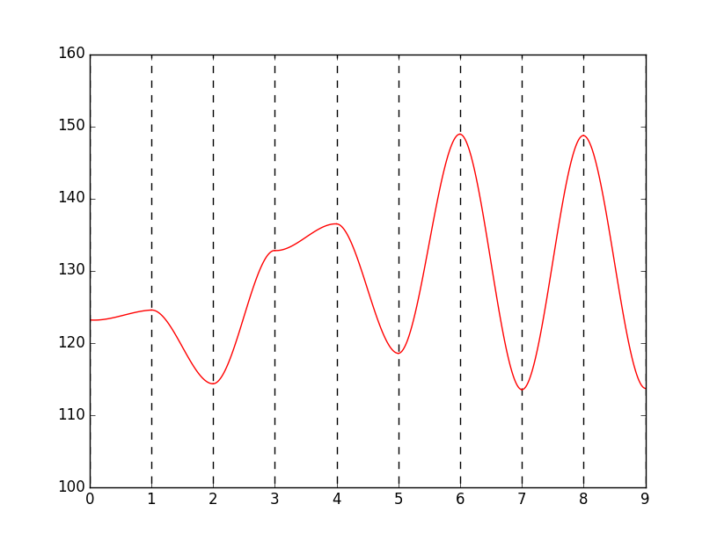
Another model: polynomials
Simple idea: constrain value and gradient of a polynomial at boundaries.
1D : trivial.

Slide 16
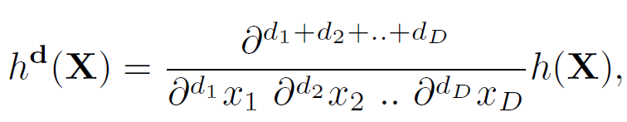
Polynomial method (1)
One step back: what do we want ? Controlled height and gradient:
Height and gradient along an edge connecting two points must depend only on constraints on these points and no other: ( )
(1)
(2)

Slide 17
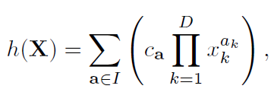
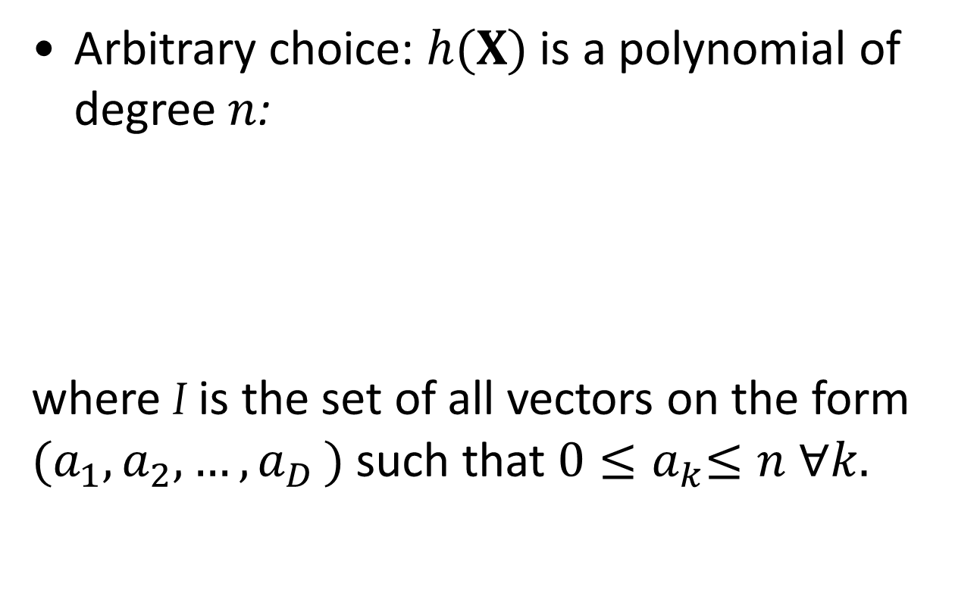
Polynomial method (2)
Arbitrary choice: $h(X)$ is a polynomial of degree $n$:
where I is the set of all vectors on the form $(a_{1},a_{2},{…,a}_{D})$such that $0{≤a}_{k}≤n ∀k.$
(3)

Slide 18
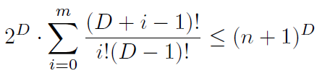
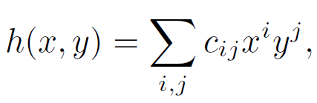
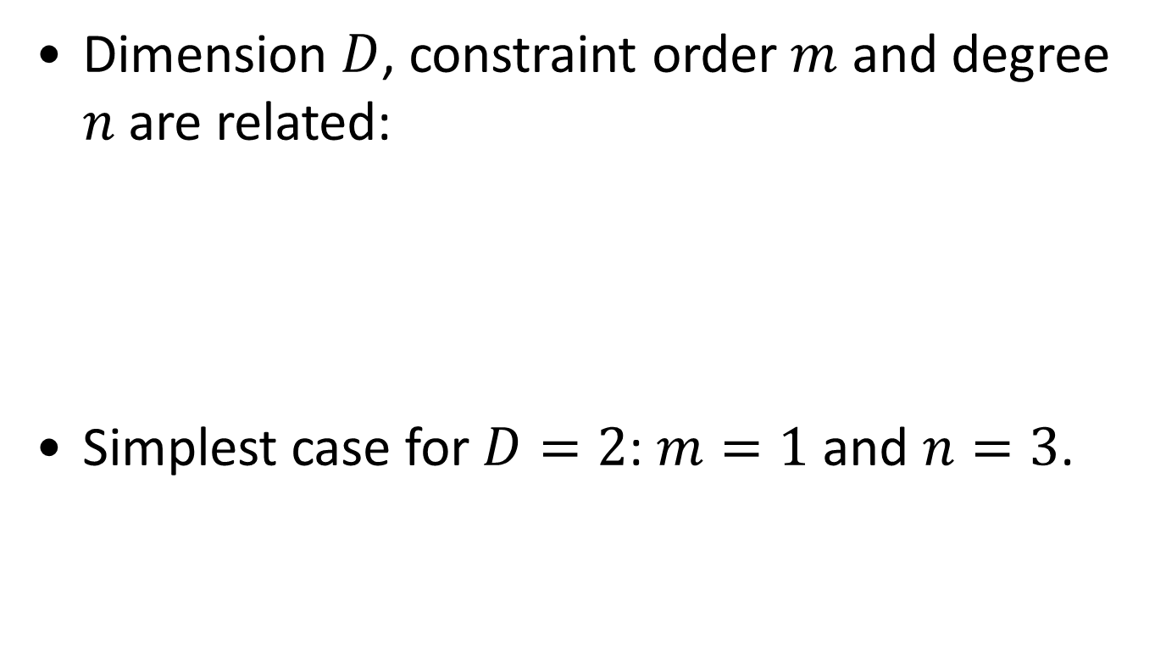
Polynomial method (3)
Dimension $D$, constraint order $m$ and degree $n$ are related:
Simplest case for $D=2$: $m=1$ and $n=3$.
.
(4)
(5)

Slide 19
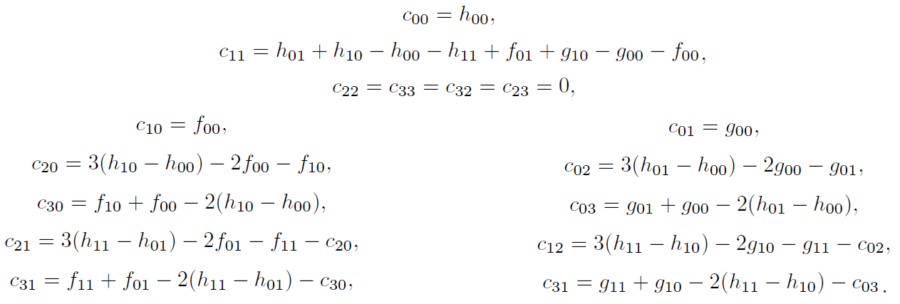


Polynomial method (4)
4 constraints $h_{ij}$ on height eq.(5), 4 constraints $f_{ij}$ on $x$-derivative, 4 constraints $g_{ij}$ on $y$-derivative, and edge condition eq.(2):

Slide 20


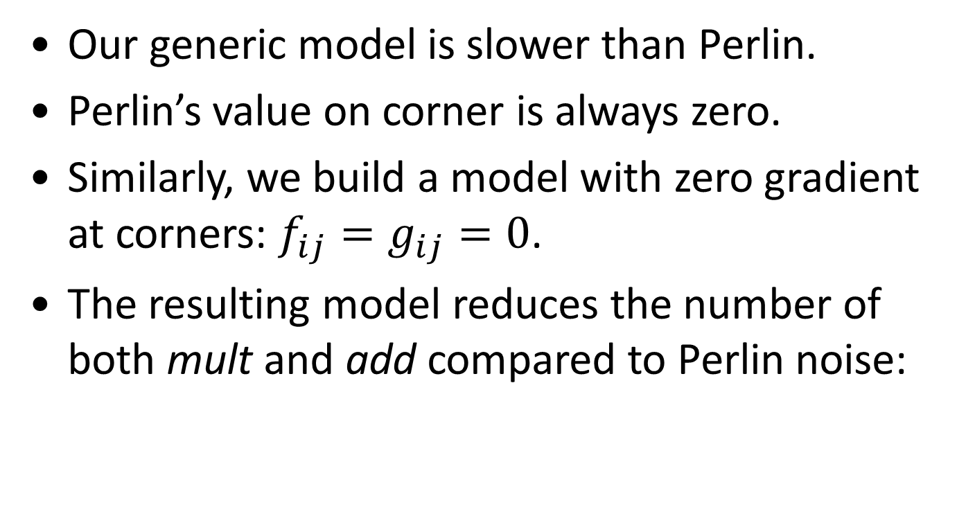
Zero-Gradient polynomial
Our generic model is slower than Perlin.
Perlin’s value on corner is always zero.
Similarly, we build a model with zero gradient at corners: $f_{ij}=g_{ij}=0$.
The resulting model reduces the number of both mult and add compared to Perlin noise:
(6)

Slide 21
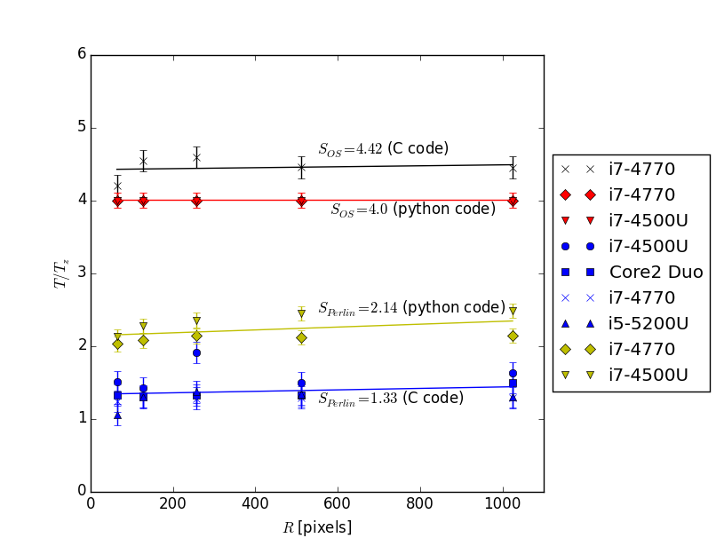
Performance comparison

Slide 22
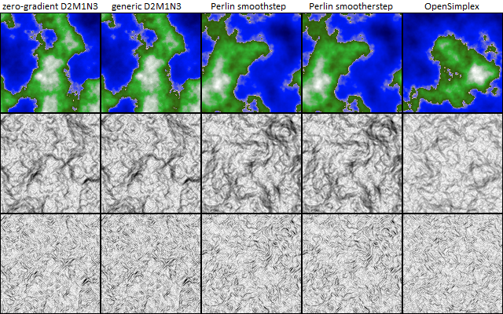
Comparison height map and gradients

Slide 23

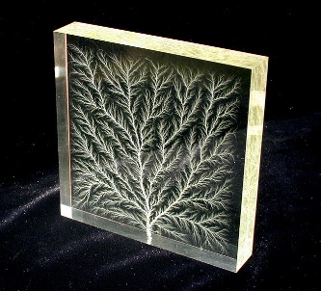
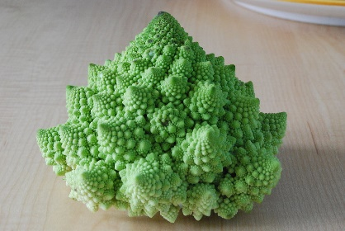
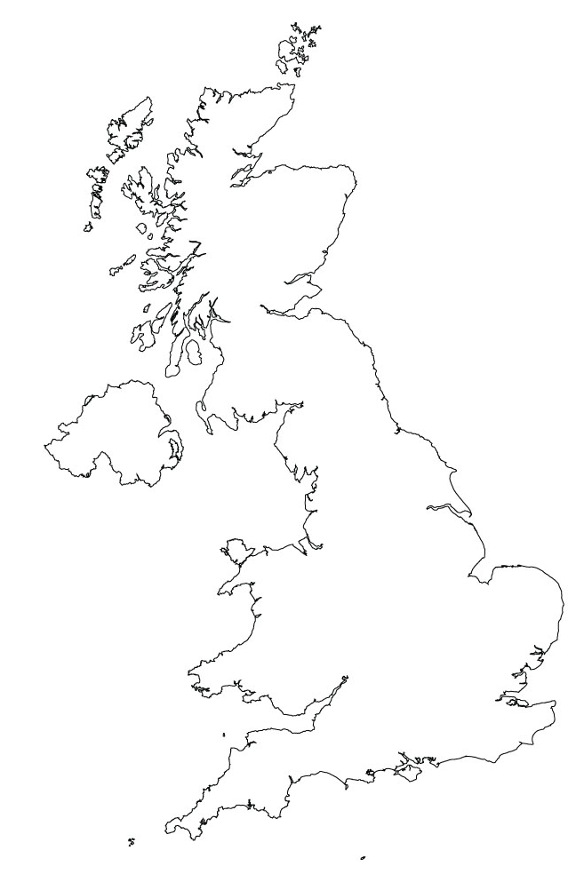
Fractals
Most real landscapes (and many natural structures in general) exhibit fractal features.
Fuzzy definition: mathematical set that is invariant under rescaling.
Tautological definition: a fractal object is an object whose each part is also a fracal object.
Image: Bert Hickman

Slide 24


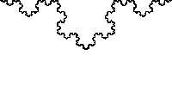
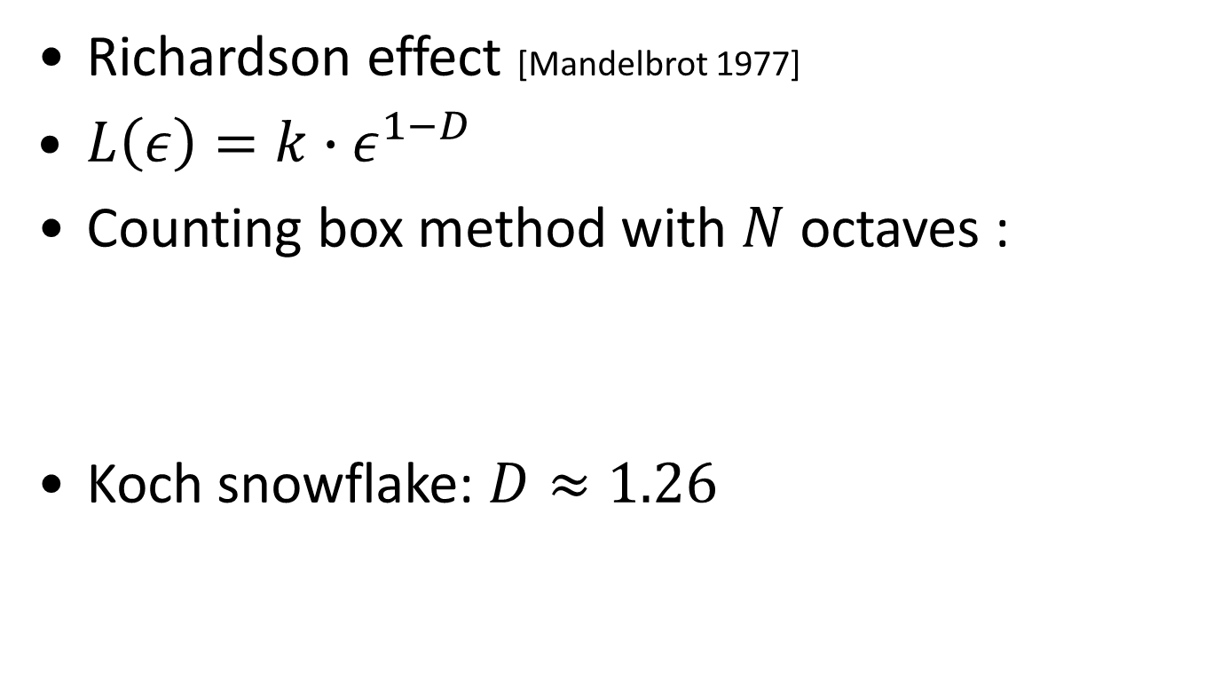
Fractal dimension
Richardson effect [Mandelbrot 1977]
$L\left(ε\right)=k∙ε^{1−D}$
Counting box method with $N$ octaves :
Koch snowflake: $D≈1.26$
(7)
Image: Christophe Dang Ngoc Chan

Slide 25
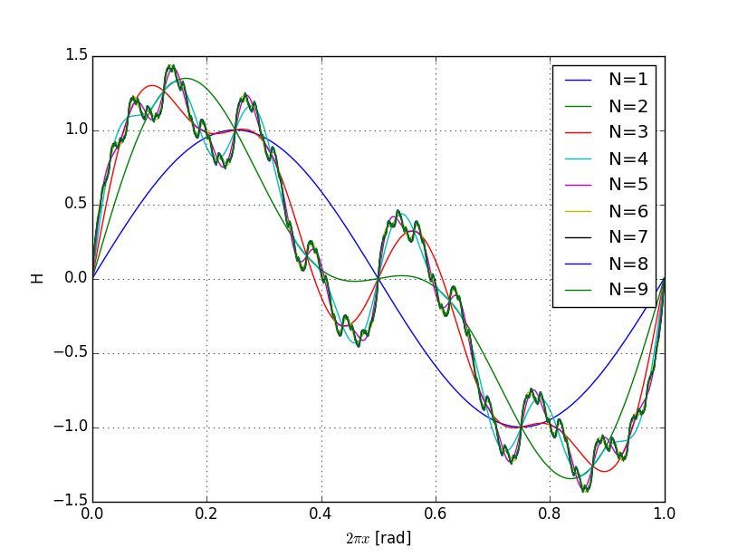
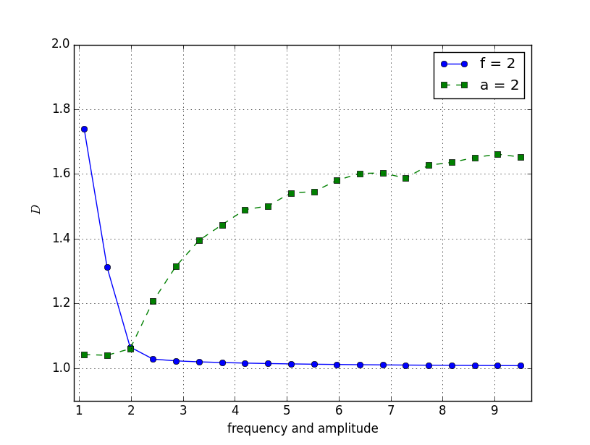

Fractality emerging from octaves superimposition
Simple sin case: $H\left(x\right)=\sum_{i=0}^{N}{a^{−i}\sin{(f^{i}x)}}$

Slide 26
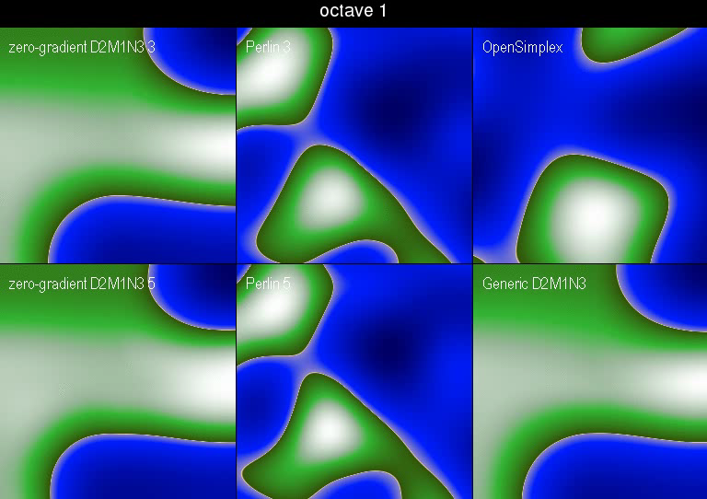
Octaves superimposition

Slide 27
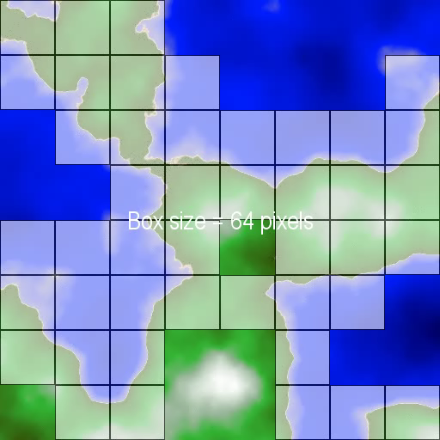
Fractal dimension of generated terrain

Slide 28
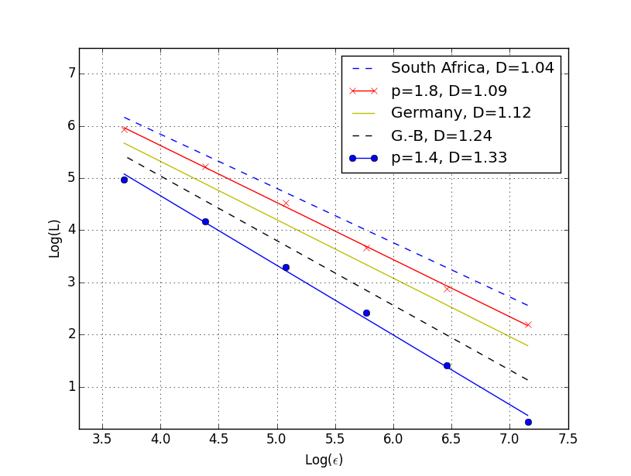
Fractal dimension of generated terrain (2)

Slide 29
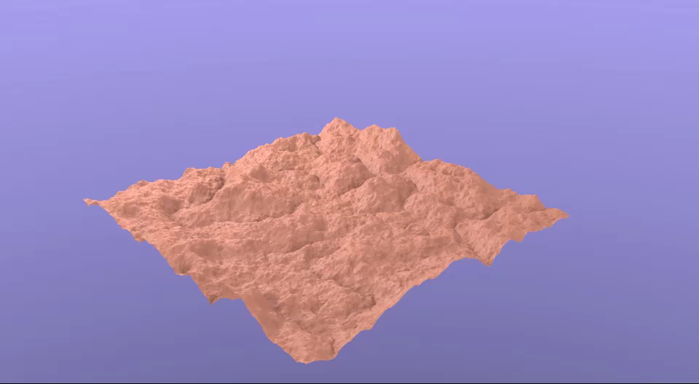
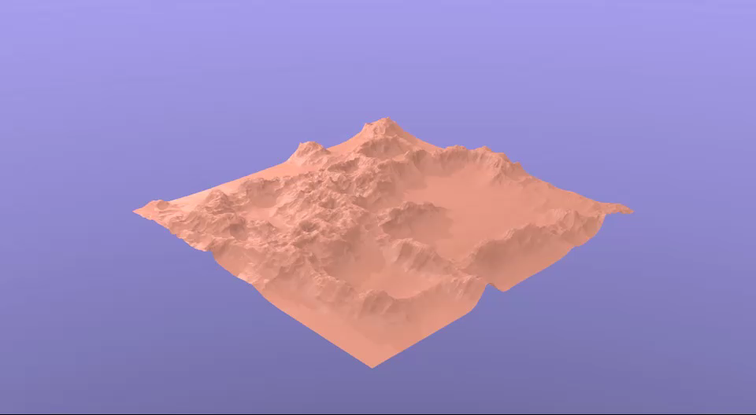

Modified noise
Abs noise : $\left|h\right|$
Ridged noise
Abs noise Ridged noise

Slide 30
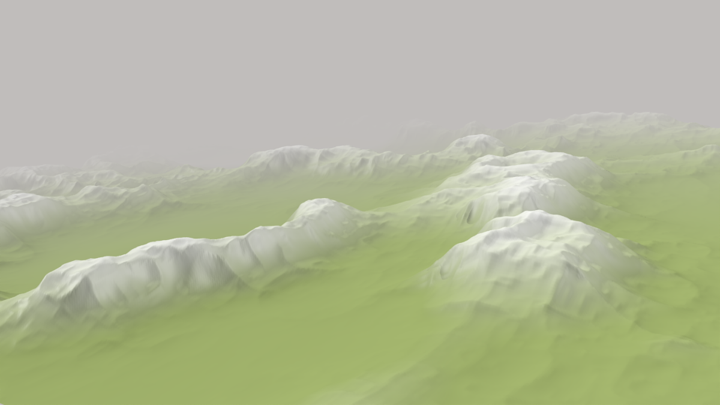


Ridged noise
Ridged noise [Libnoise]:
  Modification per octave with depth dependance
  ${h_{i}→k∙(1−\left|h_{i}\right|)}^{2}$
  $k→2h_{i}$

Slide 31


Erosion [Archer 2011]
Hydrolic erosion
Thermal erosion

Slide 32





Other uses
Pixel shaders
Dynamic modeling

Slide 33


From noise to texture
Use modified noise and colormap:
  Radial $sin$ function ➔ wood
  sin function ➔ marble
  Ridged noise ➔ marble
  Raw noise ➔ clouds
Notes:
Turbulence

Slide 34
When fluids need noise
image: [Kappraff 1986]
images: [Narain 2008]

Slide 35


Conclusion
Geomorphology: imitation or understanding?
Large use, minor renown
Coupling with other noises (Voronoi, Worley [Worley 96, …])
More controlability ➔ Feature-based models [Zhou 2007, …]
More realism ➔ Physically-based models [Génevaux 2013, …]
Image : [Génevaux 2013]
Image : [Zhou 2007]

Slide 36
References
Code, presentation and more references on http://cui.unige.ch/~thorimby/procgen/
All images produced with zero-gradient model (unless otherwise specified); 3D renderings with Blender
[Archer 2011] http://micsymposium.org/mics_2011_proceedings/mics2011_submission_30.pdf (accessed 11/11/2016)
[Dawkins 2012] Jeremy J Dawkins, David M Bevly, and Robert L Jackson. Evaluation of fractal terrain model for vehicle dynamic simulations. JOURNAL OF TERRAMECHANICS, 49(6), 2012.
[Génevaux 2013] Jean-David Genevaux, Eric Galin, Eric Guerin, Adrien Peytavie, and Bedrich Benes. Terrain generation using procedural models based on hydrology. ACM Trans. Graph 32, July 2013.
[Kappraff 1986] Jay Kappraff. The geometry of coastlines: a study in fractals. Computers & Mathematics with Applications, 12(3), 1986.
[Libnoise] http://libnoise.sourceforge.net/ (accessed 11/11/2016)
[Mandelbrot 1977] Benoit B. Mandelbrot. The Fractal Geometry of Nature. W. H. Freeman and Company, 1977.
[Miller 1986] Gavin S P Miller. The definition and rendering of terrain maps. SIG-GRAPH Comput. Graph., 1986.

Slide 37
References (2)
[Narain 2008] Rahul Narain, Jason Sewall, Mark Carlson, and Ming C. Lin. Fast animation of turbulence using energy transport and procedural synthesis. In ACM SIGGRAPH Asia 2008 Papers, NY, USA, 2008. ACM.
[Perlin 1985] Ken Perlin. An image synthesizer. SIGGRAPH Comput. Graph. July 1985.
[Perlin 2001] Ken Perlin. Noise Hardware. SIGGRAPH Course Notes, 2001.
[Smelik 2009] Ruben M. Smelik, Tim Tutenel, Klaas Jan de Kraker, and Rafael Bidarra. A case study on procedural modeling of geo-typical southern Afghanistan terrain. In Proceedings of IMAGE 2009, St.Louis, Missouri, jul 2009.
[Worley 96] Steven Worley. A cellular texture basis function. In Proceedings of the 23rd Annual Conference on Computer Graphics and Interactive Techniques, SIGGRAPH '96, ACM.
[Zhou 2007] Howard Zhou, Jie Sun, Greg Turk, and James M. Rehg. Terrain synthesis from digital elevation models. IEEE Transactions on Visualization and Computer Graphics, July/August 2007

