Slide 1
SAPERE

Slide 2
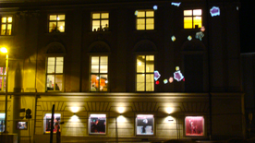
Framework: SAPERE project
Ecosystem of Services
Inspiration from chemical reactions
Service deployment
Spontaneous interactions among services
Spontaneous aggregation of data
Context-awareness (user, situation recognition)
Self-organisation (building spatial structures, composing services)
Self-management (decentralised control)
Domains
Ecosystem of displays for user/crowd steering
Middleware for Android phones / tablets
EU Funded Project - SAPERE: http://www.sapere-project.eu
Collaboration: U Geneva, U Bologna, U Modena, U Linz, U St-Andrews
2010-2013
Notes:
Theoritical and practical framework for designing, implementing and validating pervasive applications.
Uniform

Slide 3
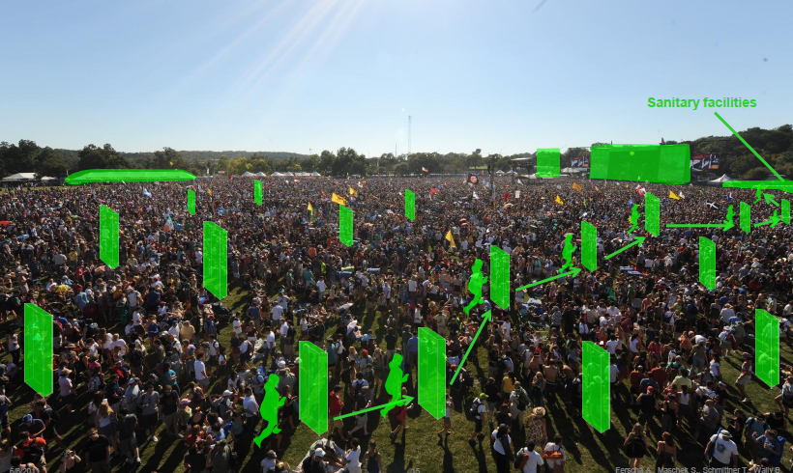
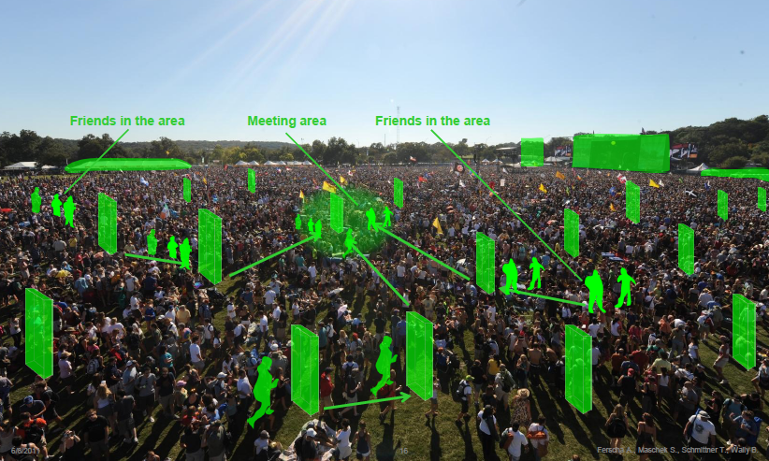
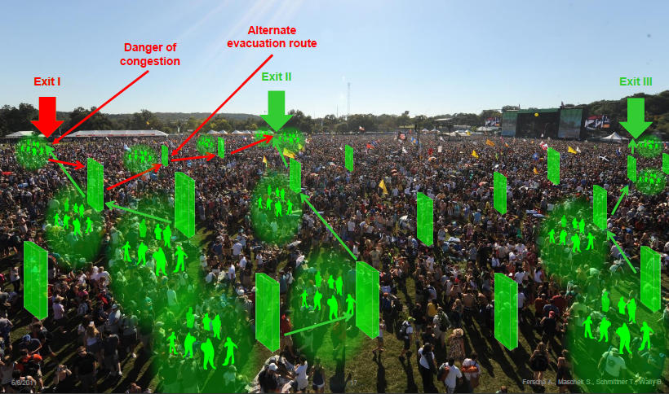
Case Studies
Crowd Steering through Self-Organising Public/Private Displays
Single user
Multiple user
Emergency

Slide 4
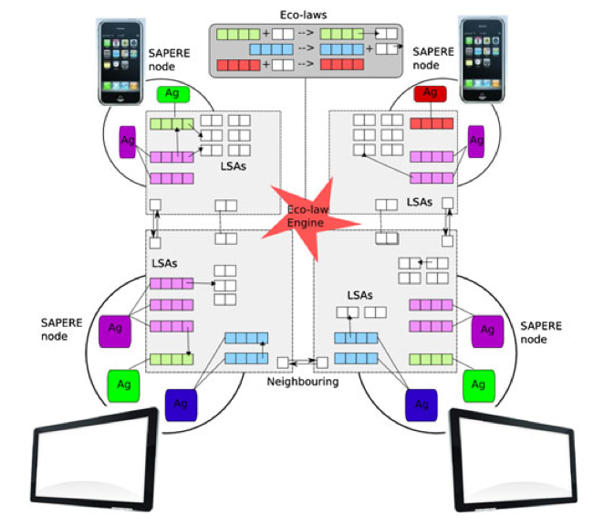
SAPERE Concepts
Live Semantic Annotation (LSA) is the virtual representation of a service, data or device (i.e. any SAPERE entity). It ensures a common treatment and manage contextual information.
LSA space is a shared tuple space where SAPERE entities interact through eco-laws.
Eco-laws are virtual chemical reactions that drive the dynamics of the eco-system.

Slide 5
SAPERE Concepts
SAPERE Concepts
Ecosystem of services is ruled by “eco-laws”
Drive the dynamics of the system
Act like Chemical Reactions
Trigger when enabled (pattern-matching, rewriting rules)
Information about services, data, devices: “Live Semantic Annotations (LSAs)”
Reflect changes in services, data, devices

Slide 6
SAPERE syntax
LSAs: <prop₁=“value₁”, prop₂=“value₂”, … prop_{n}=“value_{n}”>
ECO-LAWS:
<decay = n, … > → <decay = n-1, … >
<propagation = “gradient”, … > → send (< propagation = “gradient”, …>), < … >

Slide 7
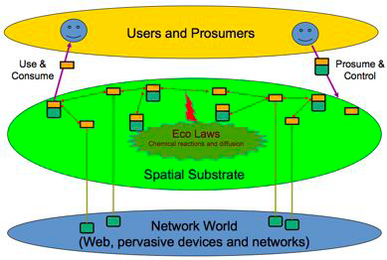
SAPERE - Structure

Slide 8
SAPERE - Structure
Node_{n} - LSA space
Eco-laws
(e.g. gradient spreading)
Network of
Nodes
-
Relates to Users
Sensors Displays
Web

Slide 9
SAPERE- Structure
Activated
Service
Application
Service
Application
Service
LSA
LSA
LSA
LSA
LSAs
Eco-laws
LSAs
Eco-laws
Connectivity
LSA
LSA space
LSA
LSA space
Sensor
Sensor
Node₂ – LSA space
Node₁
Notes:
Connectivity – SNM – Sapere network manager
Change picture?: Agent -> Application (made of agents) and Servie (are made of agent)
Show spreading of gradient on the nodes.

Slide 10
SAPERE Structure
Applications
External Libraries
LSA’s Space
Eco-laws

Slide 11
SAPERE Structure
Eco-laws:
Propagation: Spreads an LSA to one or all neighbouring LSA’s spaces.
Aggregation: Reduces the amount of LSA’s in the LSA space by extracting meaningful information.
Evaporation: Reduces the relevance of an LSA. If relevance is zero the LSA is automatically removed.
Gradient: creates a gradient structure, providing information about the distance and direction of the node source.
Bonding: creates links (references) between LSAs in order to determine the visibility of the LSAs, i.e., an agent can see an LSA if its own LSA is bound to that information.

Slide 12
SAPERE Structure
LSA Space:
The LSA Space is a blackboard where all entities in the system are represented by an LSA.
The context is defined and represented as the set of LSAs stored in a given locality (i.e. LSA space)

Slide 13
SAPERE Structure
External Libraries:
Service Self-composition
Routing implementing Chemotaxis
Dynamic Gradients
Remote data query and aggregation
Reaching a consensus (Gossip)
Self-protection (data and services)
Self-management
Encryption

Slide 14
Separation of Concerns

Slide 15
Separation of Concerns
Functionality vs Underlying mechanisms
Functionality vs Non-functional aspects
Self-management vs Control
Delegate self-management to computing environment
Notes:
To separate functionality of an application from the underlying mechanisms it uses: Selforganising
mechanisms, initially identified as building blocks from which higher level
self-organising systems and applications can be constructed [FMDMSM+12], are
provided as (reusable) services [DMSFM13].
Besides separating concerns at the spatial structures level, the SAPERE approach
also allows to separate the concerns related to context- and situation-awareness, since
reasoning entities are in charge of those tasks.
To separate functionality from non-functional aspects: Self-organising services manage
their own non-functional aspects independently from their intended functionality (e.g.
the Gradient service self-manages the number of messages sent to maintain the gradient
independently of the actual values spread across the network) [FMSY+13];
To separate self-management from control: Any application requiring the use of a selforganising
service requests that service specifying an expected Quality of Service (i.e.
exercising a form of control over that service). It relies on that service to self-manage
and to provide the Quality of Service corresponding to the application’s requirement;
To delegate self-management of low-level services to the underlying environment: A lowlevel
self-organising service (e.g. an eco-law) relies on its operating environment to
handle part of its non-functional and self-managing behaviour [FMSY+13].

Slide 16
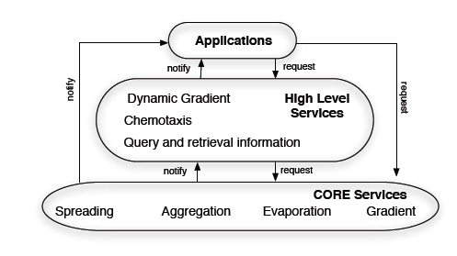
Separation of concerns: Design
Engineering
Separation of concerns
Self-organising mechanisms provided as services
Notes:
Cohesion, separation, alignement, objective

Slide 17
Separation of concerns: self-management vs control

Slide 18
Outline
Inspiration / Motivation
Self-organising Mechanisms as Design Patterns
SAPERE / Separation of Concerns
Case studies and Validation
Crowd Steering / Finding a friend / Best Artist
TheOne-SAPERE simulator
Deployment on tablets
Notes:
Self-organizing design patterns
Execution models for engineering self-organizing systems
Make an outline and repeat the slide

Slide 19
Music Festival Case Study: Single, Multiple Users Steering Publishing Events Best Artist Award

Slide 20
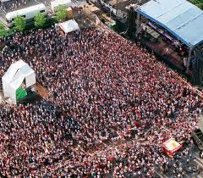
Music Festival
Features:
Current centralised solutions are not scalable:
It’s not possible to make calls, send messages, or have Internet connection.
Mobile network overload
High density of people, most of them bringing mobile phones or PDAs.
Open spaces:
It eases the positioning (use of GPS)

Slide 21
Apps Requirements
Crowd steering:
A user wants to find other users
A user wants to find a Point of Interest (PoI)
Emergency evacuation
Organisers want to publish events (without using centralised infrastructure):
Taxi or bus location
Music Festival Agenda
Emergency exits, toilets, bars, merchandising
A bar owner wants to advert offers during the festival
Voting for Best Artist

Slide 22
General assumptions
People carry mobile phone with the SAPERE middleware running.
Public displays and PoI also run the SAPERE middleware.
GPS information may be available.
At the entrance of the music festival, all devices are registered and the music festival SAPERE application is installed.
PoI can appear and disappear
PoI can be moving.

Slide 23
Find a Friend / PoI
Involved services
Gradient
Chemotaxis
Algorithm.
Agent A injects a Gradient LSA providing the other user ID (i.e. Agent B) and requesting the position information.
Information is propagated and aggregated (to keep the min hop counter at each node).
When information arrives to Agent B’s node, agent B is notified. In case B accepts to share his position, the position is sent back following the gradient (Chemotaxis) to agent A’s node.
Notes:
1.- Mainly, biological self-organising systems are providing emergent complex behaviours based on the interaction of basic rules. Distributed systems have been taking inspiration from these systems in orden to solve self-organising problems, such as, coordinated search, pattern formation, syncronization, or coordinated navegation.
These rules are the result of thousand years of evolution, where based on the limit “intelligence” of some organisims, their behaviours have been optimised to survive. Fascinating examples are Bacteria (lookig for food, or preparing an attack), or steam cells.
2.- During the evolution of these spicies, not only the rules have evolved, also their parameters. Bio-inspired self-organising systems have demonstrate to perform very good when their parameters are perfectly tunned, However, the optimization of the paramenters is problem dependent. Some examples are ACO that used different parameters for each optimization problem, or PSO that have been changing its parameters during the last years to cover the maximum number of optimization problems. Also occur in Genetic algorithms and whatever, self-organising algorithm that exist.
How to optimise parameters is an open issue. If we look at nature we see that parameters evolve to ensure the survivance of the species, but the cost is year and years of evolution and the dead of many individuals that were not properly adapted. We can’t not afford this solution in real time systems.

Slide 24
Find a Friend / PoI
Notes:
1.- Mainly, biological self-organising systems are providing emergent complex behaviours based on the interaction of basic rules. Distributed systems have been taking inspiration from these systems in orden to solve self-organising problems, such as, coordinated search, pattern formation, syncronization, or coordinated navegation.
These rules are the result of thousand years of evolution, where based on the limit “intelligence” of some organisims, their behaviours have been optimised to survive. Fascinating examples are Bacteria (lookig for food, or preparing an attack), or steam cells.
2.- During the evolution of these spicies, not only the rules have evolved, also their parameters. Bio-inspired self-organising systems have demonstrate to perform very good when their parameters are perfectly tunned, However, the optimization of the paramenters is problem dependent. Some examples are ACO that used different parameters for each optimization problem, or PSO that have been changing its parameters during the last years to cover the maximum number of optimization problems. Also occur in Genetic algorithms and whatever, self-organising algorithm that exist.
How to optimise parameters is an open issue. If we look at nature we see that parameters evolve to ensure the survivance of the species, but the cost is year and years of evolution and the dead of many individuals that were not properly adapted. We can’t not afford this solution in real time systems.

Slide 25
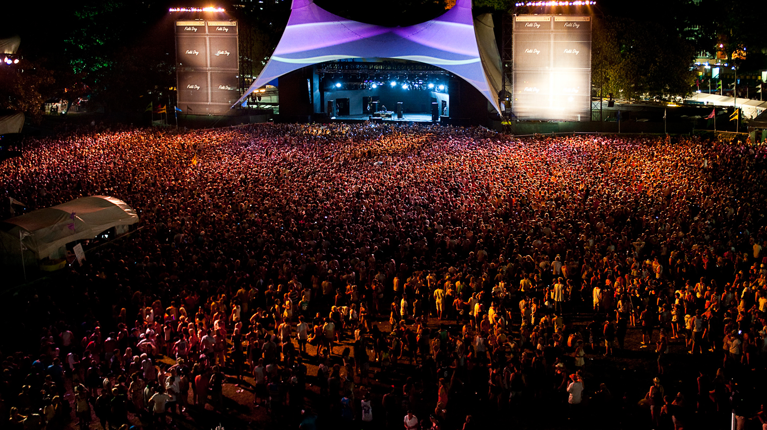
Find a Friend / PoI
0
3
1
2
5
3
2
3
4
3
5

Slide 26
Find a Friend / PoI
User: John78
Dist = 200m

Slide 27
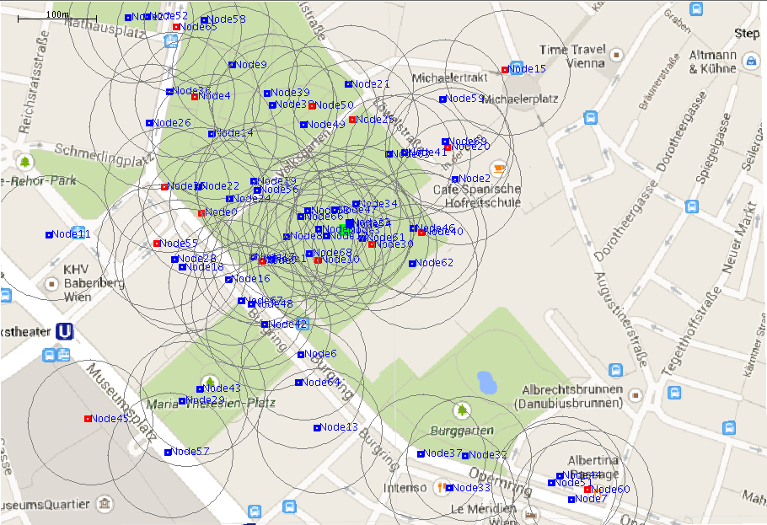
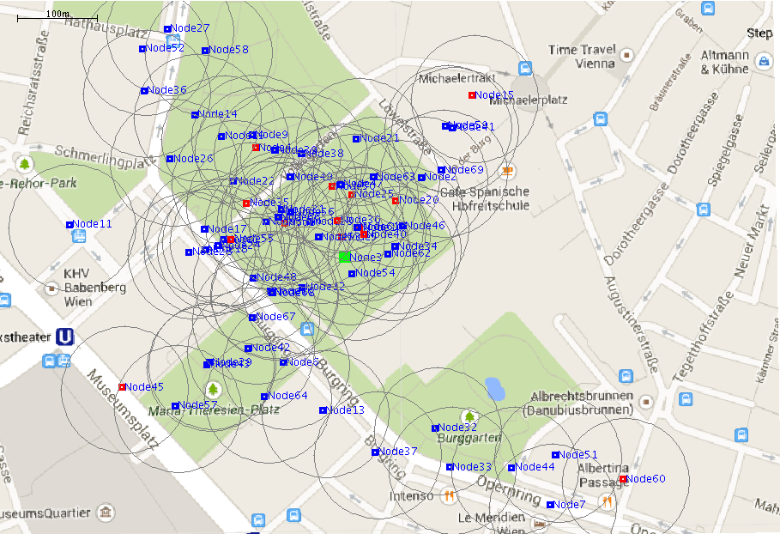
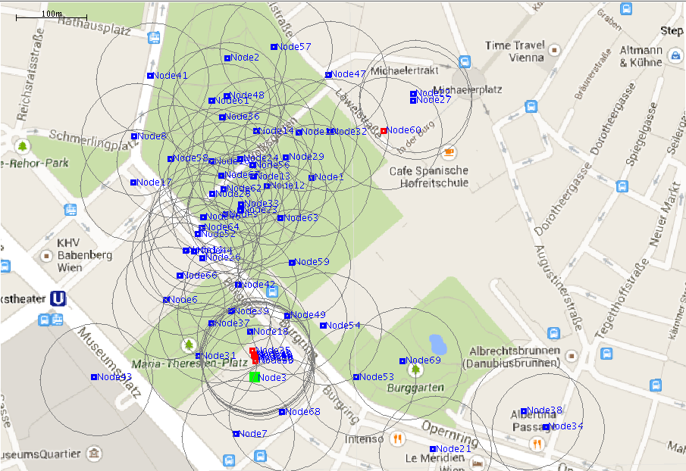
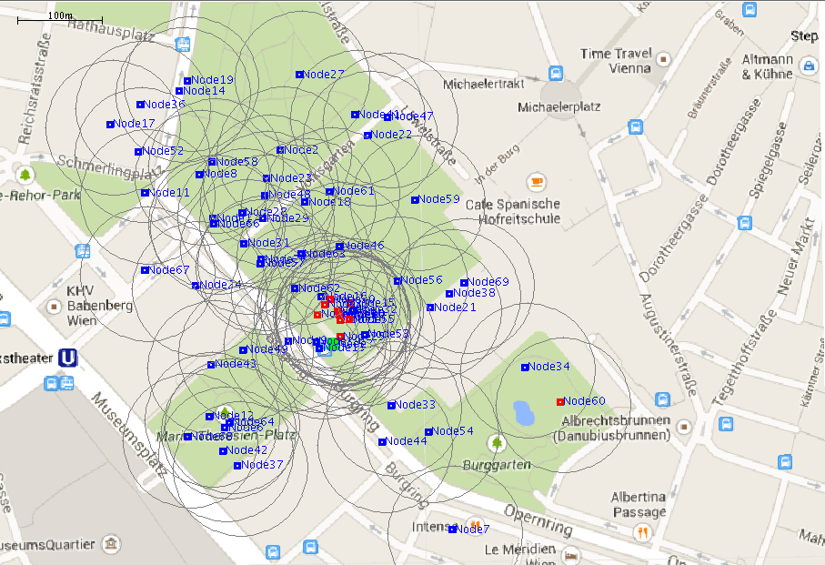
Single/Group User Steering

Slide 28
Emergency Evacuation
Assumptions
Emergency Exits (EE) are provided with a communication device (e.g. a mobile phone).
The EE devices know about the number of people using the exit by counting the number of connections.
Involved services
Gradient service
Algorithm
EE devices inject a Gradient LSA with information about the density of nodes in the exits.
Gradient information is used by mobile phones and public displays to show the closed exit.
At each node gradients are aggregated taking into account the density of nodes at each exits, thus, balancing the number of people steered to the exits.
Notes:
1.- Mainly, biological self-organising systems are providing emergent complex behaviours based on the interaction of basic rules. Distributed systems have been taking inspiration from these systems in orden to solve self-organising problems, such as, coordinated search, pattern formation, syncronization, or coordinated navegation.
These rules are the result of thousand years of evolution, where based on the limit “intelligence” of some organisims, their behaviours have been optimised to survive. Fascinating examples are Bacteria (lookig for food, or preparing an attack), or steam cells.
2.- During the evolution of these spicies, not only the rules have evolved, also their parameters. Bio-inspired self-organising systems have demonstrate to perform very good when their parameters are perfectly tunned, However, the optimization of the paramenters is problem dependent. Some examples are ACO that used different parameters for each optimization problem, or PSO that have been changing its parameters during the last years to cover the maximum number of optimization problems. Also occur in Genetic algorithms and whatever, self-organising algorithm that exist.
How to optimise parameters is an open issue. If we look at nature we see that parameters evolve to ensure the survivance of the species, but the cost is year and years of evolution and the dead of many individuals that were not properly adapted. We can’t not afford this solution in real time systems.

Slide 29
Emergency Evacuation

Slide 30
Publish Events
Involved services
Propagation
Algorithm
An organiser injects a Spread LSA containing the new information.
Information is propagated among the nodes.
At each node local information is updated.
Notes:
1.- Mainly, biological self-organising systems are providing emergent complex behaviours based on the interaction of basic rules. Distributed systems have been taking inspiration from these systems in orden to solve self-organising problems, such as, coordinated search, pattern formation, syncronization, or coordinated navegation.
These rules are the result of thousand years of evolution, where based on the limit “intelligence” of some organisims, their behaviours have been optimised to survive. Fascinating examples are Bacteria (lookig for food, or preparing an attack), or steam cells.
2.- During the evolution of these spicies, not only the rules have evolved, also their parameters. Bio-inspired self-organising systems have demonstrate to perform very good when their parameters are perfectly tunned, However, the optimization of the paramenters is problem dependent. Some examples are ACO that used different parameters for each optimization problem, or PSO that have been changing its parameters during the last years to cover the maximum number of optimization problems. Also occur in Genetic algorithms and whatever, self-organising algorithm that exist.
How to optimise parameters is an open issue. If we look at nature we see that parameters evolve to ensure the survivance of the species, but the cost is year and years of evolution and the dead of many individuals that were not properly adapted. We can’t not afford this solution in real time systems.

Slide 31
Best artist award / Voting
The organisers want people to vote about the best artist in the festival.
Involved Services:
Gossip Service (Propagation and aggregation)
Similar to Reaching an Agreement
Notes:
CF REACHING AN AGREEMENT
1.- Mainly, biological self-organising systems are providing emergent complex behaviours based on the interaction of basic rules. Distributed systems have been taking inspiration from these systems in orden to solve self-organising problems, such as, coordinated search, pattern formation, syncronization, or coordinated navegation.
These rules are the result of thousand years of evolution, where based on the limit “intelligence” of some organisims, their behaviours have been optimised to survive. Fascinating examples are Bacteria (lookig for food, or preparing an attack), or steam cells.
2.- During the evolution of these spicies, not only the rules have evolved, also their parameters. Bio-inspired self-organising systems have demonstrate to perform very good when their parameters are perfectly tunned, However, the optimization of the paramenters is problem dependent. Some examples are ACO that used different parameters for each optimization problem, or PSO that have been changing its parameters during the last years to cover the maximum number of optimization problems. Also occur in Genetic algorithms and whatever, self-organising algorithm that exist.
How to optimise parameters is an open issue. If we look at nature we see that parameters evolve to ensure the survivance of the species, but the cost is year and years of evolution and the dead of many individuals that were not properly adapted. We can’t not afford this solution in real time systems.

Slide 32
Best artist award / Voting
John = 5
Michel = 3
Tom = 2
Best Artist?
0
Best Artist?
Best Artist?
3
1
Best Artist?
Tom = 1
Best Artist?
John = 1
2
5
Tom = 1
Best Artist?
3
John = 1
Best Artist?
Best Artist?
Michel = 1
2
3
Best Artist?
John = 1
4
Michel = 1
Michel = 1
Best Artist?
Best Artist?
3
5
John = 1
John = 1

Slide 33
Validation: Simulation and Implementation in real devices
Notes:
To do, add references to all title slides
Add diagrams like in slides 108

Slide 34
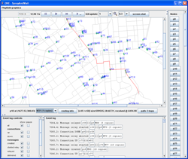
Simulation – TheOne-SAPERE
The ONE is a simulation environment that is capable of:
Generating node movement using different movement models
Using real Google maps
Importing mobility data from real traces
Creating simulations with different types of nodes (e.g. people, cars, public displays,etc..)
Assigning more than one communication interface per each device (e.g. Bluetooth, wi-fi, etc..)
Networking metrics
Reporting quality of the network (e.g. Message delivered, dropped, etc..)

Slide 35
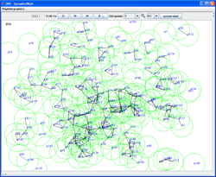
TheOne-Sapere
SAPERE middleware on top of The One simulation, helps us to:
Validate the current actual version of the middleware in large scale system.
Get easily performance metrics (e.g. analysing the number of LSAs in the system, and the bandwidth consumption).
Validate external libraries before their real implementation in the SAPERE middleware.
Evaluate the feasibility of the SAPERE middleware running on a large scale distributed environment composed of many types of devices. (i.e. to simulate real case scenario, in a very accurate way)
Notes:
---deployment
-- testing the middleware in large infrastructures
-- for methdology later

Slide 36
Simulation – The OneSAPERE
Notes:
Dynamic grqdient
1.- Mainly, biological self-organising systems are providing emergent complex behaviours based on the interaction of basic rules. Distributed systems have been taking inspiration from these systems in orden to solve self-organising problems, such as, coordinated search, pattern formation, syncronization, or coordinated navegation.
These rules are the result of thousand years of evolution, where based on the limit “intelligence” of some organisims, their behaviours have been optimised to survive. Fascinating examples are Bacteria (lookig for food, or preparing an attack), or steam cells.
2.- During the evolution of these spicies, not only the rules have evolved, also their parameters. Bio-inspired self-organising systems have demonstrate to perform very good when their parameters are perfectly tunned, However, the optimization of the paramenters is problem dependent. Some examples are ACO that used different parameters for each optimization problem, or PSO that have been changing its parameters during the last years to cover the maximum number of optimization problems. Also occur in Genetic algorithms and whatever, self-organising algorithm that exist.
How to optimise parameters is an open issue. If we look at nature we see that parameters evolve to ensure the survivance of the species, but the cost is year and years of evolution and the dead of many individuals that were not properly adapted. We can’t not afford this solution in real time systems.

Slide 37
Implementation using tablets
http://cui.unige.ch/~deangeli/SasoDemo2013.mp4
Notes:
1.- Mainly, biological self-organising systems are providing emergent complex behaviours based on the interaction of basic rules. Distributed systems have been taking inspiration from these systems in orden to solve self-organising problems, such as, coordinated search, pattern formation, syncronization, or coordinated navegation.
These rules are the result of thousand years of evolution, where based on the limit “intelligence” of some organisims, their behaviours have been optimised to survive. Fascinating examples are Bacteria (lookig for food, or preparing an attack), or steam cells.
2.- During the evolution of these spicies, not only the rules have evolved, also their parameters. Bio-inspired self-organising systems have demonstrate to perform very good when their parameters are perfectly tunned, However, the optimization of the paramenters is problem dependent. Some examples are ACO that used different parameters for each optimization problem, or PSO that have been changing its parameters during the last years to cover the maximum number of optimization problems. Also occur in Genetic algorithms and whatever, self-organising algorithm that exist.
How to optimise parameters is an open issue. If we look at nature we see that parameters evolve to ensure the survivance of the species, but the cost is year and years of evolution and the dead of many individuals that were not properly adapted. We can’t not afford this solution in real time systems.

Slide 38
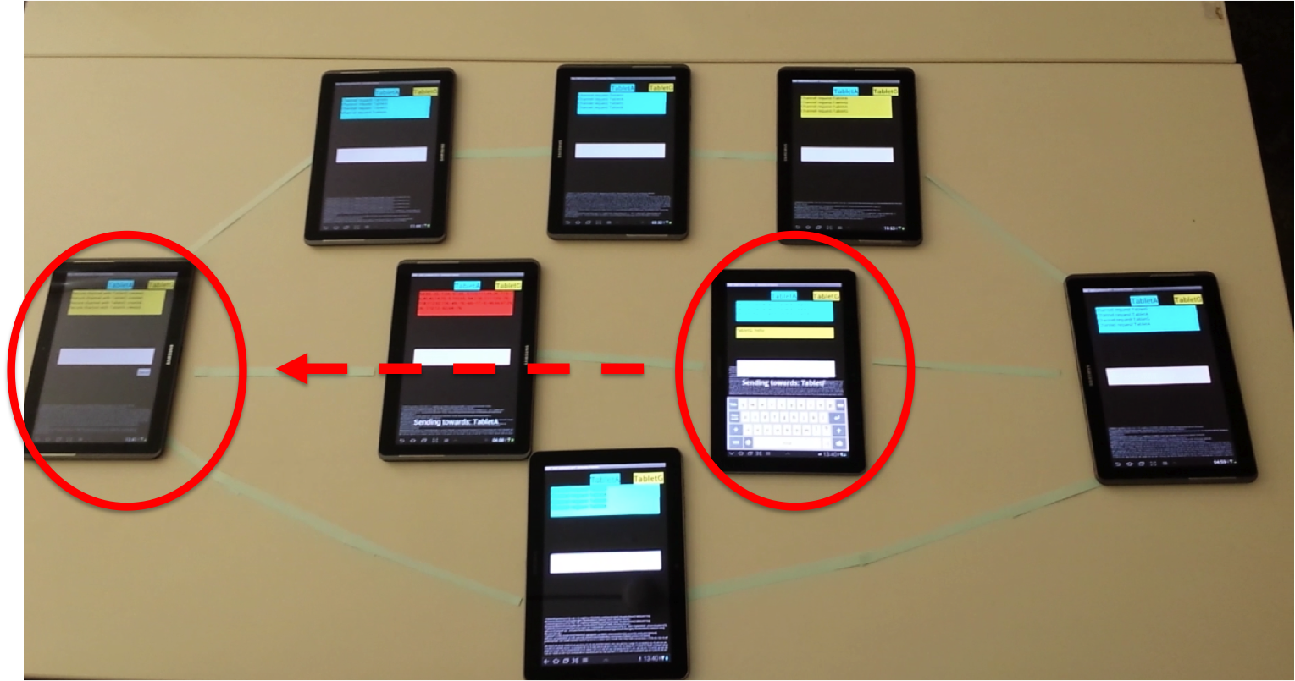
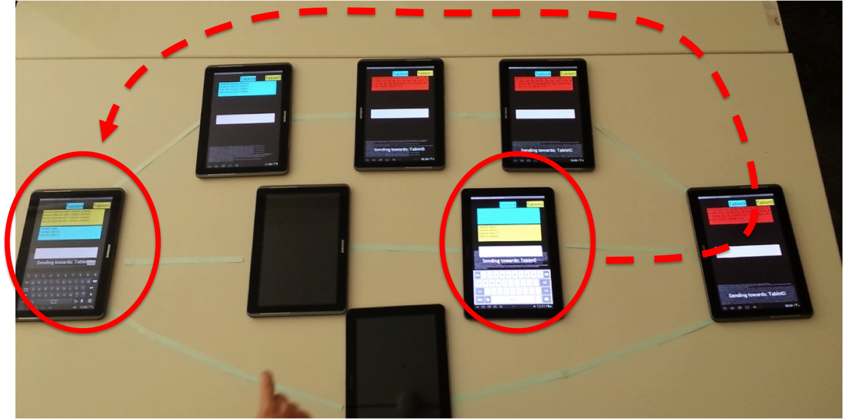
Chat using SAPERE
http://cui.unige.ch/~deangeli/videoChat.mp4

Slide 39
Vilnius – ICT 2013 Demo
http://webtv.unige.ch/ses/index.html?emission=parole-de-chercheur&videoID=parole_sapere
Notes:
Showcase three sapere concepts: diffusion, aggregation, evaporation

Slide 40
Conclusions and future work
Hardware limitations
Problem with multiple connections
Collisions, network overload
Power consumption
Continuous adaptability
Contextual information
Self-Optimisation
Controlling emergent behaviours
Downloads: www.sapere-project.eu/downloads
Notes:
1.- Mainly, biological self-organising systems are providing emergent complex behaviours based on the interaction of basic rules. Distributed systems have been taking inspiration from these systems in orden to solve self-organising problems, such as, coordinated search, pattern formation, syncronization, or coordinated navegation.
These rules are the result of thousand years of evolution, where based on the limit “intelligence” of some organisims, their behaviours have been optimised to survive. Fascinating examples are Bacteria (lookig for food, or preparing an attack), or steam cells.
2.- During the evolution of these spicies, not only the rules have evolved, also their parameters. Bio-inspired self-organising systems have demonstrate to perform very good when their parameters are perfectly tunned, However, the optimization of the paramenters is problem dependent. Some examples are ACO that used different parameters for each optimization problem, or PSO that have been changing its parameters during the last years to cover the maximum number of optimization problems. Also occur in Genetic algorithms and whatever, self-organising algorithm that exist.
How to optimise parameters is an open issue. If we look at nature we see that parameters evolve to ensure the survivance of the species, but the cost is year and years of evolution and the dead of many individuals that were not properly adapted. We can’t not afford this solution in real time systems.

Slide 41
Bibliography
[FMDMSM+12] Jose Luis Fernandez-Marquez, Giovanna Di Marzo Serugendo, Sara Montagna, Mirko Viroli, and Josep Lluis Arcos. Description and composition of bio-inspired design patterns: a complete overview. Natural Computing Journal, 2012.
[FMDMSM11] Jose Luis Fernandez-Marquez, Giovanna Di Marzo Serurendo, and Sara Montagna. Bio-core: Bio-inspired self-organising mechanisms core. In 6th International ICST Conference on Bio-Inspired Models of Network, Information, and Computing Systems (Bionetics), December 2011.
[MVR+11] Sara Montagna, Mirko Viroli, Matteo Risoldi, Danilo Pianini, and Giovanna Di Marzo Serugendo. Self-organising pervasive ecosystems: A crowd evacuation example. In Proceedings of the 3rd International Workshop on Software Engineering for Resilient Systems, volume 6968 of Lecture Notes in Computer Science, pages 115-129. Springer-Verlag, 2011.
[TRGDM11] Akla-Esso Tchao, Matteo Risoldi, and Giovanna Giovanna Di Marzo. Modelling self-* systems using chemically inspired composable patterns. In IEEE Self-Adaptive and Self-Organising Systems Conference (SASO'2011), pages 109-118, 2011.
[FMADMS+11] Jose Luis Fernandez-Marquez, Josep Lluis Arcos, Giovanna Di Marzo Serugendo, Mirko Viroli, and Montagna Sara. Description and composition of bio-inspired design patterns: The gradient case. In Workshop on Bio-Inspired and Self-* Algorithms for Distributed Systems (BADS'2011), pages 25-32. ACM, 2011.
[FMADMSC11] Jose Luis Fernandez-Marquez, Josep Lluis Arcos, Giovanna Di Marzo Serugendo, and Matteo Casadei. Description and composition of bio-inspired design patterns: the gossip case. In Proc. of the Int.Conf. on Engineering of Autonomic and Autonomous Systems (EASE'2011), pages 87-96. IEEE Computer Society, 2011.

Slide 42
Bibliography
[CTSC+2003] Christian Tschudin: "Fraglets - a Metabolistic Execution Model for Communication Protocols", Proc. 2nd Annual Symposium on Autonomous Intelligent Networks and Systems (AINS), Menlo Park, USA, Jul 2003.
[LYAMA1+2005] Lidia Yamamoto, Christian Tschudin: "Experiments on the Automatic Evolution of Protocols using Genetic Programming", to appear in Proc. 2nd IFIP Workshop on Autonomic Communication (WAC 2005), Athens, Greece, October 2005. Extended version in Univ. Basel Tech. Report CS-2005-002, April 2005.
[LYAMA2+2005] Lidia Yamamoto, Christian Tschudin: "Genetic Evolution of Protocol Implementations and Configurations", Proc. IFIP/IEEE International Workshop on Self-Managed Systems & Services (SelfMan'05), May 2005, Nice, France.
[FDR+2009] F. Dressler, I. Dietrich, R. German, and B. Kr¨uger, “A rule-based system for programming self-organized sensor and actor networks,” Comput. Netw., vol. 53, pp. 1737–1750, 2009.
[FZAM2011] F. Zambonelli, G. Castelli, L. Ferrari, M. Mamei, A. Rosi, G. Di Marzo, M. Risoldi, A.-E. Tchao, S. Dobson, G. Stevenson, J. Ye, E. Nardini, A. Omicini, S. Montagna, M. Viroli, A. Ferscha, S. Maschek, B. Wally, "Self-aware Pervasive Service Ecosystems", The European Future Technologies Conference and Exhibition 2011, Procedia Computer Science, 7: 197-199, 2011.

Slide 43
Thank you!
Giovanna Di Marzo Serugendo
Jose-Luis Fernandez-Marquez
University of Geneva
Giovanna.Dimarzo@unige.ch
Joseluis.Fernandez@unige.ch

