Slide 1
Self-Organising Design Patterns
Giovanna Di Marzo Serugendo
Jose-Luis Fernandez-Marquez
University of Geneva
Giovanna.Dimarzo@unige.ch
Joseluis.Fernandez@unige.ch
Notes:
Application of Self-Organising patterns in smart cities.
---------------------------------------------------------------------------
Spreading: - Free parking. - Emergency Evacuation of the city. - An accident.
–Aggregation: - - Car Navegation: Average cars' speed in one road. Maximum car speed. - Counting attendants in massive events (e.g. strikes, manifest…) - whatever statistic about a massive event or… even the whole city. - Average power consumption of each street. - Average pollution of the streets. - Point of the city with highest pollution.
Evaporation: - Information indicating and accident or a blackice or pothole. - Repulsion: - Hovering Information: covering an area with the minimum number of nodes providing the information
- Gradients: - Finding a friends. - Chat. -
- Gossip: - Voting best artist in a music festival. - Voting the best day for having the next meeting.
- Morphogenesis: - Change of role base on the position. 3 emergency exits spread gradients, I will know my relative position based on the distance of the 3 emergency exits and my behaviour will change based on that information. It is a local choice. - Changing traffic signals for reducing pollution peaks in the city. Cars would be deviated in order to reduce the pollution in a determine area where a peak of pollution has been detected.
- Flocking: - Driving semiautonomous vehicles. Imagine 5 cars. the first one is driven by a person, and the other are automatically following the first one. - Drones. Finding survivors, or ad-hoc links between emergency services (EPFL example) - google ballons
- Quorum sensing: - When a digital signal should change. Imagine that a road is getting overload… collaboratelly we should be able to decide when the road is getting overload, and indicates other car to take another road. Many signal should change at the some time
. - Chemotaxis: - Whatever routing application. -

Slide 2
Outline
Inspiration / Motivation
Self-organising Mechanisms as Design Patterns
SAPERE / Separation of Concerns
Case study: Crowd Steering
Notes:
Self-organizing design patterns
Execution models for engineering self-organizing systems
Make an outline and repeat the slide

Slide 3
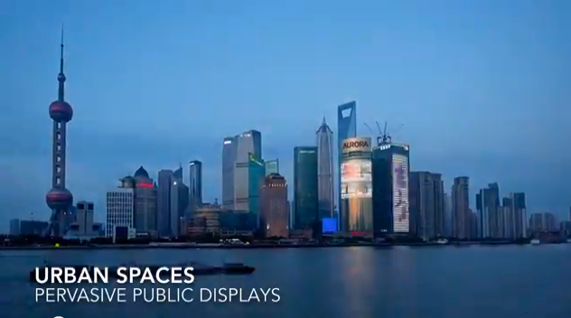
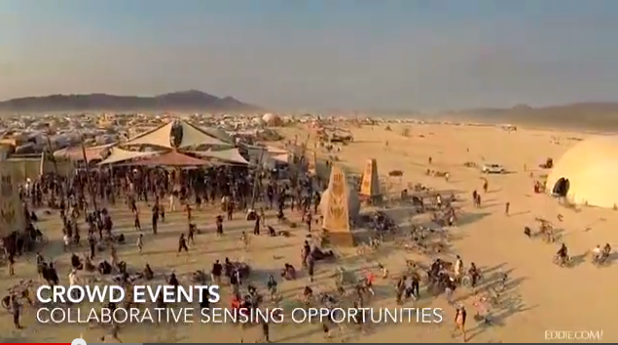
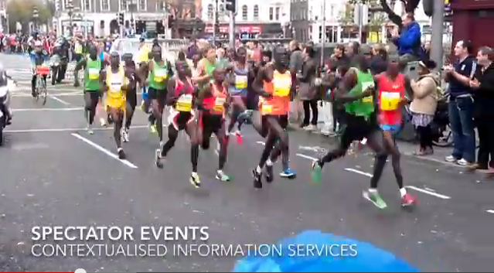
SAPERE Video
http://www.youtube.com/watch?v=nSIPesWIDx8&feature=youtu.be

Slide 4
Spatial Structures and Services

Slide 5
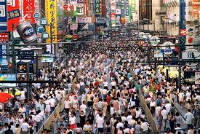
Self-organising services
Self-organising mechanisms … provided as services
Crowd Steering
Chemotaxis
Gradient
Spreading

Slide 6
Motivation
Engineering self-organising applications and services in pervasive system, such that:
(Re-)use of code, easing the design and implementation of bio-inspired applications.
Set of bio-inspired mechanisms provided as low-level services
Creation of spatial structures through dedicated services
Used as a basis to build applications or high level services.
Low-level services are requested on demand by applications or high level services
Low-level services are embedded in a middleware
[FMADMSC11, FMADMS+11, FMDMSM+12]
Notes:
Hovering information model that is our main model for dynamic storing data in mobile environments.
WE make contributions…..

Slide 7
Motivation
Engineering of complex systems
Environment
Software Agents / Applications (autonomous entities)
Self-* Mechanisms / Services
Middleware infrastructures
Self-* mechanisms (bio-inspired)
Expressed under the form of design patterns
Composition / inter-relations and boundaries among mechanisms

Slide 8
Self-organising services
Crowd Steering
Chemotaxis
Gradient
Spreading
Self-organising mechanisms … provided as services

Slide 9
Spatial Structures and Services

Slide 10
Motivation
Engineering self-organising applications and services in pervasive system, such that:
(Re-)use of code, easing the design and implementation of bio-inspired applications.
Set of bio-inspired mechanisms provided as low-level services
Creation of spatial structures through dedicated services
Used as a basis to build applications or high level services.
Low-level services are requested on demand by applications or high level services
Low-level services are embedded in a middleware
[FMADMSC11, FMADMS+11, FMDMSM+12]
Notes:
Hovering information model that is our main model for dynamic storing data in mobile environments.
WE make contributions…..

Slide 11
Motivation
Engineering of complex systems
Environment
Software Agents / Applications (autonomous entities)
Self-* Mechanisms / Services
Middleware infrastructures
Self-* mechanisms (bio-inspired)
Expressed under the form of design patterns
Composition / inter-relations and boundaries among mechanisms

Slide 12
Outline
Inspiration / Motivation
Self-organising Mechanisms as Design Patterns
SAPERE / Separation of Concerns
Case study: Crowd Steering
Notes:
Self-organizing design patterns
Execution models for engineering self-organizing systems
Make an outline and repeat the slide

Slide 13
Self-organising mechanisms expressed as design patterns

Slide 14
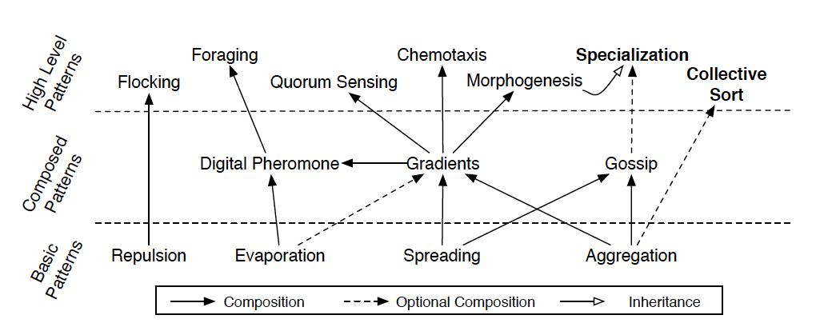
Self-Organising Design Patterns
Notes:
MODIFY PICTURE TO ADD – DYNAMIC GRADIENT + SPECIALIZATION AND CLUSTERING

Slide 15
Design Patterns
Design Patterns’ Catalogue
Self-organising mechanisms recurrent and frequently involved in more complex mechanisms
Identification of:
Inter-relations between mechanisms
Boundaries of each mechanism
Classification into three levels
[FMDMSM+12]

Slide 16
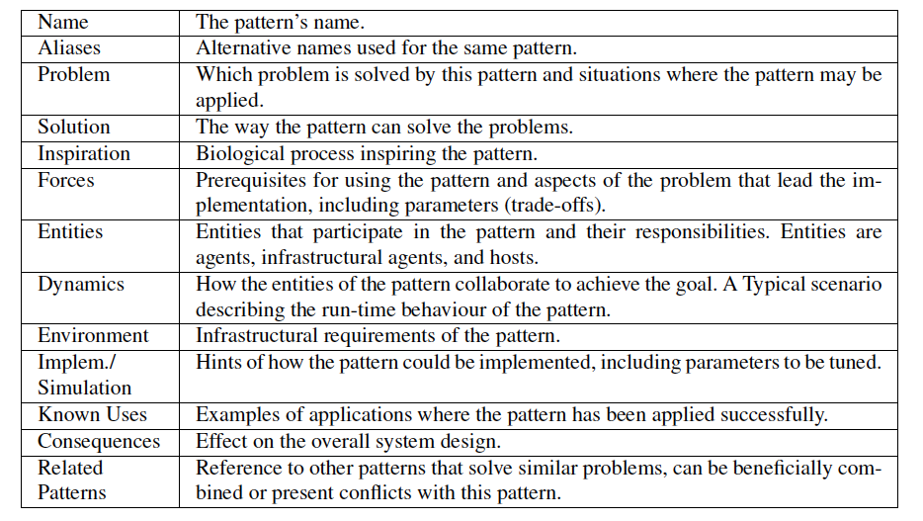
Self-Organising Design Patterns
Description
Abstract Transition Rule
Sequence Diagram, Implementation details, Explanations
Notes:
(i) the left-hand side (reagents) specifies which tuples are involved in the
transition rule: they will be removed as an effect of the rule execution; (ii) the righthand
side (products) specifies which tuples are accordingly to be inserted back in the
specified locations: they might be new tuples, transformation of one or more reagents
or even unchanged reagents; and (iii) rate r is a rate, indicating the speed/frequency
L:location C: content

Slide 17
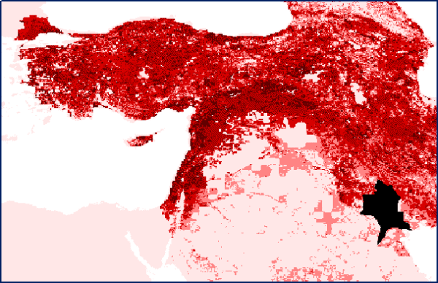
Spreading
http://ergodd.zoo.ox.ac.uk/eurasia/Eurasian%20Street%20Web/Studies/animations/Sim_30_608_393_smoothed.gif
Notes:
Eurasian animal disease spreading

Slide 18
Spreading
Problem:
in systems, where agents perform only local interactions, agents’ reasoning suffers from the lack of knowledge about the global system.
Solution:
a copy of the information (received or held by an agent) is sent to neighbours and propagated over the network from one node to another. Information spreads progressively over the system and reduces the lack of knowledge of the agents while keeping the constraint of the local interaction.
Entities – Dynamics – Environment
Usage
Information dissemination
Notes:
A function nu(L) is given for determining the sequence of
locations, among the neighbours of L, to which the information
in input has to be spread. The set of such locations
cannot be empty, cannot be composed of L only, but can be
composed of all the neighbourhood of L including L itself.
A function sigma(C, L) is given for computing the new information
content, which may change within the spreading
process.

Slide 19
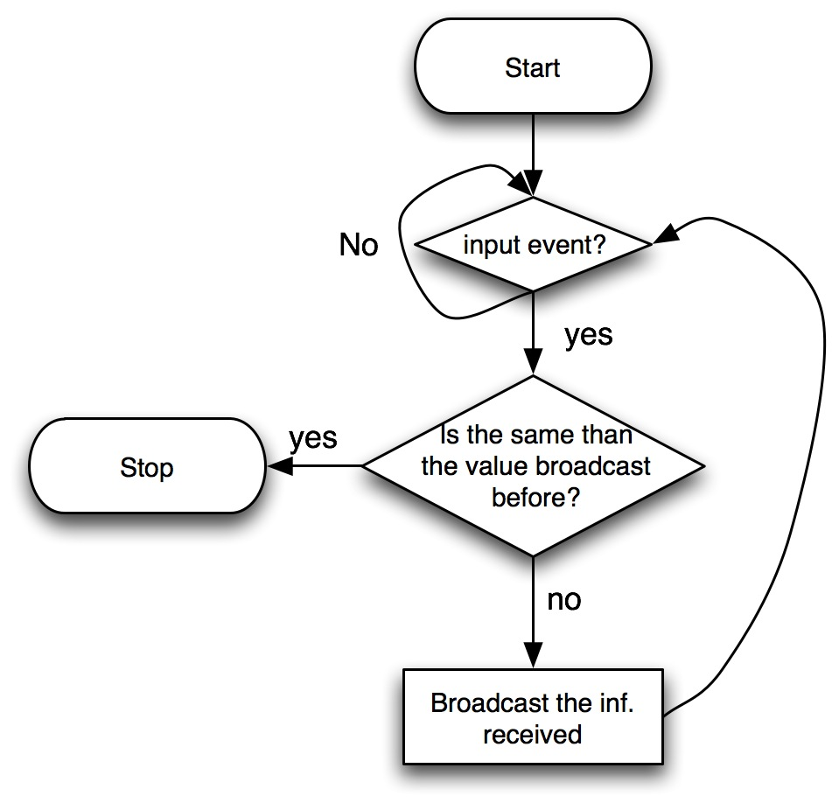
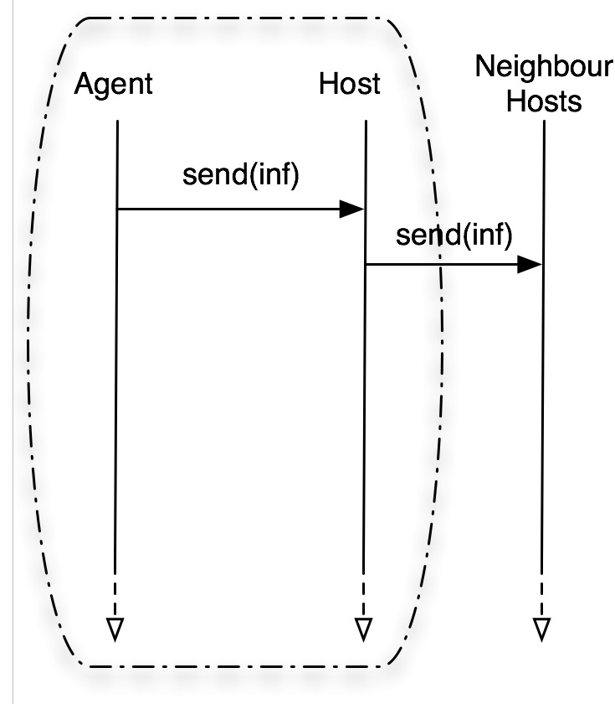
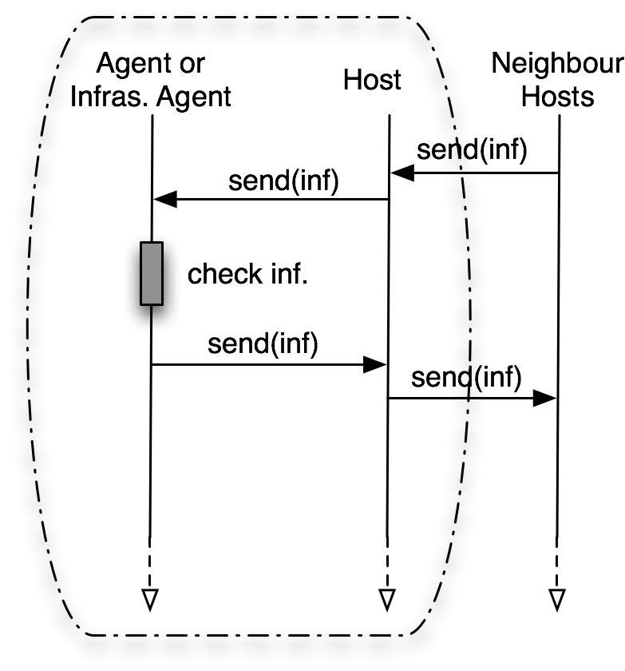
Spreading
Implementation
Notes:
ADD EXAMPLES OF APPLICATIONS

Slide 20
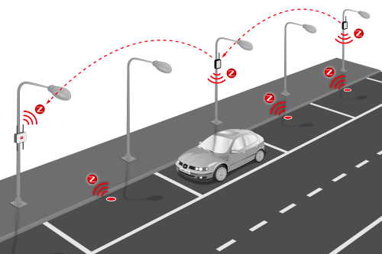
Smart Parking
http://www.libelium.com/smart_parking/
Notes:
The new Smart Parking sensor – part of Libelium’s Smart Cities solution – is designed to be buried in parking spaces and to detect the arrival and departure of vehicles. The Smart Parking platform will allow system integrators to offer comprehensive parking management solutions to city councils. By providing accurate information on available parking spaces, motorists save time and fuel and cities reduce atmospheric pollution and congestion.
Other examples:
emergency evacuation
accident

Slide 21
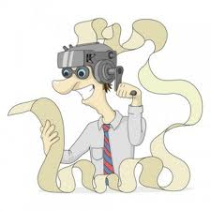
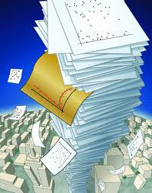
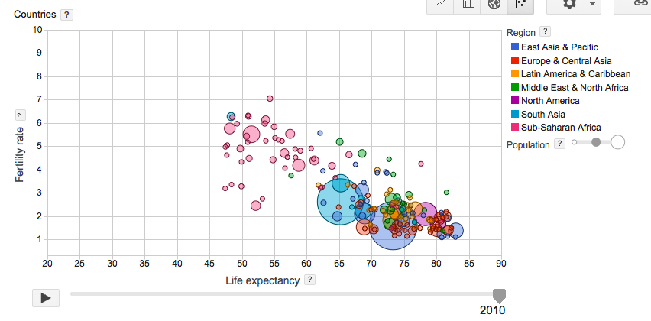
Aggregation
Notes:
What does it mean to aggregate? What is the purpose?

Slide 22
Aggregation
Problem:
Excess of information produces overloads. Information must be distributively processed in order to reduce the amount of information and to obtain meaningful information.
Solution
Aggregation consists in locally applying a fusion operator to synthesise macro information (filtering, merging, aggregating, or transforming)
Entities – Dynamics – Environment
Usage
Aggregation of pheromones, fusion of information, context-awareness
Notes:
Merge=? Combine(possibly change type)
Aggregate=? Make tuples
Filter = subset
Transfor = change type
information in input (possibly a set of information) is
transformed into a new set of information with smaller
cardinality then the input set through an aggregation
Function alpha.

Slide 23
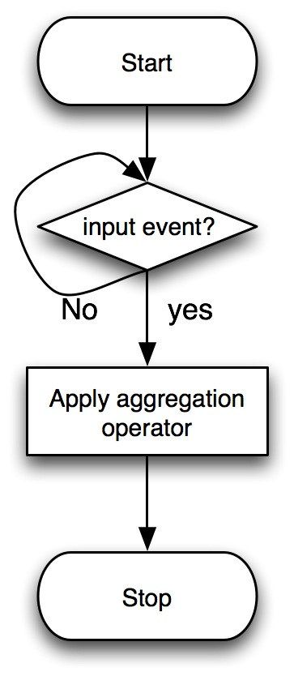
Aggregation
Implementation

Slide 24
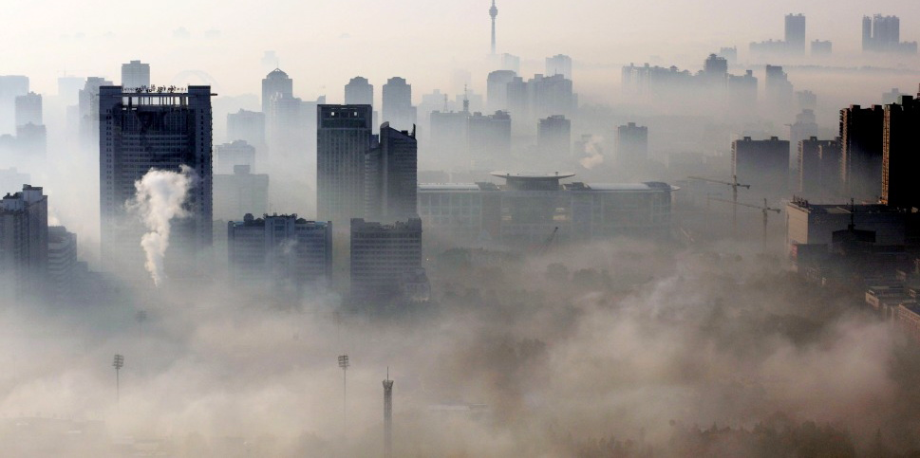
Measure Average Pollution / Highest Pollution Point

Slide 25
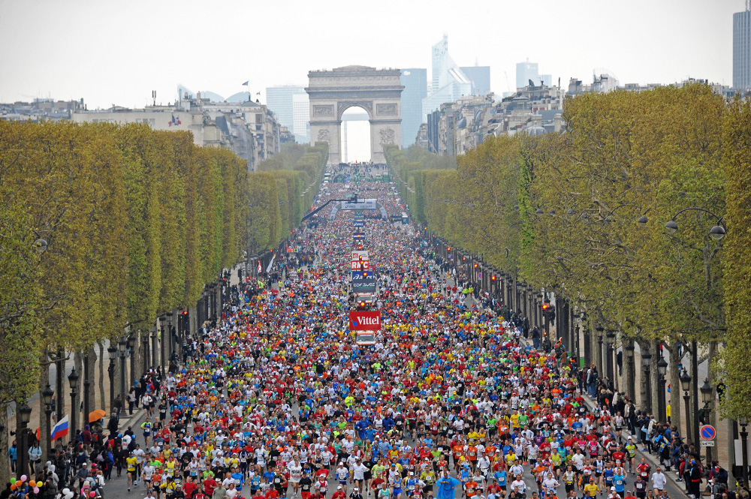
Measure density of people

Slide 26
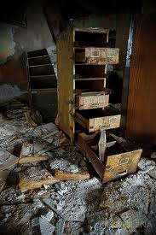
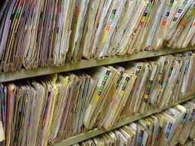
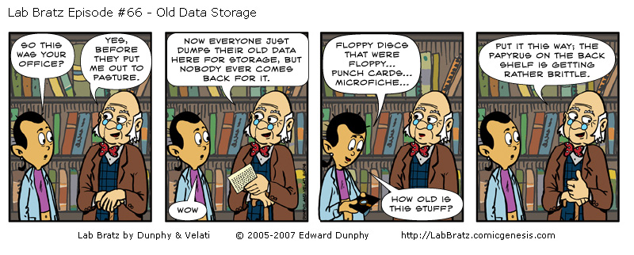
Evaporation

Slide 27
Evaporation
Problem:
Outdated information cannot be detected and it needs to be removed, or its detection involves a cost that needs to be avoided. Agent decisions rely on the freshness of the information presented in the system, enabling correct responses to dynamic environments.
Solution
Evaporation is a mechanism that periodically reduces the relevance of information. Thus, recent information becomes more relevant than older information.
Entities – Dynamics – Environment
Usage
Digital pheromone, context-awareness (ageing information)
Notes:
The rule affects the relevance value contained in C
applying the function epsilon that can reduced (ratio or amount) de value of C

Slide 28
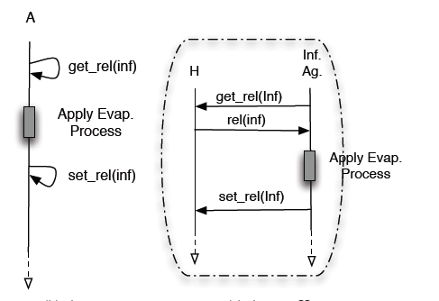
Evaporation
Implementation

Slide 29
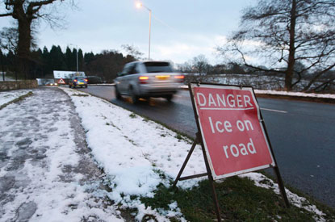
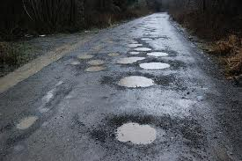
Ice on Road / Potholes
Remove information when no longer useful
Notes:
Evaporation to remove the info if finished or not true, to be used in conjunction with reinforcement

Slide 30
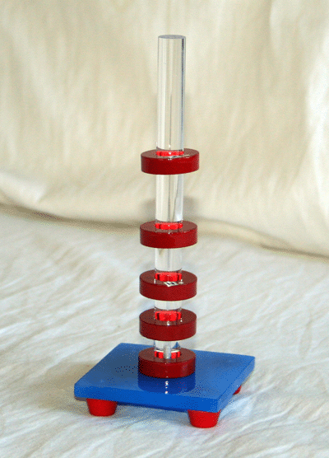
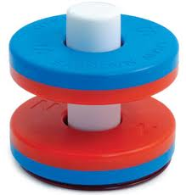
Repulsion
Notes:
Floating magnets
When should we use repulsion, for what reason?

Slide 31
Repulsion
Problem:
Agents’ movements have to be coordinated in a decentralised manner in order to achieve a uniform distribution and to avoid collisions among them
Solution
The Repulsion Pattern creates a repulsion vector that guides agents to move from regions with high concentrations of agents to regions with lower concentrations. Thus, after few iterations agents reach a more uniform distribution in the environment
Entities – Dynamics – Environment
Usage
Shape formation
Notes:
A function rho is given for
computing the new location of the information or of the
agent according to the spatial distribution of the neighbours
and to its actual position. An example of such a function
follows. Function rho depends also on the values of attributes
contained in C, for instance the concentration of particles
in each location.

Slide 32
Repulsion
Implementation

Slide 33
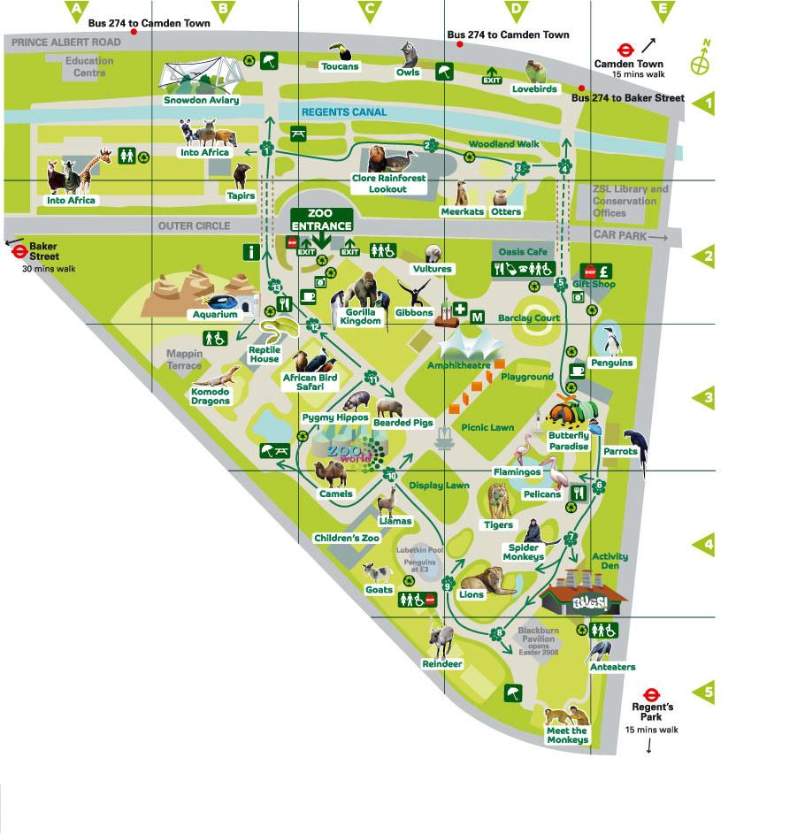
Spatial Memory Service
Special Gorilla Exhibition at 3pm
Time: 2.30pm-3pm
Accessibility: Public 80%
Area: Gorilla Kingdom
London Zoo

Slide 34
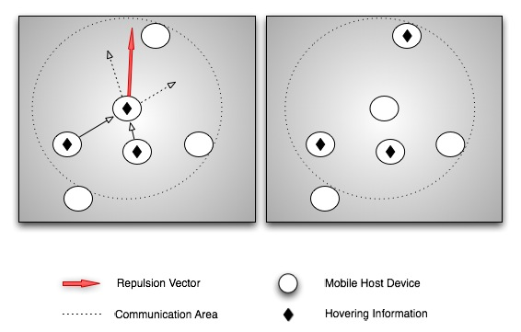
Spatial Memory Service
Repulsion
Information
moves to node
closest to
repulsion
vector

Slide 35
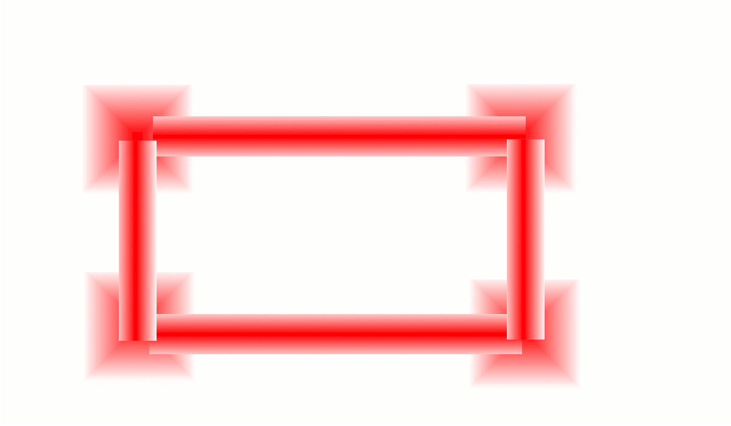
Spatial Memory Service

Slide 36
Self-Organising Design Patterns
Notes:
MODIFY PICTURE TO ADD – DYNAMIC GRADIENT + SPECIALIZATION AND CLUSTERING

Slide 37
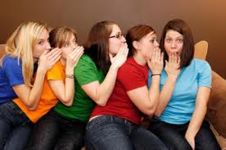
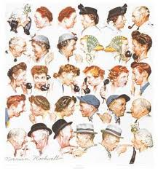
Gossip
Notes:
Gossip name is used for spreading without modification/aggregation

Slide 38
Gossip
Problem:
in large-scale systems, agents need to reach an agreement, shared among all agents, with only local perception and in a decentralised way
Solution
information spreads to neighbours, where it is aggregated with local information. Aggregates are spread further and their value progressively reaches the agreement
Entities – Dynamics – Environment
Usage
Computation of sums, averages
Notes:
Nu: list of neighbours
Alpha: aggregation function

Slide 39
Gossip
Implementation:

Slide 40
Reaching an agreement / Voting best artist

