Slide 1
Sequences searching and sorting
Gilles Falquet
Université de Genève/GSEM MSc. Business Analytics

Slide 2
Content
List
Value searching
Sorting
Order statistic

Slide 3
Lists
A list is an indexed sequence of values, called elements.
The indices are the non-negative integers, the elements can have any type
indices
0
1
2
3
4
5
elements
45
3
45
-1
8
-9

Slide 4
Lists: Indexed, extensible, mutable sequences
Indexed ⇒
operation to get the element at index i
s[i]
Mutable ⇒
operation to set the element at index i
s[i] = e
Extensible ⇒
operation to insert or append or remove elements
s.append(e)
s.insert(i, e)
s.pop(i)

Slide 5
List operations
Creation
a = ["bang", "zebra", "flower"]
b = [] # an empty list
c = [0 for x in range(10)] # ⇒ [0, 0, 0, 0, 0, 0, 0, 0, 0, 0]
d = [x*x for x in range(-5,6)] # ⇒ [25, 16, 9, 4, 1, 0, 1, 4, 9, 16, 25]

Slide 6
List operations
Access
a = ["bang", "zebra", "flower"]
v = a[0] # ⇒ v = "bang"
h = a[2] # ⇒ h = "flower"
i = a[3] # ⇒ ** runtime error

Slide 7
List operations
a = ["bang", "zebra", "flower"]
Mutation
a[2] = "shadow" # ⇒ a = ["bang", "zebra", "shadow"]
Expansion and contraction
a.append("fog") # ⇒ a = ["bang", "zebra", "shadow", "fog"]
a.insert(1, "five") # ⇒ a = ["bang", "five", "zebra", "shadow", "fog"]
w = a.pop(2) # ⇒ w = "zebra"
# a = ["bang", "five", "shadow", "fog"]

Slide 8
Finding a Value in an Indexed Sequence
Pre-condition: $a$ is sequence, $x$ is an object
Post-condition:
$i$ is the smallest integer such that $a[i] == x$
or $i = −1$ and $x$ is nowhere in $a$

Slide 9
Finding a Value in an Indexed Sequence
Algorithm: examine successively all the elements of the sequence (in any order)
def find(x: int, a: list[int]) -> int :
i = 0
while i < len(a) and a[i] != x :
i += 1
if i == len(a) :
return -1 # not found
else:
return i

Slide 10
Reminder about the and operation
not evaluated when i < len(a) is False
i = 0
while i < len(a) and a[i] != x : i += 1
i = 0
while a[i] != x and i < len(a) : i += 1
evaluated when i = len(a) ⇒ runtime error : a[len(a)] is undefined

Slide 11
Computational cost (efficiency)
for an array of size $n$
worst case: when $x$ is not in $a$
⇒ number of iterations = $n$
⇒ Real computing time is approximately proportional to $n$

Slide 12
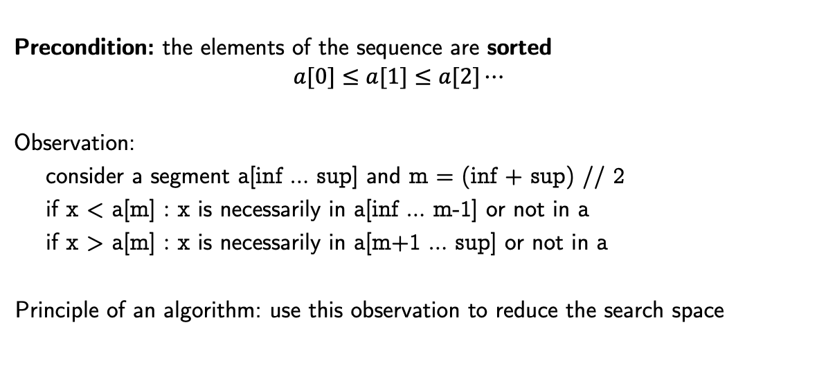
Binary Search
Precondition: the elements of the sequence are sorted
$$a[0]≤a[1]≤a[2]⋯$$
Observation:
consider a segment a[inf … sup] and m = (inf + sup) // 2
if x < a[m] : x is necessarily in a[inf … m-1] or not in a
if x > a[m] : x is necessarily in a[m+1 … sup] or not in a
Principle of an algorithm: use this observation to reduce the search space

Slide 13
Looking for 45
0
9
18
1 4 7 11 21 22 23 45 59 86 101 109 204 207 333 375 408 1002 1304
45 < 86
1 4 7 11 21 22 23 45 59 86 101 109 204 207 333 375 408 1002 1304
45 > 21
1 4 7 11 21 22 23 45 59 86 101 109 204 207 333 375 408 1002 1304
45 > 23
1 4 7 11 21 22 23 45 59 86 101 109 204 207 333 375 408 1002 1304
45 = 45
0
4
8
5
6
8
7
8

Slide 14
def bin_search(x: int, a: list[int]) -> int:
inf, sup = 0, len(a) - 1
m = (inf + sup) // 2
while inf <= sup:
m = (inf + sup) // 2
if a[m] == x : inf = sup + 1 # force stop at next iteration
elif x > a[m]: inf = m + 1
else: sup = m – 1
if len(a) > 0 and a[m] == x: return m
else: return -1

Slide 15
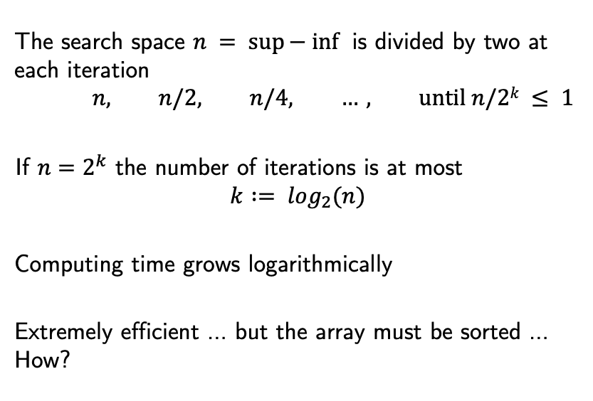
Efficiency
The search space $n = sup⁡− inf⁡$ is divided by two at each iteration
$$n, n/2, n/4, …, until n/2k ≤ 1$$
If $n=2^{k}$ the number of iterations is at most
$$k := \log_{2}(n)$$
Computing time grows logarithmically
Extremely efficient … but the array must be sorted … How?
n = 1000 → 10 iterations
n = 1000000 → 20 iterations
n = 1000000000 → 30 iterations

Slide 16
The Sorting (in Place) Problem
Given a sequence $a$, reorder the elements of $a$ such that after the process
$a$ is sorted: $a\left[0\right]≤a\left[1\right]≤a\left[2\right]≤⋯$
nothing is lost or created $⇔$ the final content $a$ is a permutation of the initial content

Slide 17
Selection Sort
Find the smallest element of a and exchange it with a[0]
Find the smallest element of a[1 … n-1] and exchange it with a[1]
Find the smallest element of a[2 … n-1] and exchange it with a[2]
etc.
https://gifimage.net/wp-content/uploads/2018/05/selection-sort-gif-12.gif

Slide 18
def selection_sort(a: list[int]) :
n = len(a)
for i in range(n-1) :
# find the index of the smallest element in a[i ... n-1]
min_j = i
for j in range(i+1, n) :
if a[j] < a[min_j] : min_j = j
a[i], a[min_j] = a[min_j], a[i] # exchange

Slide 19
sorting [8, 2, 4, 9, 3, 6]
j =
1
2
3
4
5
2
3
4
5
3
4
8 2 4 9 3 6
8 2 4 9 3 6
8 2 4 9 3 6
8 2 4 9 3 6
8 2 4 9 3 6
2 8 4 9 3 6
2 8 4 9 3 6
2 8 4 9 3 6
2 8 4 9 3 6
2 8 4 9 3 6
2 3 4 9 8 6
. . .
def selection_sort(a: list[int]) :
n = len(a)
for i in range(n-1) :
min_j = i
for j in range(i+1, n) :
if a[j] < a[min_j] : min_j = j
a[i], a[min_j] = a[min_j], a[i]
i = 0
i = 1
a[min_j]
a[j]

Slide 20
Computational cost
n = len(a)
for i in range(n-1) :
min_j = i
for j in range(i+1, n) :
if a[j] < a[min_j] : min_j = j
a[i], a[min_j] = a[min_j], a[i]
executed
n-1 times
executed
n-(i+1) times
The comparison a[j] < a[min_j]is executed
$\left(n−1\right)+\left(n−2\right)+…+2+1$ = $\left(n−1\right)n/2$ times
The execution time is quadratic : ${an}^{2}+bn+c$

Slide 21
Insertion sort
Suppose the segment a[0 ... j-1] is already sorted
Consider a[j] and shift it downwards (to the left) to the appropriate position
sorted part
a[j]
2
3
3
5
6
8
4
. . .
j
2
3
3
4
5
6
8
. . .
sorted part
While a[j] moves downwards the elements before it move upwards
Do this for j = 1, 2, ..., len(a)

Slide 22
Example:
8 2 4 9 3 6
8 2 4 9 3 6
2 8 4 9 3 6
2 4 8 9 3 6
2 4 8 9 3 6
2 3 4 8 9 6
j=1
j=2
j=3
j=4
j=5

Slide 23
Algorithm to put a[j] in place
x = a[j]
i = j – 1
while i >= 0 and a[i] > x :
a[i+1] = a[i] # move a[i] forward
i = i-1
a[i+1] = x # put x (i.e. a[j]) in place

Slide 24
Complete algorithm
def insertion_sort(a: list[int]) :
for j in range(1, len(a)) :
x = a[j]
i = j – 1
while i >= 0 and a[i] > x :
a[i+1] = a[i] # move a[i] forward
i = i-1
a[i+1] = x # put x (i.e. a[j]) in place

Slide 25
What about the efficiency of this algorithm?
for j in range(1, len(a)) :
x = a[j]
i = j – 1
while i >= 0 and a[i] > x :
a[i+1] = a[i]
i = i-1
a[i+1] = x
executed
n-1 times
executed min 0 max j times
for j = 1, 2, ..., n-1

Slide 26
Case analysis
Best case: the array is already sorted
⇒ execution time is linear in n
Worst case: the array is in reverse order
⇒ execution time is quadratic of the form t(n) = c(n² – n)/2+k
Average case (random permutation)
execution time is quadratic of the form t(n) = c(n² – n)/4+k
Better than selection sort when the array is already sorted or partially sorted

Slide 27
Order statistic – kth-smalest value
In statistics, the kth order statistic of a statistical sample is equal to its kth-smallest value. Together with rank-statistics , order statistics are among the most fundamental tools in non-parametric statistics and inference [Wikipedia]
Problem: How to find the kth-smallest value of a list?
Obvious solution: sort the list and return the kth element
Can we do better?

Slide 28
Algorithmic idea – problem reduction
Pick an element p of the list a
Rearrange the elements of the list to obtain
a[0] ≤ p, …, a[ip-1] ≤ p, a[ip] = p, a[ip+1] > p, …, a[len(a)-1] > p
if k = ip+1 the kth-smallest element is p
if k < ip+1 the kth-smallest element is the kth-smallest element of a[0 … ip-1]
if k > ip+1 the kth-smallest element is the (k-ip-1)th-smallest element of a[ip+1 … len(a)-1]

Slide 29
Rearranging the elements
p
L
H
L
H
≤p
> p
L
H
≤p
≤ p
> p
L
H
≤p
> p
> p
etc.

Slide 30
def rearrange(a: list[int]) -> int:
low, high = 0, len(a)-1
p = a[high] # improvement: first exchange a[high//2] and a[high]
while low < high:
while low < high and a[low] <= p : low += 1
if low < high :
a[high] = a[low]
high -= 1
while high > low and a[high] > p : high -= 1
if low < high :
a[low] = a[high]
low += 1
a[high] = p
return high

Slide 31
def kthsmallest(a: list[int], k: int) -> int :
"""
precondition: 1 ≤ k ≤ len(a)
"""
if len(a) == 1 : return a[0]
else:
ip = rearrange(a)
if k == ip+1 : return a[ip]
if k < ip+1 : return kthsmallest(a[0:ip], k)
else: return kthsmallest(a[ip+1: len(a)], k-ip-1)

Slide 32
Efficiency, for a list of size $n$
The search space shrinks with each iteration
from a to a[0 … ip-1] or a[ip+1 … n-1]
with an expected value (n-1)/2
At each iteration the number of comparisons = length of the search space (a)
⇒ The expected value of the number of comparisons is
$\left(1+\frac{1}{2}+\frac{1}{4}+\frac{1}{8}+…\right)n<2n$ (linear)
But the worst case is $n^{2}$(however, extremely improbable)

