Slide 1
Databases II
Gilles Falquet
Centre universitaire d'informatique
UniGE

Slide 2
Content
More database querying operations
Databases and programming
Update operations
Integrity constraints

Slide 3
SQL … MORE OPERATIONS
Aggregation
Grouping
Subqueries
Null values and ternary logic

Slide 4
Aggregation operations (sum, avg, count, min, max)
Compute values that depend on the whole set of selected rows of table
select aggregation-operation (column), ...
from ...
where ...
Apply the selection operations (from ... where ...)
Apply the the aggregation operation on the rows that have a non NULL value for this column

Slide 5
Examples
select avg(Price)
from Sales
where Date = 2033-11-05 and ItemType = 'bicycle’
select max(Price)
from Sales
where Date = 2033-11-05 and ItemType = 'bicycle'

Slide 6
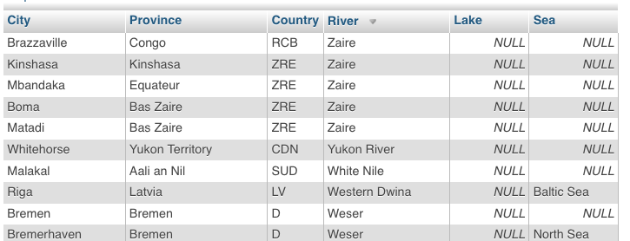
SELECT count(city) FROM located
==>> 857
SELECT count(lake) FROM located
==>> 49
SELECT count(distinct lake) FROM located
==>> 27

Slide 7
Grouping
tables
select, join, project
Make groups with the result of a select operation
Criteria: groups tuples with the same value for an attribute (or expression)
The attributes must be aggregated, except for the grouping attribute
group by
aggregation functions

Slide 8
Sales
Quantity | Item | Year | Region
455 | Car | 2018 | CH
112 | Car | 2019 | FR
14 | Bus | 2019 | CH
12 | Bus | 2020 | FR
712 | Car | 2020 | CH
9 | Bus | 2021 | FR
select Region, sum(Quantity), min(Year)
from Sales
group by Region
Region | sum(Quantity) | min(Year)
CH | 1181 | 2018
FR | 132 | 2019

Slide 9
Subqueries
The selection part (where) of a query may contain a subquery
The result of a subquery is either a single value or a multi-set of values
select Item
from Sales
where Quantity > (select avg(Quantity) from Sales) -- one value
select Item
from Sales
where Region in (select Region from World where Continent = 'Europe')

Slide 10
Subqueries and ANY
SELECT ... FROM T
WHERE A operator ANY (SELECT B FROM T2 WHERE condition);
A tuple t is selected if there exist at least one value u in (SELECT B FROM T2 WHERE condition) such that
t.A operator u is true.
SELECT name, population FROM city
WHERE population < any (SELECT population FROM city WHERE country = 'CH')

Slide 11
Subqueries and ALL
SELECT ... FROM T
WHERE A operator ALL (SELECT B FROM T2 WHERE condition);
A tuple t is selected if for every value u in (SELECT B FROM T2 WHERE condition)
t.A op u is true
SELECT name, population FROM city
WHERE population > ALL (SELECT population FROM city WHERE country = 'CH')

Slide 12
NULL values and three-valued logic
The domain of each attribute is extended with the special value NULL
NULL may indicate that
the actual value is unknown
no value can exist (e.g. Weight for an eBook)
etc.
Comparing NULL with another value always yields NULL (neither TRUE nor FALSE)
The select operation selects the tuples for which the condition evaluates to TRUE

Slide 13
When (P or not P) ≠ true
Wine
Region | Year | Quality
Bordeaux | 2010 | Excellent
Bourgogne | 2010 | NULL
Valais | 2014 | Excellent
Valais | 2013 | NULL
Bordeaux | 2011 | Good
select * from Wine
where Quality = Good or Quality <> Good
Region | Year | Quality
Bordeaux | 2010 | Excellent
Valais | 2014 | Excellent
Bordeaux | 2011 | Good

Slide 14
IS NULL and IS NOT NULL
Test if a value is NULL (or not NULL)
select * from Wine where Quality = NULL ⟶ empty result
select * from Wine where Quality IS NULL ⟶
Region | Year | Quality
Bourgogne | 2010 | NULL
Valais | 2013 | NULL

Slide 15
3-valued logic
OR | TRUE | FALSE | NULL
TRUE | TRUE | TRUE | TRUE
FALSE | TRUE | FALSE | NULL
NULL | TRUE | NULL | NULL
AND | TRUE | FALSE | NULL
TRUE | TRUE | FALSE | NULL
FALSE | FALSE | FALSE | NULL
NULL | NULL | NULL | NULL
NOT | TRUE | FALSE | NULL
 | FALSE | TRUE | NULL

Slide 16
NULL values and aggregation
R
A | B
aaa | 17
bbb | 19
ccc | NULL
ddd | 21
eee | NULL
NULL values are ignored
select count(*), count(B), avg(B) from R
count(*) | count(B) | avg(B)
5 | 3 | 19

Slide 17
DATABASES & PROGRAMMING
The relational algebra (and basic SQL) is not Turing complete
Some functions cannot be computed in relational algebra
The size of the result is always polynomial in the size of the relations
⇒ impossible to compute exponential size results (powerset, permutations, etc.)
Some relations cannot be expressed as a first-order logic formula on the database vocabulary
⇒ they cannot be computed in SQL
e.g. the reachability in a graph

Slide 18
Example: reachability
The edges of a graph are represented in a table Edge(source, destination, weight )
Find the nodes reachable from 'a' by following one edge
select e.destination from Edge e where e.source = 'a'
Find the nodes reachable from 'a' by following two edges
select e2.destination from Edge e1, Edge e2
where e1.source = 'a' and e1.destination = e2.source

Slide 19
Example: reachability (cont.)
Find the nodes reachable from 'a' by following k edges
select e_{k}.destination from Edge e₁, Edge e₂, ..., Edge e_{k}
where e₁.source = 'a' and e₁.destination = e₂.source
and e₂.destination = e₃.source and ... and e_{k-1}. destination = e_{k}. source
Problem: we don't know in advance the number of edges to follow to reach every reachable node. It depends on the data
Remark. This is partially solved by additional “transitive closure” or recursive query operations provided by some DBMSs

Slide 20
Programming and Databases
SQL and the relational algebra query are not Turing complete
⇒ Database Application must rely on general purpose languages
Different solutions
procedural extensions of SQL (PL/SQL, etc.)
SQL-like extensions of general-purpose languages (SQLJ, ...)
Object-Relational Mapping
libraries to invoke database services from a general-purpose languages (JDBC)
through a specific Web service interface

Slide 21
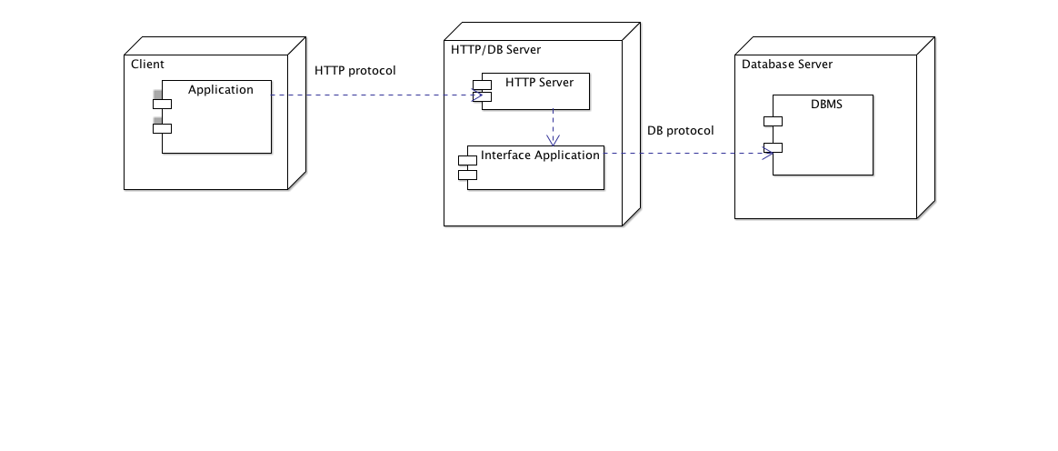
Invoking database interface service
send requests to an HTTP (web) server to invokes the interface application
get result as HTTP content (text, HTML, XML, JSON)
transform results to application language objects (Python, C, R, ...)

Slide 22
Example: a basic protocol
HTTP request: send an SQL statement
http://kr.unige.ch/phpmyadmin/query.php?db=Enviro&sql=select%20name,subregion%20FROM%20country
Returned content
Afghanistan\tSouth Asia\nAlbania\tCentral Europe\nAlgeria\tNorthern Africa\nAmerican Samoa\tSouth Pacific\nAndorra\tWestern Europe\nAngola Southern Africa\nAnguilla\tCa ribbean\nAntarctic\tAntarctic\nAntigua and Barbuda\tCaribbean\nArgentina\tSouth Amer ica\nArmenia\tEastern Europe\nAruba\tCaribbean\nAustralia\tAustralia + New Zealand\n Austria\tWestern Europe\n ...

Slide 23
In Python: send a query to an http server
from urllib.request import urlopen
from urllib.parse import quote, urlencode
def cities_on_river(r: str) -> set[str] :
q = "select city from located where river = '" + r + "'"
eq = quote(q)
url = "http://kr.unige.ch/phpmyadmin/query.php?db=mondial&sql=" + eq
query_results = urlopen(url)
cities = set()
for line in query_results :
string_line = line.decode('utf-8').rstrip()
columns = string_line.split("\t")
cities.add(columns[0])
query_results.close()
return cities

Slide 24
Problem 1: Model Mismatch
necessary to convert between the application data structure and the database schema
a graph in a relational DB
create table EDGE(fromNode INTEGER, toNode INTEGER, weight REAL)
in a Python program
g : dict[str, dict[str, float]]

Slide 25
Problem 2: A language within a language
The application must build SQL statements
⇒ concatenate SQL strings and application variables
sql = "select name from country where pop > " + max.toString
+ " and subregion = " + sr
the syntax of these SQL statements is not checked by the host language compiler
⇒ possible run-time errors

Slide 26
Problem 3: Algorithmic Design
the dbms efficiently computes selections/projections/joins (SQL statements)
(if the appropriate indexes have been set up)
⇒ do not re-invent these operations in the application !
transferring data between servers is much less efficient than in-memory transfers
⇒ reduce the number of database queries
⇒ favor "powerful" select statements
act on many data items and produce small outputs

Slide 27
Object-Relation Mapping, for example Django
https://docs.djangoproject.com/en/4.1/intro/overview/
from django.db import models
class Reporter(models.Model):
full_name = models.CharField(max_length=70)
def __str__(self):
return self.full_name
class Article(models.Model):
pub_date = models.DateField()
headline = models.CharField(max_length=200)
content = models.TextField()
reporter = models.ForeignKey(Reporter, on_delete=models.CASCADE)
def __str__(self):
return self.headline
then run the Django command-line utilities to create the database tables automatically:

Slide 28
# Import the models we created from our "news" app
>>> from news.models import Article, Reporter
# No reporters are in the system yet.
>>> Reporter.objects.all()
<QuerySet []>
# Create a new Reporter.
>>> r = Reporter(full_name='John Smith')
# Save the object into the database. You have to call save() explicitly.
>>> r.save()
# Now it has an ID.
>>> r.id
1
# Now the new reporter is in the database.
>>> Reporter.objects.all()
<QuerySet [<Reporter: John Smith>]>

Slide 29
# Fields are represented as attributes on the Python object.
>>> r.full_name
'John Smith'
# Django provides a rich database lookup API.
>>> Reporter.objects.get(id=1)
<Reporter: John Smith>
>>> Reporter.objects.get(full_name__startswith='John')
<Reporter: John Smith>
>>> Reporter.objects.get(full_name__contains='mith')
<Reporter: John Smith>

Slide 30
>>> Article.objects.all()
<QuerySet [<Article: Django is cool>]>
# Article objects get API access to related Reporter objects.
>>> r = a.reporter
>>> r.full_name
'John Smith'
# And vice versa: Reporter objects get API access to Article objects.
>>> r.article_set.all()
<QuerySet [<Article: Django is cool>]>
# The API follows relationships, performing efficient JOINs behind the scenes.
# This finds all articles by a reporter whose name starts with "John".
>>> Article.objects.filter(reporter__full_name__startswith='John')
<QuerySet [<Article: Django is cool>]>

Slide 31
DATABASE UPDATES
represents
database
state of the world
events
update operations
new state
represents
updated database

Slide 32
Insertion
insert into table(col₁, col₂, …, col_{k})
values (val₁, val₂, …, val_{k})
Add a new row r with r.col₁ = val₁, ..., r.col_{k} = val_{k}, and r.c = NULL for the other columns
Example
insert into Wine(Region, Quality, Year)
values ('Bourgogne", 'Good', 2022)

Slide 33
Deletion
delete from table
where condition
Remove all the rows that satisfy the condition
Exemple
delete from Wine where Region = 'Valais'
delete from Wine where Year < 2011

Slide 34
Modify one or more rows
update table
set col₁ = val₁, ..., col_{k} = val_{k}
where condition
For each row that satisfies the condition
Modify the values for the columns col_{k}, ..., col_{k}

Slide 35
Set the quality of the wines from Valais to Excellent for every year
update Wine set quality = 'Excellent'
where Region = 'Valais'
The current values can be used to compute the new one
update Catalogue set Price= Price * 1.05
where Category = 'Toy'

Slide 36
INTEGRITY CONSTRAINTS
Conditions that must remain true throughout the life of the database (invariants)
Generally reflect general rules of the world, or specific rules of a domain in the data
« A latitude value must lie between -90 et +90 »
« At most one course may take place in a given room and time slice »
« Every car with a licence plate must have exactly one owner »
« A course may take place only if at least 4 students have enrolled »
DBMSs can automatically check some categories of constraints

Slide 37
Constraint on a column value
Restrict the set of accepted values in a column
forbid null values (NOT NULL constraint)
specify a subtype of the domain (e.g Strings with at most 8 characters)
specify a closed list of accepted values (ENUM type)

Slide 38
Relations and their Keys
Superkey: any set of columns that have a unique combination of values in each row
Key: a minimal superkey
Primary Key: choice of a particular candidate key
Booking
room | date | start | end | event | person
M4567 | 2033-11-06 | 12:00 | 14:20 | course | Alina
M4567 | 2033-11-06 | 16:15 | 18:000 | conf | George
R0093 | 2033-11-06 | 12:00 | 14:20 | course | Luis
R0093 | 2033-01-26 | 12:00 | 14:20 | course | Alina
R7770 | 2033-01-26 | 12:00 | 14:20 | seminar | Alina

Slide 39
Relations and their Keys
Keys: {room, date, start}, {room, date, end}
Booking
room | date | start | end | event | person
M4567 | 2033-11-06 | 12:00 | 14:20 | course | Alina
M4567 | 2033-11-06 | 16:15 | 18:000 | conf | George
R0093 | 2033-11-06 | 12:00 | 14:20 | course | Luis
R0093 | 2033-01-26 | 12:00 | 14:20 | course | Alina
R7770 | 2033-01-26 | 12:00 | 14:20 | seminar | Alina

Slide 40
Key constraint
If $\{K1, …, Km\}$ is a key of a relation r
for each pair of row $u,v∈r$ $u.K_{1}≠v.K_{1}$ or … or $u.K_{m}≠v.K_{m}$
(no two tuples have the same values on $\{K1, …, Km\}$
DMBSs enforce the key constraint for the selected primary key

Slide 41
Examples
Student(StudentNo, FirstName, LastName, Faculty)
CREATE TABLE Student(StudentNo VARCHAR, FirstName VARCHAR, LastName VARCHAR, Faculty VARCHAR) PRIMARY KEY (Region, Year)
Wine(Region, Year, Quality, AvgPrice)
CREATE TABLE Wine(Region VARCHAR, Year INT, Quality VARCHAR, AvgPrice INT)
PRIMARY KEY (Region, Year)

Slide 42
Violation of the primary key constraint (Region, Year)
Region | Year | Quality | AvgPrice
Bordeaux | 2010 | Excellent | 12.34
Bourgogne | 2010 | Good | 19.55
Valais | 2014 | Excellent | 11.77
Valais | 2013 | Good | 10.33
Bordeaux | 2010 | Good | 12.34

Slide 43
Foreign key constraint
The value of a (set of) column of a table T must be a primary key value of a (reference) table
A foreign key is a set of attributes of the referring relation
If r is a relation that has a foreign key F to S and s is a relation that has a primary key K then
if t ∈ r and t.F is not NULL
then there exists u ∈ s such that t.F = u.K

Slide 44
Example
Real-world constraint
« A French university is located in a French departement. »
Database constraint
The inDept column of the University table is a foreign key of the Departement
CREATE TABLE Departement(no INTEGER, population INTEGER, name VARCHAR)
PRIMARY KEY ( no )
CREATE TABLE Uni(name VARCHAR, inDept INTEGER, … )
FOREIGN KEY ( inDept) REFERENCES Departement ( no )

Slide 45
Departement
University
no | population | name
1 | 634554 | Ain
…
20 | 323003 | Corse
…
75 | 5324443 | Seine
…
95
name | inDept | ….
PARIS VI | 75 | …
LYON III | 204 | …
PARIS X | 75 | …
U. Corse | 20 | …
Foreign key constraint violation

Slide 46
Foreign Keys and Relationships
Foreign Keys express relationships between relations of a database
These are n to 1 relationships
Foreign keys ARE NOT relations

Slide 47
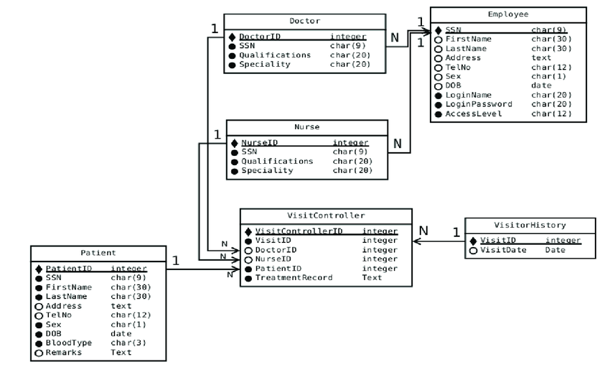
Database schema with foreign keys
Cankaya, Ebru & Kywe, Than. (2015). A Secure Healthcare System: From Design to Implementation. Procedia Computer Science. 62. 203-212. 10.1016/j.procs.2015.08.441.

Slide 48
DATABASE DESIGN
Redundancy and anomalies
Normalization
Class-association diagrams

Slide 49
Example: Equipment orders for the departments
department | equipment | quantity | supplier | s_address
D1 | screen | 10 | Paul | Genève
D1 | keyboard | 8 | Paul | Genève
D2 | computer | 5 | Pierre | Lausanne
D3 | printer | 3 | Jean | Genève
D2 | keyboard | 4 | Paul | Genève
D3 | screen | 7 | Pierre | Lausanne
business rule: each department has only one supplier for a given equipment type

Slide 50
Update anomalies
to update Paul's address
update 3 rows
Potential problem:
create a situation in which Paul has two different addresses
Cause
data redundancy
department | equipment | quantity | supplier | s_address
D1 | screen | 10 | Paul | Genève
D1 | keyboard | 8 | Paul | Genève
D2 | computer | 5 | Pierre | Lausanne
D3 | printer | 3 | Jean | Genève
D2 | keyboard | 4 | Paul | Genève
D3 | screen | 7 | Pierre | Lausanne

Slide 51
Deletion anomaly
Delete the rows concerning department D3
⇒ We lose the information on the supplier Jean (address)
department | equipment | quantity | supplier | s_address
D1 | screen | 10 | Paul | Genève
D1 | keyboard | 8 | Paul | Genève
D2 | computer | 5 | Pierre | Lausanne
D3 | printer | 3 | Jean | Genève
D2 | keyboard | 4 | Paul | Genève
D3 | screen | 7 | Pierre | Lausanne

Slide 52
Insertion anomalies
We want to record the name and address of the supplier Mary
If Mary is not currently supplying any department, this cannot be done
department | equipment | quantity | supplier | s_address
D1 | screen | 10 | Paul | Genève
D1 | keyboard | 8 | Paul | Genève
D2 | computer | 5 | Pierre | Lausanne
D3 | printer | 3 | Jean | Genève
D2 | keyboard | 4 | Paul | Genève
D3 | screen | 7 | Pierre | Lausanne

Slide 53
A Solution to Update, Delete, Insert Anomalies : Relation Decomposition
Supplier
Order
supplier | s_address
Paul | Genève
Pierre | Lausanne
Jean | Genève
Mary | Paris
department | equipment | quantity | supplier
D1 | screen | 10 | Paul
D1 | keyboard | 8 | Paul
D2 | computer | 5 | Pierre
D3 | printer | 3 | Jean
D2 | keyboard | 4 | Paul
D3 | screen | 7 | Pierre

Slide 54
3rd Normal Form (The Theory Behind Redundancies)
Conditions to avoid redundancies, and hence anomalies
Definition. There is a functional dependency X → A in r if the attribute set X uniquely determine the attribute A
Definition. A relation is in 3rd normal form if for each of its non trivial functional dependencies X → A
X contains a key of the relation

Slide 55
key:
{department, equipment}
functional dependencies
department, equipment → quantity
department, equipment → supplier
department, equipment → s_address
supplier → s_address
Not in 3NF
{supplier} $⊉$ {department, equipment}
department | equipment | quantity | supplier | s_address
D1 | screen | 10 | Paul | Genève
D1 | keyboard | 8 | Paul | Genève
D2 | computer | 5 | Pierre | Lausanne
D3 | printer | 3 | Jean | Genève
D2 | keyboard | 4 | Paul | Genève
D3 | screen | 7 | Pierre | Lausanne

Slide 56
In 3NF
All the functional dependencies are of the form Key → Attribute
Supplier
Order
supplier | s_address
Paul | Genève
Pierre | Lausanne
Jean | Genève
Mary | Paris
department | equipment | quantity | supplier
D1 | screen | 10 | Paul
D1 | keyboard | 8 | Paul
D2 | computer | 5 | Pierre
D3 | printer | 3 | Jean
D2 | keyboard | 4 | Paul
D3 | screen | 7 | Pierre

Slide 57
Object-Oriented Design
Find the types of entities in the domain to model (classes)
Find the relationships between the classes
→ UML Class Diagram or Entity-Relationship Diagram
Transform the diagram into a relational schema

Slide 58
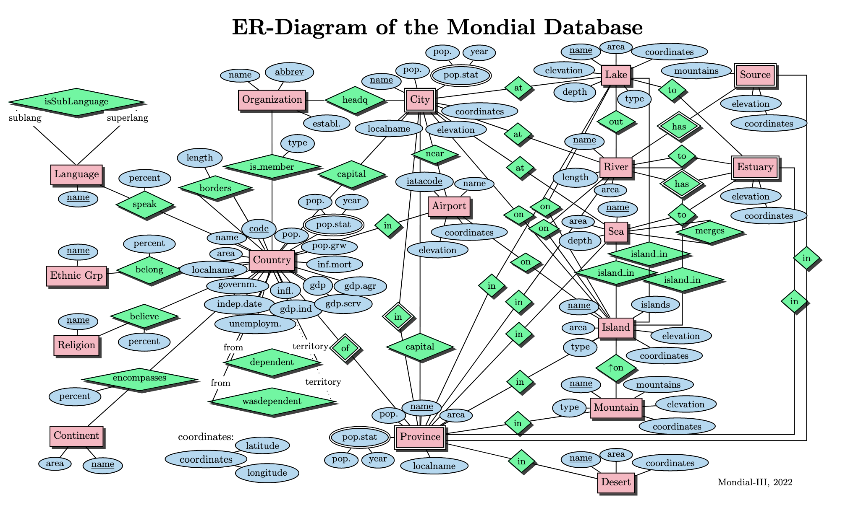
https://www.dbis.informatik.uni-goettingen.de/Mondial/

Slide 59
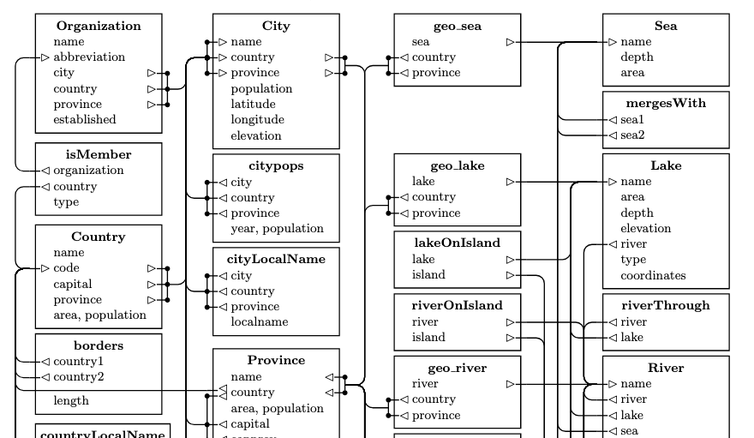
Relational Schema
https://www.dbis.informatik.uni-goettingen.de/Mondial/

Slide 60
UML Class Diagram
enrolement
course
code
...
student
sno
name
date
grade
elective
mandatory
study plan
name
...

Slide 61
Class Diagram to Relational Schema
enrolment
course
code
...
student
sno
name
date
enrolment
student
course
std | course | date
sno | name
code

Slide 62
n to 1 Case
enrolment
faculty
name
...
student
sno
name
1 .. 1
student
faculty
sno | name | in_faculty
name

Slide 63
Summary
Database design is important
to avoid anomalies
to minimize redundancies
to correctly represent the domain objects
Can be based on
normalization
conceptual models (entity-relationship, class diagrams)

