Slide 1
Modules and Classes
Gilles Falquet
Université de Genève/GSEM MSc. Business Analytics

Slide 2
In python a module is a file that contains declarations
variables and constants
functions
classes (new data types)

Slide 3
A module must be imported to make its definitions visible
The math module of the standard python library defines well known mathematical functions
import math
x = math.cos(0)
y = math.sqrt(x)
elements defined in a module must be prefixed with the module name.

Slide 4
It is also possible to explicitly import some definitions
In this case we don't need prefixes
from math import cos, sqrt
x = cos(0)
y = sqrt(x)

Slide 5
A module may define classes to introduce new types
If a module defines a class C
the function call
C ( parameters )
creates an instance of C == a new object that has type C

Slide 6
Example: dates
The datetime module defines the class date
from datetime import date
# let's create two dates
dd = date(2021, 10, 26)
ee = date(2021, 12, 25)

Slide 7
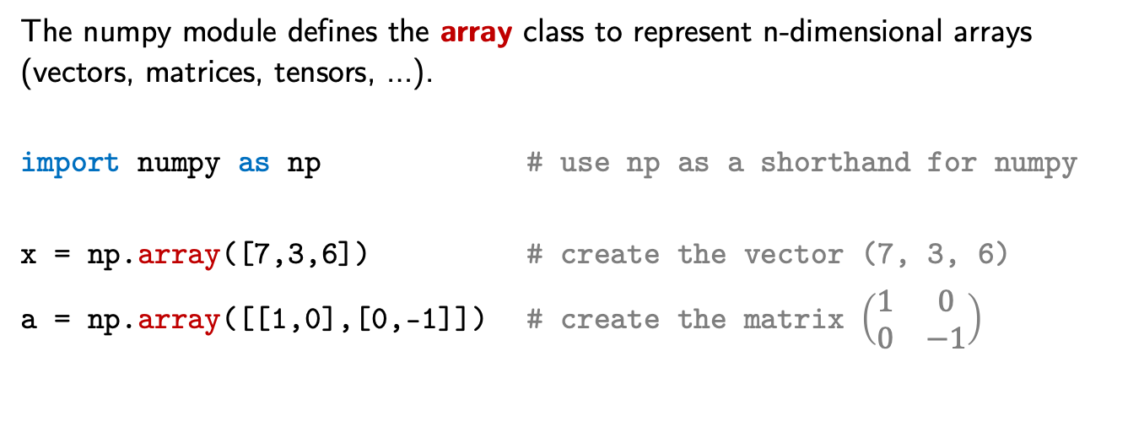
Example: numpy arrays
The numpy module defines the array class to represent n-dimensional arrays (vectors, matrices, tensors, …).
import numpy as np # use np as a shorthand for numpy
x = np.array([7,3,6]) # create the vector (7, 3, 6)
a = np.array([[1,0],[0,-1]]) # create the matrix $\left(\begin{matrix}1 & 0 \\ 0 & −1\end{matrix}\right)$

Slide 8
Other functions may create objects
x = date.fromisoformat('2022-12-22')
⇒ x = date(2022,12,22)
y = date.today()
⇒ y = date(...)

Slide 9
Created objects can be used in expressions
a = np.array([[1,2],[0,1]])
b = np.array([[4,5],[6,9]])
c = np.matmul(a,b) # apply the matrix multiplication function
⇒ array([[16, 23],
[ 6, 9]])
len(c)
⇒ 2

Slide 10
Methods are object-centred functions defined in a class
The first parameter of a method is always an object of that class: the target object
Methods are invoked with the “dot” notation
target_object . method_name ( parameters )

Slide 11
Example: invoking methods on date objects
from datetime import date
dd = date(1879, 3, 14)
dd . isoformat()
⇒ '1879-03-14'
dd . isoweekday()
⇒ 5 (Friday)

Slide 12
methods on numpy arrays
import numpy as np
a = np.array([[1,0],[0,-1]])
m = a.max()
⇒ m = 1
f = a.flatten()
⇒ f = array([ 1, 0, 0, -1])

Slide 13
The standard operators execute "magic" methods
a = np.array([[1,2],[0,1]])
b = np.array([[4,5],[6,9]])
d = b-a # executes b.__sub__(a)
⇒ array([[ 3, 5],
[ 6, 10]])
'abc'+'def' # executes 'abc'.__add__('def')
# the concatenation method for str

Slide 14
Defining your own classes
Define the object structure:
An object value is made of data attributes that represent the object's value
a fraction object has two attributes: numerator and denominator
a GPS point object has longitude, latitude, altitude
Define the operations on these objects
fraction: addition, multiplication, …
GPS point: distance on Earth, Euclidean distance, …

Slide 15
Basic Class definition
class ClassName :
def __init__(self, other parameters) :
""" initialization method """"
self.attribute_name = . . .
. . .
other method definitions

Slide 16
Example: Point on Earth
class Point:
"""
lat and long represent the latitude and longitude
of the point
"""
def __init__(self, lat: float, long: float):
self.lat = lat
self.long = long
self represents the object being initialized
self.lat, self.long are attributes of the new Point object
lat and long are initialization parameters

Slide 17
Object creation
Objects in memory
class_name(v1, v2, ...)
creates a new (empty) object of type class_name
invokes __init__ to initialize this object
p1 = Point(48.861111, 2.3363891)
p2 = Point(27.175, 78.041944)
Point
lat: 48.861111
long = 2.3363891
p1
Point
p2
lat: 27.175
long: 78.041944

Slide 18
Accessing the object attributes
# create objects
p1 = Point(48.861111, 2.3363891)
p2 = Point(27.175, 78.041944)
# access the attributes with the dot notation
print(p2.long) # >> 2.3363891
print(p2.lat – p1.lat) # >> -21.68611

Slide 19
Defining methods
A method is a function
defined in a class
with self as first parameter, representing the target object
invoked with the syntax
target_object . method_name ( parameters )
assigned to self

Slide 20
Methods on Point
class Point
def __init__(self, lat: float, long: float ) :
assert -90 <= lat and lat <= 90 and -180 <= long and long <= 180
self.lat = lat
self.long = long
def long_radian(self) :
return self.long / 360 * 2 * pi
def lat_radian(self) :
return self.lat / 360 * 2 * pi
x = Point(45.5, 180)
lor = x.long_radian() # ⇒ lor = 3.141592653589793

Slide 21
Methods on Point
from math import sin, cos, acos, pi
class Point :
...
def distance_to(self, other) -> float :
""" see https://en.wikipedia.org/wiki/Great-circle_distance
"""
phi1 = self.lat_radian()
phi2 = other.lat_radian()
d_lambda = self.long_radian() - other.long_radian()
d_sigma = acos(sin(phi1)*sin(phi2)+cos(phi1)*cos(phi2)*cos(d_lambda))
return 6371.0 * d_sigma

Slide 22
class Route:
def __init__(self):
self.waypoints = []
def addPoint(self, lat: float, long: float):
self.waypoints.append(Point(lat, long))
def length(self):
r = 0.0
for i in range(len(self.waypoints)-1):
r += self.waypoints[i].distance_to(self.waypoints[i+1])
return r

Slide 23
t = Route()
t.addPoint(0, 0)
t.addPoint(0, 90)
t.addPoint(90, 0)
t.addPoint(0, -90)
t.addPoint(0,0)
print(t.length())
⇒ 40030.173592041145

