Slide 1
Branching Programs
Gilles Falquet
Université de Genève/GSEM MSc. Business Analytics

Slide 2
Branching algorithms
Many problems cannot be solved by "straight-line programs"
An algorithm may follow different execution paths, depending on the input data.

Slide 3
Example: divisibility by 7
Answer "yes" is x is divisible by 7, "no" otherwise
Algorithm
compute the remainder r of x divided by 7
if r = 0
then answer "yes"
else
answer "false"

Slide 4
Conditional execution in Python
...
if condition :
instruction block 1
else:
instruction block 2
...
if condition evaluates to True execute this
if it evaluates to False execute that
instruction block
sequence of instructions
must be indented
each line starts with the same number of spaces

Slide 5
Divisibility by 7 algorithm in Python
r = x % 7
if r == 0 :
print("yes")
else:
print("no")
% is the remainder operator
⚠️ the test for equality is == , not =
Instruction blocks are indented

Slide 6
One branch form
...
if condition :
instruction block 1
next instructions
If condition is True execute instruction block 1
otherwise jump directly to next instructions

Slide 7
One branch form
# apply a 5% discount on amounts greater than 1000
if amount > 1000 :
amount = amount * 0.95
print('Amount due: ', amount)

Slide 8
Nested conditional executions
The instruction blocks may contain if … else instructions
if condition1 :
...
if condition2 :
instructions
else:
instructions
...
else:
instructions
executed if condition1 is True
executed if condition1 and condition2 are True
executed if condition1 is True and condition2 is False

Slide 9
Solve the equation $ax+b=0$ for $x$
Algorithm (for a human being)
if $a≠0$ the solution is $x=−b/a$
if $a=0$ there are two cases
if $b ≠ 0$ there is no solution ($0x + b = 0$ is unsolvable)
if $b = 0$ any value is a solution ($0x + 0 = 0$ is true for any $x$)

Slide 10
In Python : nested blocks
if a != 0 :
x = -b/a
print("the solution is", x)
else:
if b == 0 :
print("any number is a solution of 0x = 0")
else:
print("unsolvable" )

Slide 11
Complex conditions
Conditions are boolean expressions
Building blocks
test and comparison operators: <, >, ==, !=, …
logical operators: not, and, or
( )
a < b and c > b
(not a > b or a < c) and c != 0

Slide 12
The boolean operators
A and B
is True if both A and B are True
is False in all the other cases
A or B
is False if both A and B are False
is True in all the other cases
not A
is False if A is True
is True if A is False
From the Language reference
The expression x and y first evaluates x; if x is false, its value is returned; otherwise, y is evaluated and the resulting value is returned.
The expression x or y first evaluates x; if x is true, its value is returned; otherwise, y is evaluated and the resulting value is returned.

Slide 13
Consequence: and and or are not commutative
if a != 0 and b/a < 10 :
print("ratio < 10")
else:
print("ratio >= 10")
Works for any value of a
if b/a < 10 and a != 0 :
print("ratio < 10")
else:
print("ratio >= 10")
Crashes (division by zero) if a == 0

Slide 14
Example: age computation
Given
today's date (year, month, day)
a person's birthdate (birthYear, birthMonth, birthDay)
What is the age (in years) of that person?
Algorithm
if the anniversary date (birthMonth, birthDay) comes before or is equal to today's date (month, day)
the age is year-birthYear
else it is year-birthYear-1

Slide 15
In Python
if birthMonth < month or birthMonth == month and birthDay <= day :
age = year - birthYear
else:
age = year - birthYear – 1

Slide 16
A Test
birthYear = 2000 birthMonth = 11 birthDay = 17 year = 2020 month = 9 day = 21 if birthMonth < month or (birthMonth == month and birthDay <= day) : age = year - birthYear else : age = year - birthYear - 1 print(age) # should print 19

Slide 17
A note about testing programs
If the test succeeds it shows that the program works for this problem instance
⇒ need to test on other "representative" instances
If the test fails, it shows that the program is wrong
either the algorithm is wrong
or the algorithm is correct, but it has been incorrectly programmed (coding error)

Slide 18
Simplifying deep condition nesting with elif
Example. Compute the price of a ticket given the age of a person and the price table
Age | Price
under 6 | 0
between 6 and 16 | 5
between 16 and 25 and student | 10
between 16 and 60, not student | 15
over 60 | 10

Slide 19
Program with if … else
if age < 6 :
price = 0
else:
if age <= 16 :
price = 5
else:
if age <= 25 and student = True :
price = 10
else:
if age <= 60 :
price = 20
else:
price = 15

Slide 20
Program with elif – avoids deep indentation
if age < 6 :
price = 0
elif age <= 16 :
price = 5
elif age <= 25 and student :
price = 10
elif age <= 60 :
price = 20
else:
price = 15

Slide 21
Input-Output Programs
An algorithm can solve different instances of a problem
3x + 8 = 0, 657x + 893 = 0, …
The problem instance are described by data (a, b values) that exist outside the program
A program must be able to read these data from external sources
files/
database
files/
database
program to
solve
ax+b=0
input values for
a and b
output
(results)
user
(keyboard,
mouse, …)
user
(screen,
audio, …)
print(…)

Slide 22
Reading data from the user keyboard
instruction
variable = input("prompt text"))
prints the prompt text in the execution window
waits for the user to type a string of characters ended by ⏎
assigns that string to variable

Slide 23
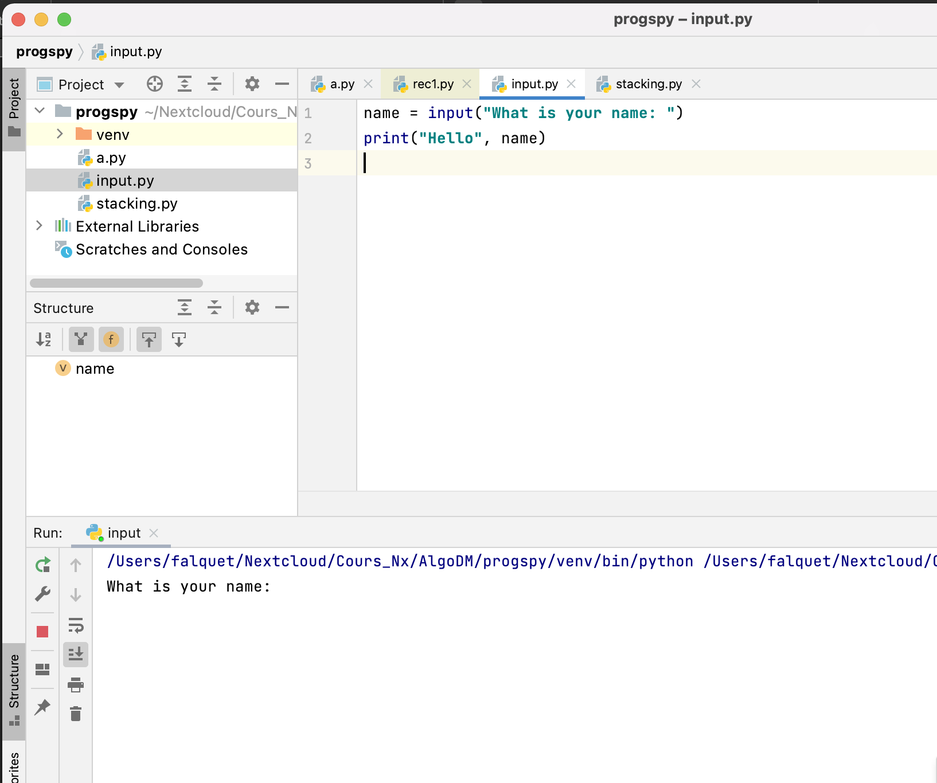

Slide 24
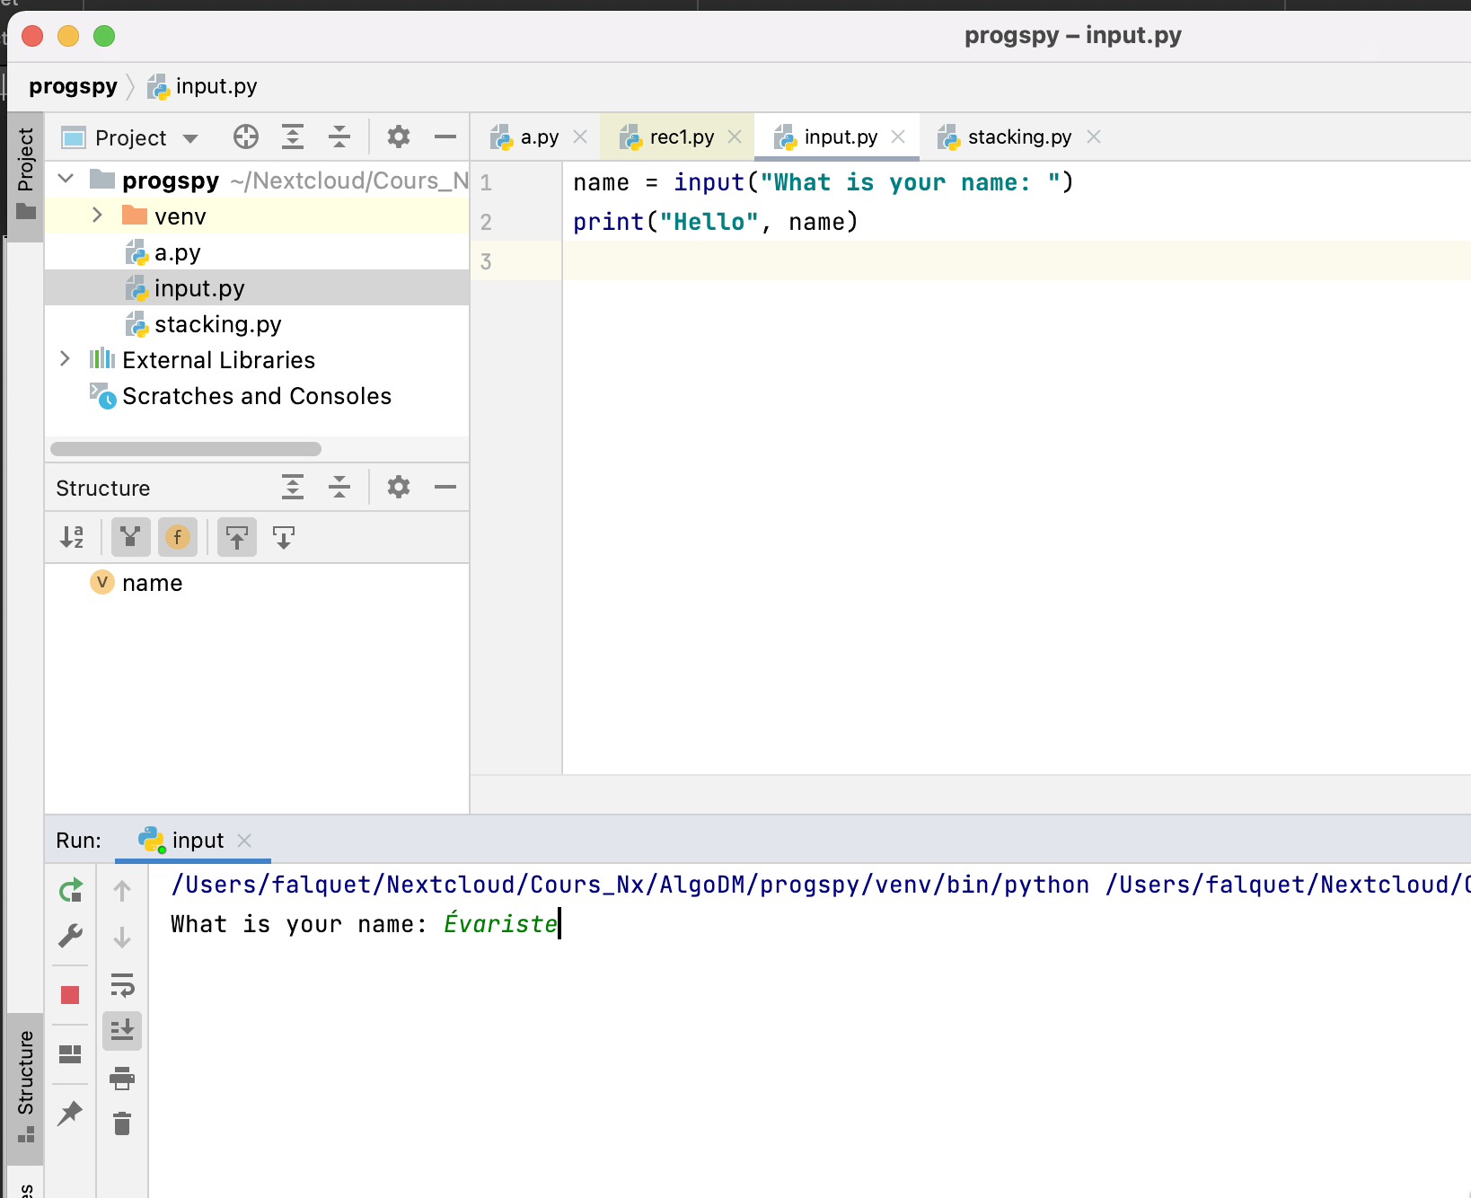

Slide 25
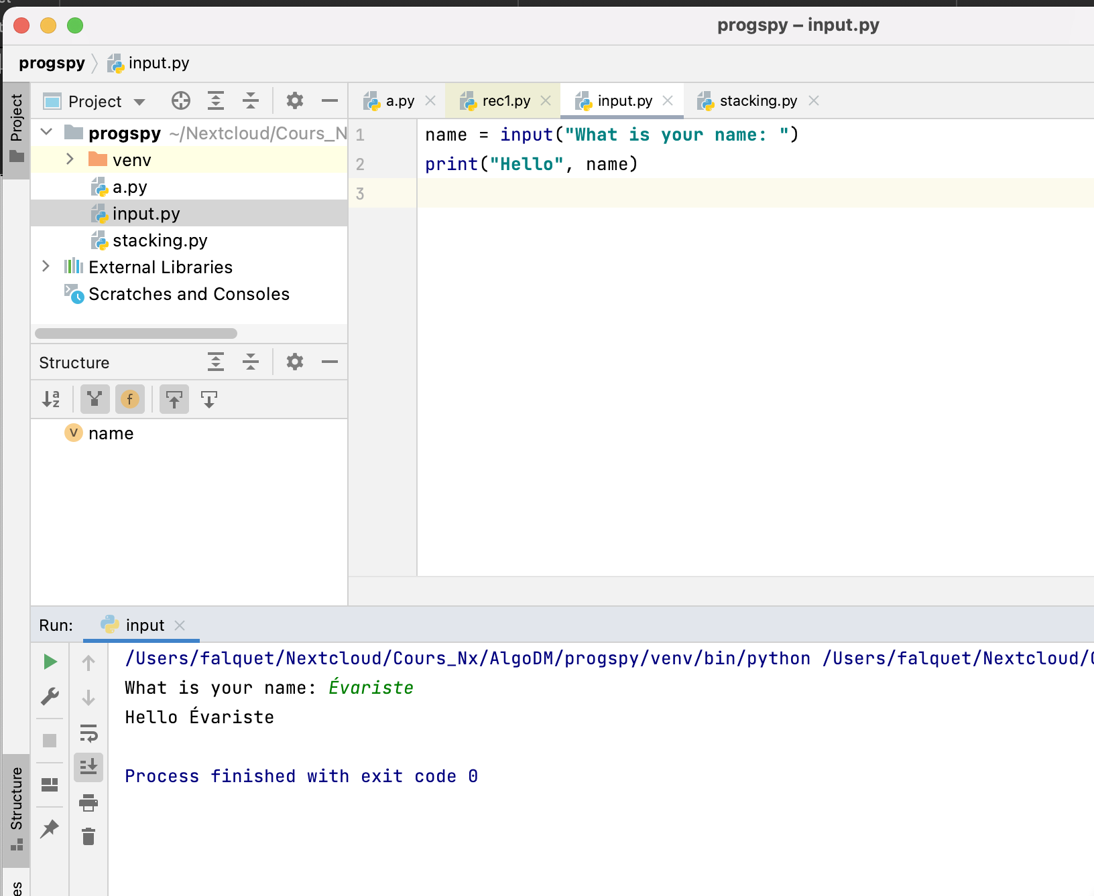

Slide 26
Reading numbers from the user keyboard
instruction
numvar = conversion(input("prompt text")))
prints the prompt text in the execution window
waits for the user to type a string of characters ended by ⏎
converts the string by executing conversion
assigns the result to intvar
conversion can be int or float
the string must be syntactically correct

Slide 27
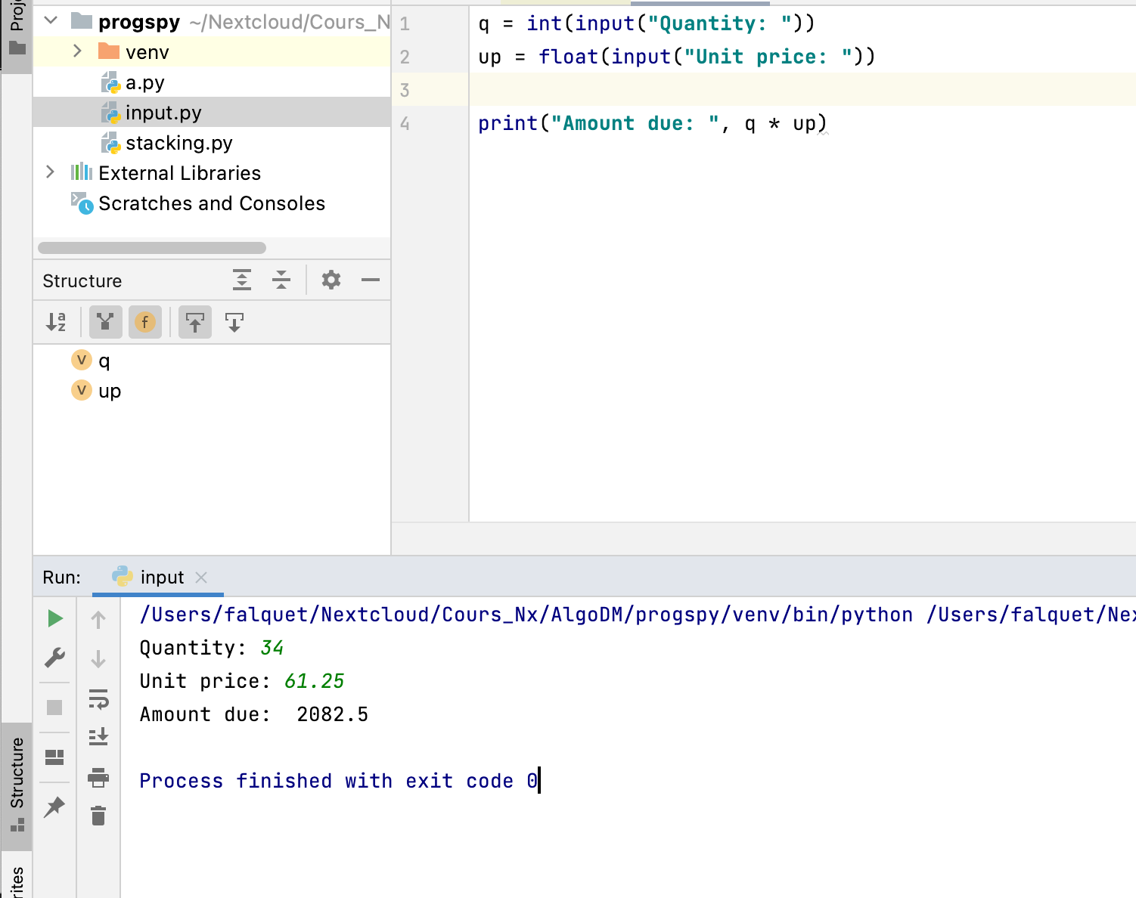

Slide 28
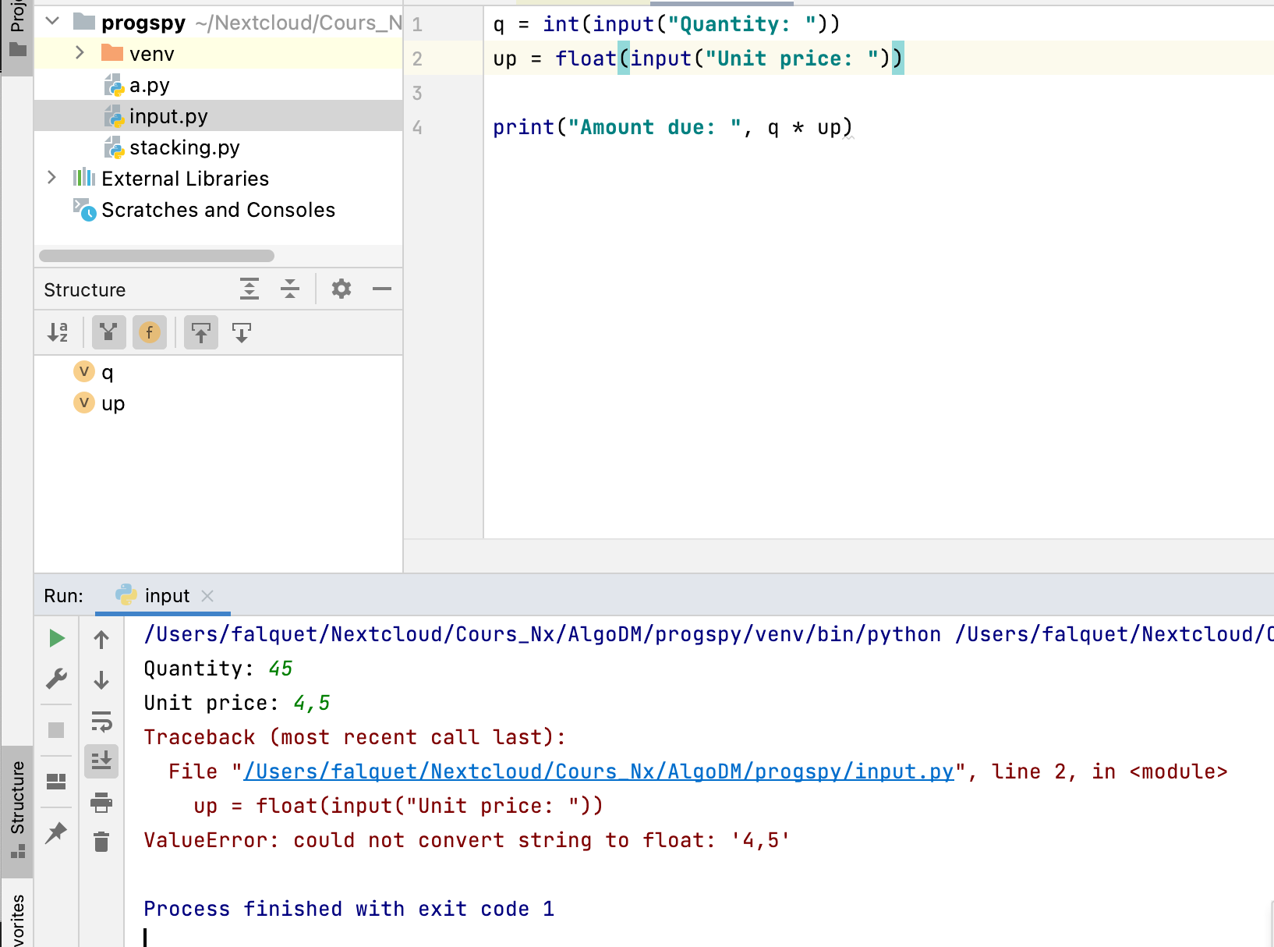

Slide 29
An interactive program for ages
year, month, day = 2021, 9, 28
print("Enter your birthdate") byear = int(input("year: ")) bmonth = int(input("month: ")) bday = int(input("day: "))
age = year - byear # tentative value if bmonth > month or (bmonth == month and bday > day) : age = age - 1 # adjustment if born later in the year print("you are ", age)

Slide 30
A complete program that works any day
from datetime import date # use predefined functions for dates
now = date.today()
year, month, day = now.year, now.month, now.day
print("Enter your birthdate") byear = int(input("year: ")) bmonth = int(input("month (1-12): ")) bday = int(input("day: "))
age = year - byear # tentative value if bmonth > month or (bmonth == month and bday > day) : age = age - 1 # adjustment if born later in the year print("you are "+str(age))

Slide 31
Catching errors (exceptions)
Exceptional situations or errors (e.g. division by zero, number format error)
must be detected
must interrupt no normal course of operations
must be treated specifically
Exception handling principle
try:
…
…
…
…
error
except:
…
…

Slide 32
The try … except instruction
try:
... instruction block A
... except T: instructions block B
If an error of type T occurs in instruction block A
stop the execution of this block
execute instructions block B

Slide 33
try … except to safely read numbers
try: y = int(input("year: "))
...
...
... except ValueError: print('Input value error: please enter a number')

Slide 34
Some exception types:
+-- Exception
+-- ArithmeticError
| +-- FloatingPointError
| +-- OverflowError
| +-- ZeroDivisionError
+-- AssertionError
+-- BufferError
+-- EOFError
+-- LookupError
| +-- IndexError
| +-- KeyError
+-- TypeError
+-- ValueError
| +-- UnicodeError
+ many others

Slide 35
Improving the age program
...
inputOK = True try: byear = int(input("year: ")) except ValueError: inputOK = False if inputOK : try: bmonth = int(input("month (1-12): ")) except ValueError: inputOK = False if inputOK : try: bday = int(input("day: ")) except ValueError: inputOK = False if inputOK: age = ...
... else: print('Value error: please enter a number')

Slide 36
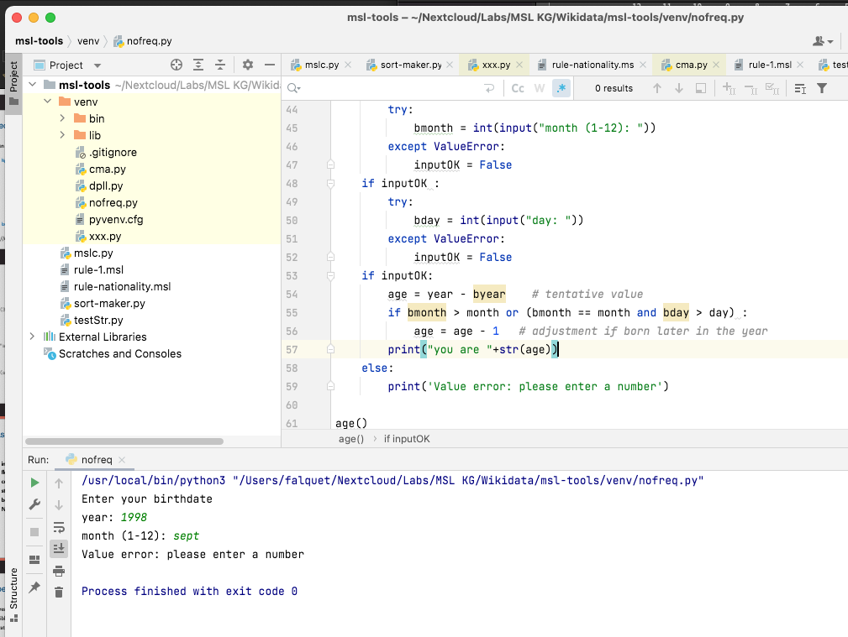

Slide 37
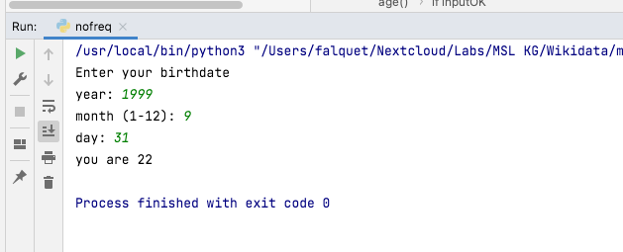
but there is still a problem
this date does not exist

Slide 38
Syntax checking is not enough, we need to check the semantics of the input data
do the data make sense?
for dates(for the age problem):
year must be between 1850 and the current year
month must be between 1 and 12
day must be between 1 and 31, depending on the month
and the date must in the past

Slide 39
with the match instruction
match bmonth :
case 1 | 3 | 5 | 7 | 8 | 10 | 12 :
max = 31
case 2 :
max = 29
else:
max = 29
case 4 | 6 | 9 | 11 :
max = 30
if bday > max :
print("error in day")

Slide 40
taking leap years into account
match bmonth :
case 1 | 3 | 5 | 7 | 8 | 10 | 12 :
max = 31
case 2 :
if byear % 4 != 0 or (byear % 100 == 0 and byear % 400 != 0) :
max = 28
else:
max = 29
case 4 | 6 | 9 | 11 :
max = 30
if bday > max :
print("error in day")

Slide 41
Quiz
Write a program that reads three integer numbers and prints the largest one
Write a program that reads five integer numbers and prints the largest one
Simplify the following program fragment
if a > k :
if a < k :
print("aaa")
else:
print("bbb")
else:
print("bbb")

