Slide 1
Introduction to Algorithms
Algorithms and Data Management - 2022
G. Falquet
© Université de Genève, 2022

Slide 2
Contents
Algorithms by Example
Properties of an Algorithm
Programming

Slide 3
Algorithm
some definitions
a process or set of rules to be followed in calculation or other problem-solving operations, especially by a computer
an unambiguous specification of how to solve a class of problems.
a formal specification for stating a method to solve a problem.
Etymology: from Muhammad ibn Musa al-Khwarizmi (11th century) author of al-Mukhtasar fi Hisab al-Jabr wa I-Muqabala (Treatise on Demonstration of Problems of Algebra),

Slide 4
Example: Add two natural numbers
express the two numbers in decimal notation
write the two numbers one under the other, aligning the units, tens, hundreds, ...
consider the rightmost column
find the sum of the two digits in an addition table
write the units of the result in this column
keep the tens digit of the result as carry digit
consider the following column (left)
if it is empty and the carry is null: stop
add the digits of the column and the carry digit
go to step 5.
 |  | 9 | 3 | 6
+ |  | 2 | 4 | 8

Slide 5
Example : GCD
Problem : find the greatest common divisor of two positive integer numbers
given $M$ and $N$ in $ℕ^{+}$, find $D$ such that
$D$ is a divisor of both $M$ and $N$
there is no $D′$ such that $D′$ is a divisor of $M$ and $N$ and $D^{′}>D$
Algorithm ?

Slide 6
An algorithm
N and M integers > 0
a ← M
b ← N
yes
a = b
GCD ← a
no
yes
no
a > b
a ← a – b
b ← b – a
Euclid ca. 300 BC

Slide 7
Execution for M = 12 and N = 9
1.
a ← M
b ← N
a b
2.
(1.) 12
(2.) 12 9
(3.) (false) 12 9
(4.) (true) 12 9
(5.) 3 9
(3.) (false) 3 9
(4.) (false) 3 9
(6.) 3 6
(3.) (false) 3 6
(4.) (false) 3 6
(6.) 3 3
(3.) (true) 3 3
(7.) 3 3 3
3.
a = b
yes
GCD ← a
no
7.
yes
no
a > b
4.
a ← a – b
b ← b – a
5.
6.
Euclid ca. 300 BC

Slide 8
In a more “textual” style
let M and N be two positive integers
set a to M
set b to N
while a ≠ b do
if a > b then set a to a – b else set b to b – a
GCD(M, N) is a

Slide 9
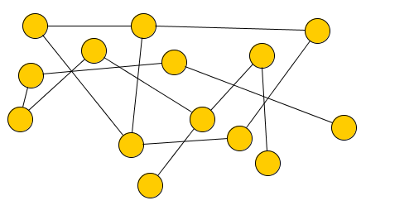
Example: Network connectivity
Is this network connected?
= Is there a path between each pair of nodes?
$$a$$
$$b$$
$$c$$
$$f$$
$$d$$
$$g$$
$$e$$
$$b$$
$$h$$
$$i$$
$$j$$
$$k$$
$$l$$
$$m$$

Slide 10
No
$$a$$
$$b$$
$$c$$
$$f$$
$$d$$
$$g$$
$$e$$
$$b$$
$$h$$
$$i$$
$$j$$
$$k$$
$$l$$
$$m$$

Slide 11
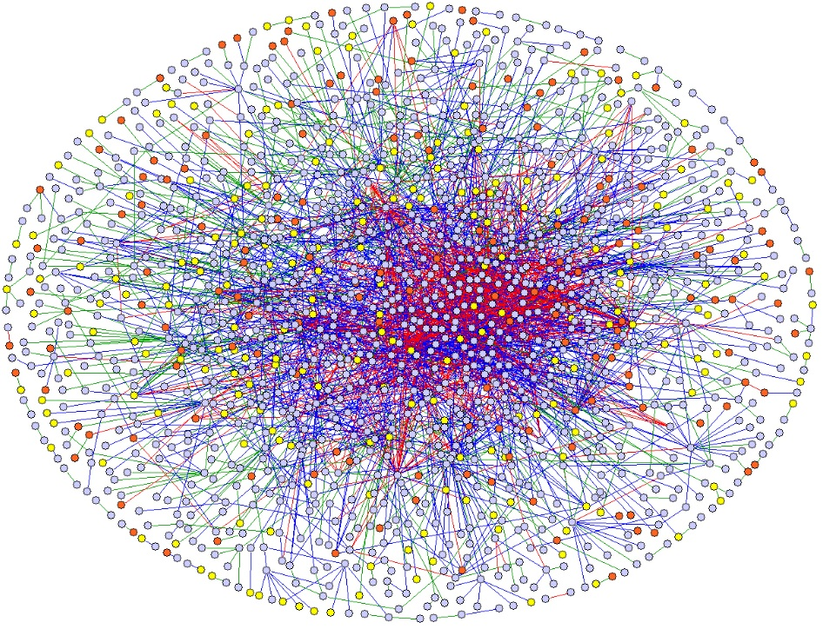
what about this one?
https://www.hpcwire.com/2013/11/16/sc13-research-highlight-large-graph-processing-without-overhead/

Slide 12
An algorithm
color each node white
select randomly a starting node n
paint it red
repeat
select a red node r
paint it black
inspect each node s connected to r
if s is white : paint it red
until no more red nodes
if all the nodes are black answer "true"
else answer "false"
r
n

Slide 13
Executing ...

Slide 14
Executing ...

Slide 15
Executing ...

Slide 16
Executing ...

Slide 17
Executing ...

Slide 18
Executing ...

Slide 19
Executing ...

Slide 20
Executing ...

Slide 21
Executing ...

Slide 22
Executing ...

Slide 23
Executing ...

Slide 24
Executing ...
⇒ not connected

Slide 25
Properties of an algorithm
Automation (Executable)
the rules can be executed “mechanically” by an agent (human or machine), the agent must know how to execute each rule (no thinking needed)
Correctness
the algorithm must provide a correct answer
Termination
the algorithm must provide an answer after a finite number of execution steps

Slide 26
The connectivity algorithm terminates
at each each iteration
a red node becomes black
⇒ the number of black nodes increases by one
after n (number of nodes in the graph) iterations there are no more red nodes
the algorithm stops after k < n iterations if the graph is not connected

Slide 27
The connectivity algorithm is correct (more difficult)
if a node becomes red there is a path from the initial node to it
if there is a path from the initial node to x, x will eventually become red
all red nodes eventually become black
⇒ a node remains white if and only if there is no path from the starting node to it
⇒ The problem must be formalized (define the notion of graph, path, connectivity)

Slide 28
Euclid terminates
after each iteration either a or b has decreased
a and b are integers, and they remain > 0
they cannot decrease an infinite number of times
a ← M
b ← N
while a ≠ b do
if a > b
then a ← a – b
else b ← b – a
GCD ← a

Slide 29
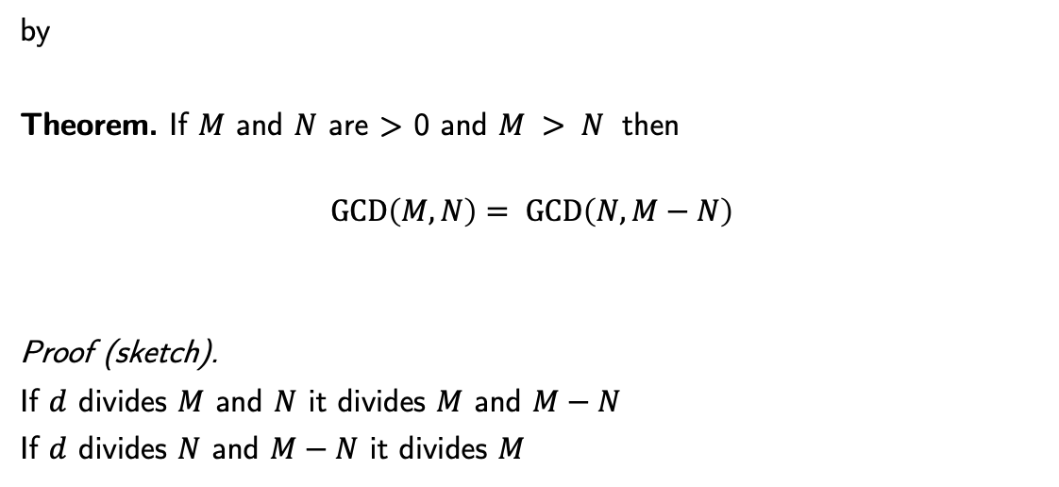
Euclid is correct
by
Theorem. If $M$ and $N$ are > 0 and $M > N$ then
$$GCD\left(M, N\right)= GCD\left(N, M−N\right)$$
Proof (sketch).
If $d$ divides $M$ and $N$ it divides $M$ and $M−N$
If $d$ divides $N$ and $M−N$ it divides $M$

Slide 30
Non-algorithms (1)
Painting the floor of a room
repeat
paint half of the unpainted area
until nothing left to paint
⇒ "terminates" after an infinite number of steps
. . .

Slide 31
Non-algorithms (2)
To win at chess
repeat
let the opponent play
select a move that leads to a winning position
play it
until checkmate
select a move that leads to a winning position is not executable mechanically

Slide 32
From algorithms to programs
Goal: use a computer to solve a general problem (GCD, connectivity, …) for which we have an algorithm
execute the algorithm much faster than a human being
with less errors (machines are rarely tired)
⇒ Transform the "paper and pencil" algorithm into instructions for a real machine
express the algorithm in a programming language
use a compiler to translate the program into basic machine instructions that are directly executable by the hardware

Slide 33
The high-level language approach
machine code (ARM)
sub sp, sp, #16
str w0, [sp, #12]
str w1, [sp, #8]
ldr w8, [sp, #12]
str w8, [sp, #4]
ldr w8, [sp, #8]
str w8, [sp]
ldr w8, [sp, #4]
ldr w9, [sp]
cmp w8, w9
b.eq #60 <ltmp0+0x64>
cmp w8, w9
b.le #24 <ltmp0+0x50>
subs w8, w8, w9
str w8, [sp, #4]
b #20 <ltmp0+0x60>
subs w8, w8, w9
str w8, [sp]
b #-68 <ltmp0+0x1c>
ldr w0, [sp, #4]
add sp, sp, #16
ret
compile
code
program (in C):
int b(int x, int y) {
int a = x;
int b = y;
while (a != b) {
if (a > b) a = a-b;
else b = b-a;
}
return a;
}
GCD algorithm:
a ← M
b ← N
while a ≠ b do
if a > b
then subtract b from a
else subtract a from b
GCD ← a

Slide 34
formalize
problem
specification
problem
invent/find
check
correctness
algorithm
input data
(problem instance)
code
execute
compile
program
results

Slide 35
Summary
Algorithms are problem-solving methods
Algorithms can (and should) be proven (termination, correctness)
Programs are algorithms coded in a programming language
Programs must be compiled (translated) to real machine code to be executed

